Slide 1
Co-creation for climate services. Concepts and methodology
Dr. Jon Olano Pozo
Dra. Anna Boqué Ciurana
Centre for Climate ChangeC3
Universitat Rovira i Virgili
IU-RESCAT
Vila-seca, Spain, May 2024

Slide 2
THE PROCESS OF CO-CREATION
1. Co-creation with end-users: the process and the focus group
2. Definition of optimal variables and conditions
3. The Role of Experts
4. Co-creation workshops: experiences
5. Basic steps for co-creation

Slide 3
1. Co-creation with end-users
Climate services (CS) aim to provide different types of users with useful information on climate information and variability, the impacts of climate change and their related risks, opportunities and uncertainties.
As a result of their importance, value, and benefits, CSs now exist at different scales, such as local, national, regional, and international, and in various sectors, including agriculture, health, forestry, fisheries, transport, energy, disaster risk reduction, water resource management, and tourism (Vaughan & Dessai, 2014).
The purpose of CS is to develop, translate and personalise climate information for the different needs of users taking into account all related stakeholders, such as academics, NGOs, decision-makers in companies and administrative bodies, policy makers at various levels and citizens (JPI Climate, 2016; Lehoczky, 2017).
Collaboration between decision-makers, climate scientists, and specialized academics provides an opportunity to leverage the expertise of all parties to better serve problem-solving (Briley, et al., 2015; Golding, et al., 2017).
Stakeholder engagement is the basis for a good implementation of CS: effective user participation and co-production of climate services.

Slide 4
1. Co-creation with end-users
What is co-creation?
It is an active, creative and social process; based on the collaboration between producers and users that is initiated by an organization to generate value for its users
It is a complete and complex methodology that is very useful
It has a qualitative soul (participatory workshops, interviews with experts, communication) and quantitative soul (data, statistical analysis, creation of the index, communication)
What does it consist of?
In a process of user engagement with the different stakeholders, aimed at defining the needs of users in terms of climate and for decision-making in different activities that can occur in a territory.
What is the goal?
Obtain information on the behaviour of the sector to be co-created in relation to climatic conditions, adaptive strategies and information needs to guide future strategic action.
Why this methodology?
By interacting with potential users it provides a clear view on their needs
For the definition of the value that this climate information has for these actors and for decision-making.
Through the channel for the provision of climate services; taking into account the specific context of each sector and each actor, defining the best tool to communicate translated climate information.

Slide 5
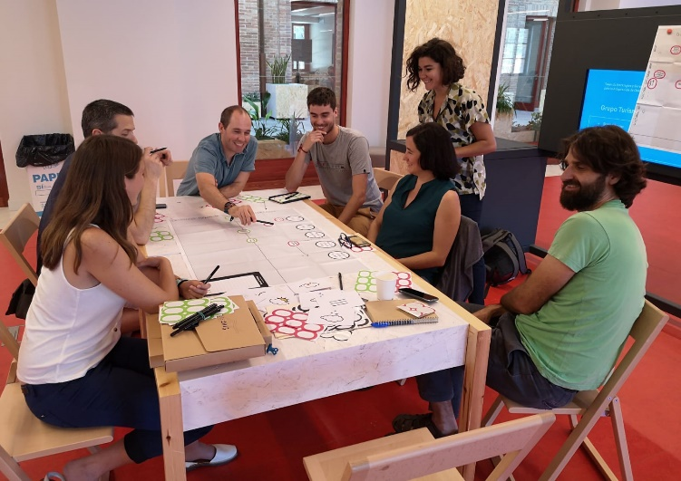
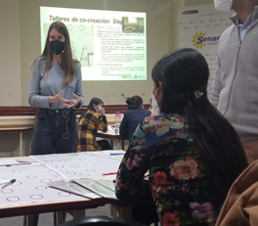
1. Co-creation with end-users
  A focus group is a qualitative research technique for obtaining information about elements, attitudes or opinions of the people who participate.
  Generally, participants share concerns about a given topic.
  Basically, it's a group interaction for data production
  The information, in our case, is collected through mind maps that represent a multidimensional reality made up of basic ideas of ordering.
  The mind map is a graphic organizer in which information is integrated using visualization and dynamism techniques (folding maps, reversible labels, colors, flows).
  The goal of a mind map is to build consensus around a problem based on subjective realities.
  In this sense, Reckien et al. (2013) studied these subjective realities in climate change, concluding that these mind maps are a good tool for socially sensitive adaptation options.

Slide 6

1. Co-creation with end-users
The information is collected through mind maps (MM), which represent a multidimensional reality made up of "basic ideas of ordering" (Muñoz, & Serrano, 2014).
The Mind Map is a qualitative model,
It is a descriptive process that collects descriptive data,
it has a humanistic interpretative approach when the meanings given by the subjects themselves are seen;
observation is the main source of data;
reflection is a thought-generating activity (González et al., 2014).
It is a graphic organizer where information is integrated through visualization and dynamism techniques:
Foldable maps, reversible labels, colors...
SYNTHESIZE
PRIORITIZE
The main objective of the GM is to build consensus around a problem based on subjective realities.
In this sense, Reckien et al. (2013) studied these subjective realities due to climate change and the conclusion defined these maps as a good tool for socially sensitive adaptation options.
EXPAND
ORDER
SHARE

Slide 7


1. Co-creation with end-users
THE GROUP
1) A common goal
2) Outside the work environment
3) Invite collaborators, (external) experts
4) Each minute of a group work is worth this minute multiplied by the number of participants[1x9=9minutes]
It's a matter of attitude!!
WORKSPACE
Spacious and pleasant (large format papers)
Transform Rooms
We need to move around the room
ATTITUDE
Mentally and physically active
Motivation and positivity
Participatory and democratic
Creativity and imagination
"In order for a team to be creative, it has to be organized..."Ferran Adrià

Slide 8
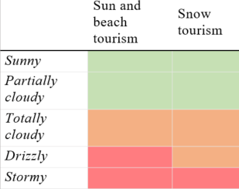
2. Definition of optimal variables and conditions
What weather/weather conditions affect the sector/activity?
Do they affect a lot or a little? When? How?
Does it prevent you from doing the activity?
How do end users perceive it?
verd=condició favorable;
taronja=condició poc favorable (no impedeix la realització de l’activitat);
vermell=condició desfavorable (impedeix la realització de l’activitat).

Slide 9


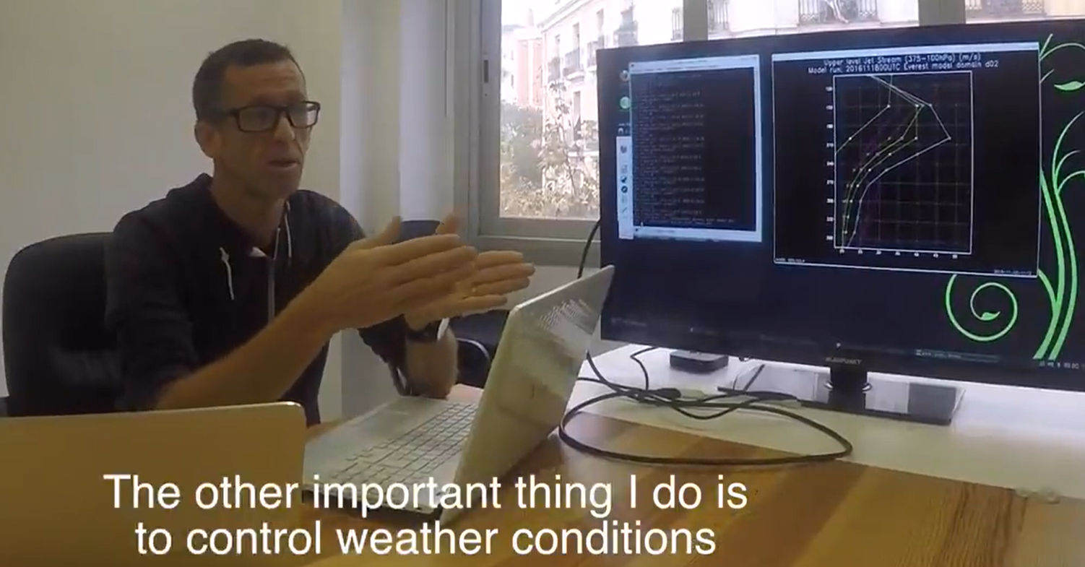
3. The Role of Experts
ENTREPRENEURS
CLIENTS
EMPRESARIS
CLIENTS
ACADEMIC/
RESEARCHERS
ONGs
ACADÈMICS/
INVESTIGADORS
CITIZENSHIP
ADMINISTRATION
POLITICIANS
END USERS
EXPERTS???
DETAIL, INTERPRET, QUESTION, EXPAND AND VALIDATE VARIABLES
EXPERTS
PERSONALIZED INTERVIEWS
QUESTIONNAIRES
MEETINGS / FORUMS

Slide 10
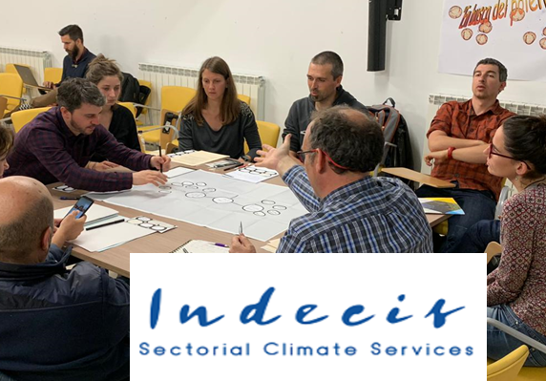
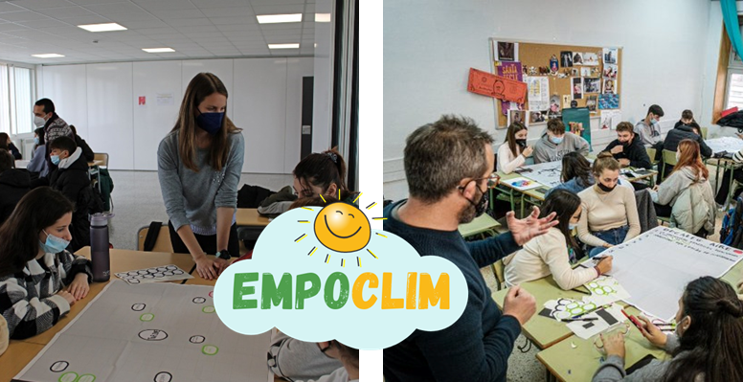
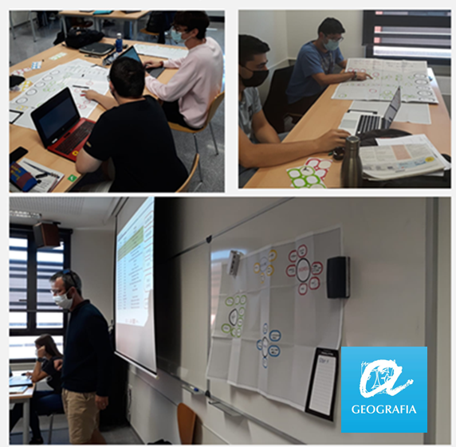
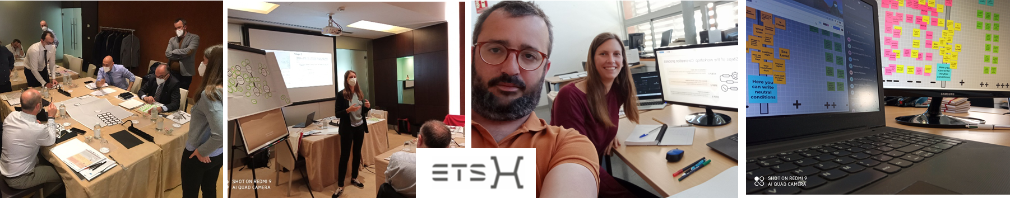
4. Co-creation workshops: experiences

Slide 11
4. Co-creation workshops: experiences
Co-creation of climate services for tourism
Origin of the climate services co-creation methodology
Case Study: Different European Tourist Destinations
Creation of indicators for different types of tourism
Project website: http://www.indecis.eu/
Co-creation methodology and preliminary results of the workshops: http://www.indecis.eu/docs/Deliverables/Deliverable_7.2.pdf
Software for the calculation of sun and beach tourism indicators: http://www.indecis.eu/docs/Deliverables/Deliverable_7.4_AnnexB.pdf
Different types of tourism: sun and beach, snow, culture...

Slide 12
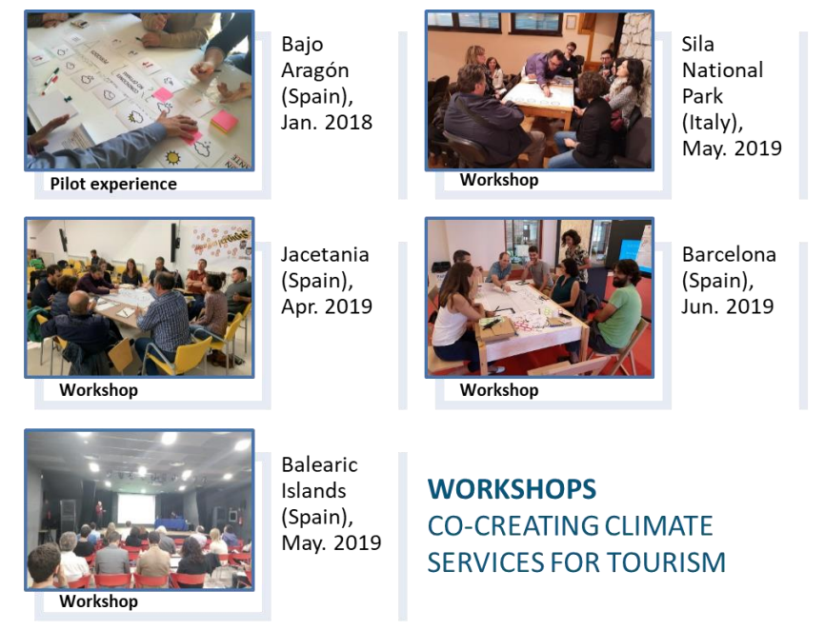
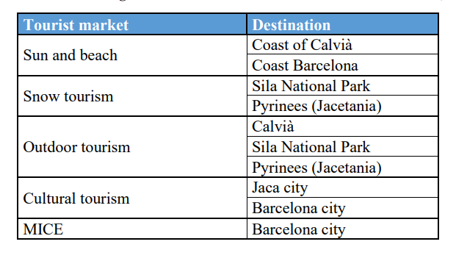
4. Co-creation workshops: experiences

Slide 13
4. Co-creation workshops: experiences
Step 1. Definition of the activity: periods of affluence, reasons for cancellation, time in advance of booking the activity
Step 2. Identification of weather conditions that affect the activity
Step 3. Establishment of strategies (on different time scales) in case of climate weather information

Slide 14
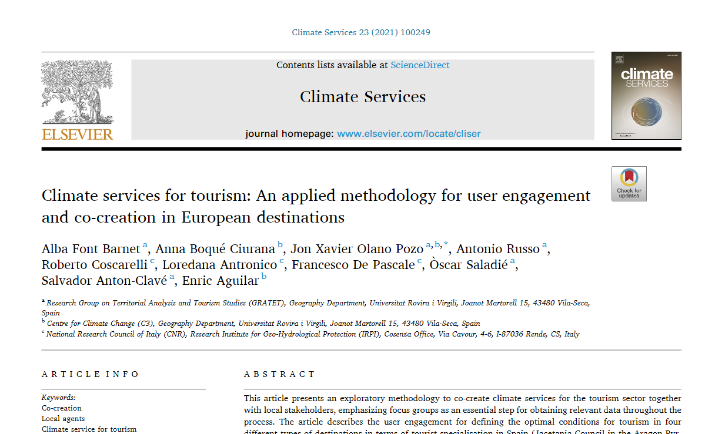
4. Co-creation workshops: experiences
https://www.sciencedirect.com/science/article/pii/S2405880721000376

Slide 15
5. Basic steps for co-creation
STEP 1. General definition of the activity/sector/object of study
STEP 2. Identification of the degree of impact of meteorological and climatic conditions on the object of study
STEP 3. Identification of adaptation measures at different time scales

Slide 16
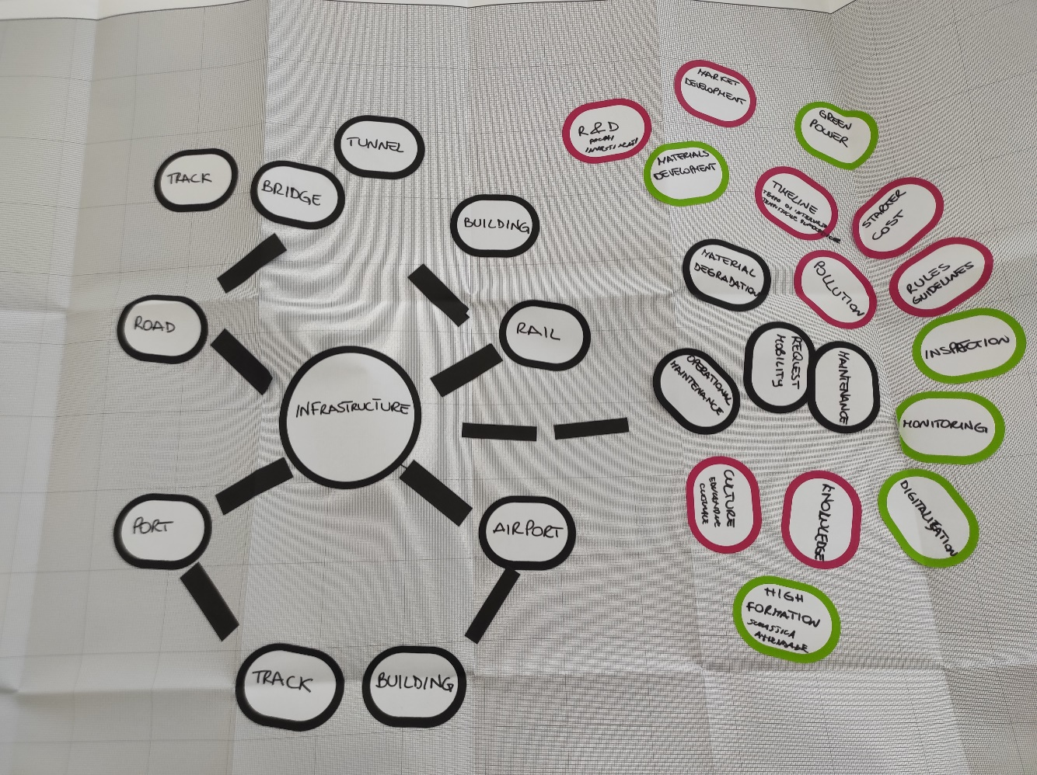
5. Basic steps for co-creation
STEP 1. General definition of the activity/sector/object of study

Slide 17
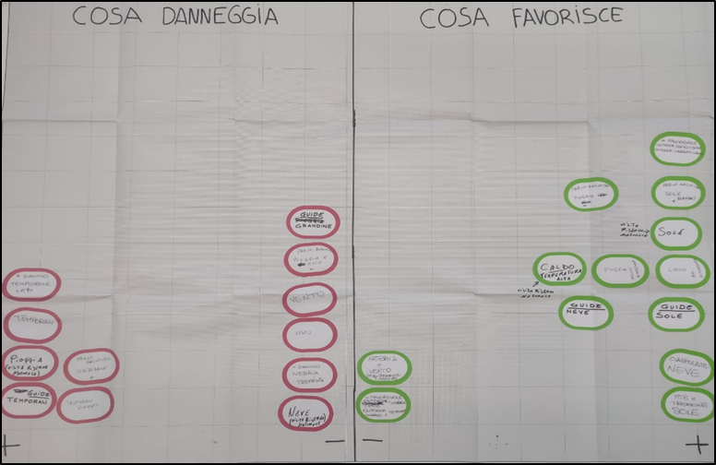
5. Basic steps for co-creation
STEP 2. Identification of the degree of impact of meteorological and climatic conditions on the object of study

Slide 18
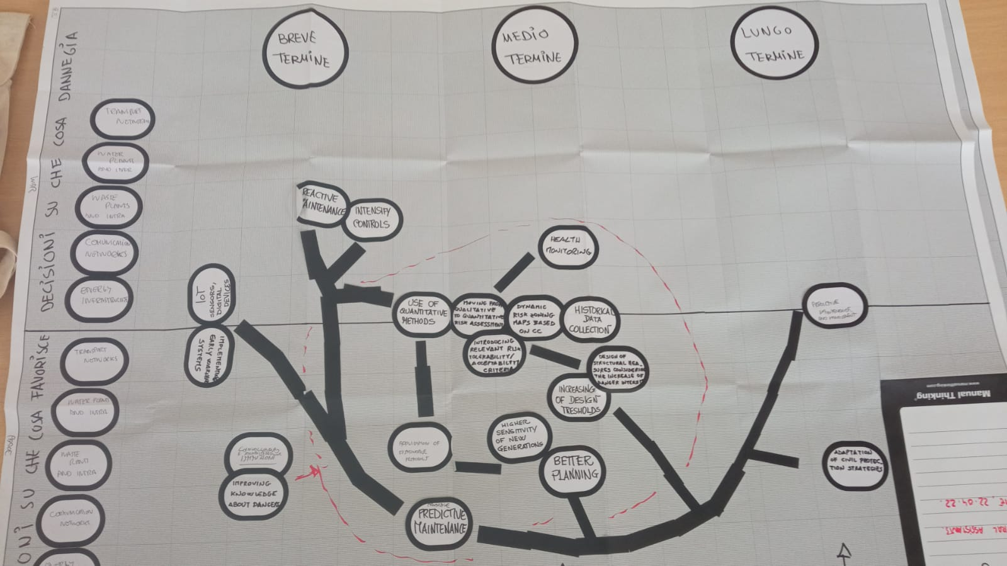
5. Basic steps for co-creation
STEP 3. Identification of adaptation measures at different time scales

Slide 19
5. Basic steps for co-creation
Let's organize ourselves into groups!

Slide 20
Thank you!

