Slide 1

Climate Datasets.
An Overview
Dr. Enric Aguilar, C3/IU-RESCAT/URV

Slide 2
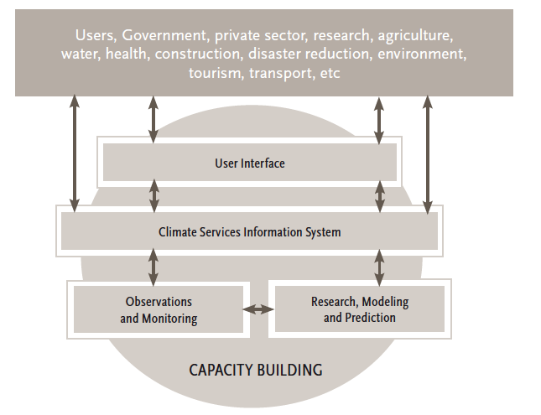


Competencies for the Provision of Climate Services
II. Derive products from climate data
V. Communicate climatological information to users
I. Create and manage climate data sets
III. Create
and/or interpret climate forecasts and model output
IV. Ensure the quality of climate information and services

Slide 3
Competency II:
Derive products from climate data
Competency III
Create and/or interpret climate forecasts and model results
Competency I:
Create and manage climate datasets
DATASET PREPARATION
(DARE, Compilation, QC, Homogeneity)
CLIMATE PRODUCTS
CLIMATE SERVICE
CLIMATE ANALYSIS
Competency V:
Communicate climate information with users.
Competency IV:
Ensure the quality of climate information and services

Slide 4
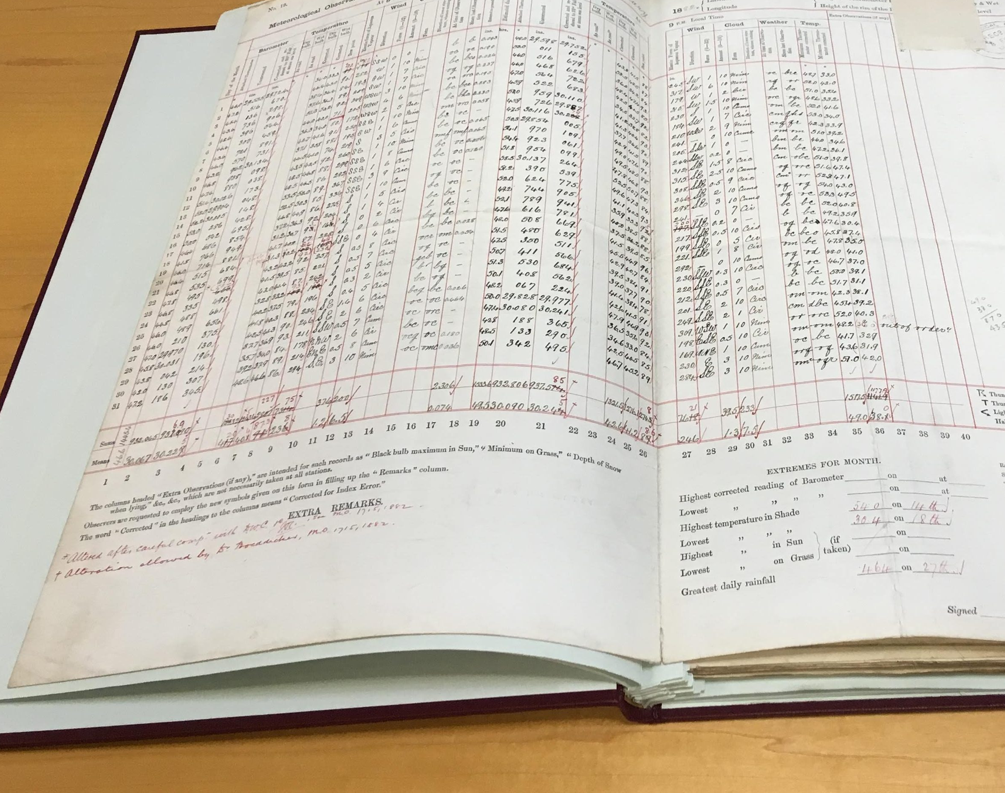
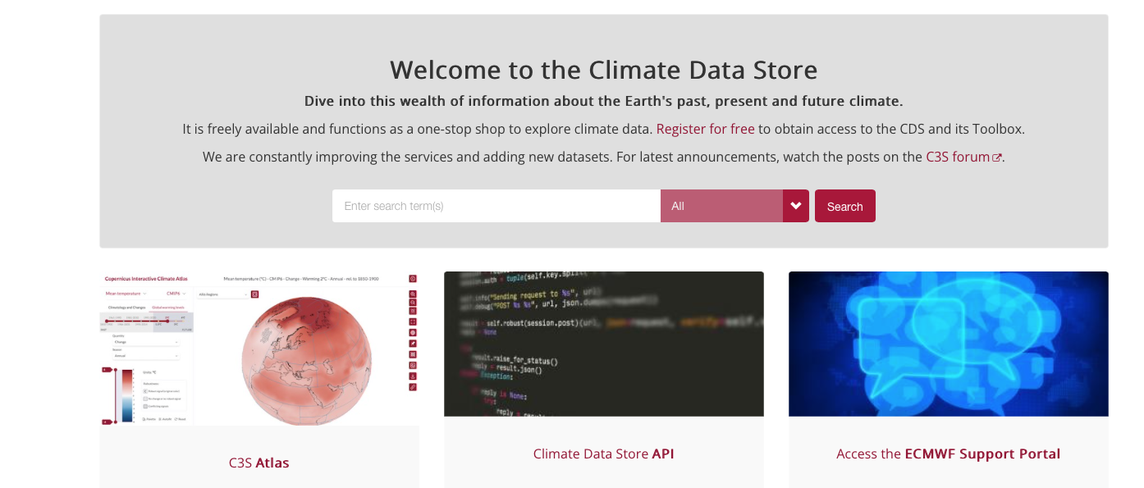
Yesterday vs. Today

Slide 5
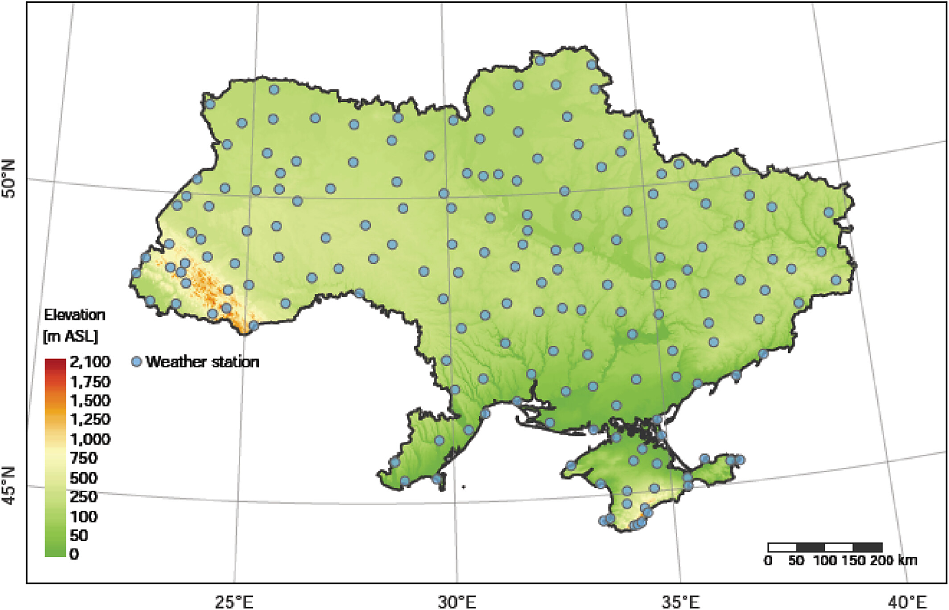
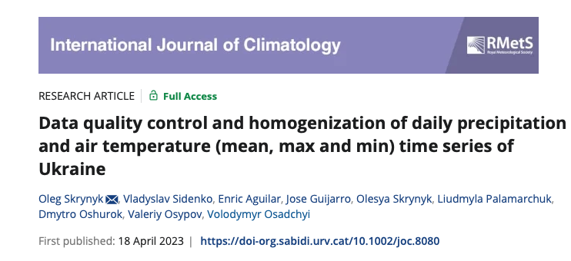
… 147 stations
Notes:
Locations of the climatological/weather stations of Ukraine used in the study
IF THIS IMAGE HAS BEEN PROVIDED BY OR IS OWNED BY A THIRD PARTY, AS INDICATED IN THE CAPTION LINE, THEN FURTHER PERMISSION MAY BE NEEDED BEFORE ANY FURTHER USE. PLEASE CONTACT WILEY'S PERMISSIONS DEPARTMENT ON PERMISSIONS@WILEY.COM OR USE THE RIGHTSLINK SERVICE BY CLICKING ON THE 'REQUEST PERMISSIONS' LINK ACCOMPANYING THIS ARTICLE. WILEY OR AUTHOR OWNED IMAGES MAY BE USED FOR NON-COMMERCIAL PURPOSES, SUBJECT TO PROPER CITATION OF THE ARTICLE, AUTHOR, AND PUBLISHER.

Slide 6
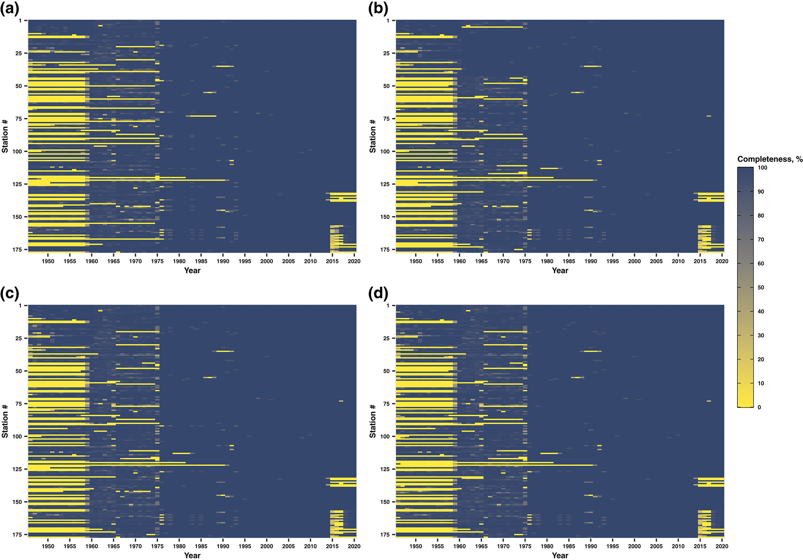
Data quality control and homogenization of daily precipitation and air temperature (mean, max and min) time series of Ukraine
1940s
Data starts in the 1940s,
1975
optimal coverage after 1975,
2015
decaying after 2015
Intl Journal of Climatology, Volume: 43, Issue: 9, Pages: 4166-4182, First published: 18 April 2023, DOI: (10.1002/joc.8080)

Slide 7
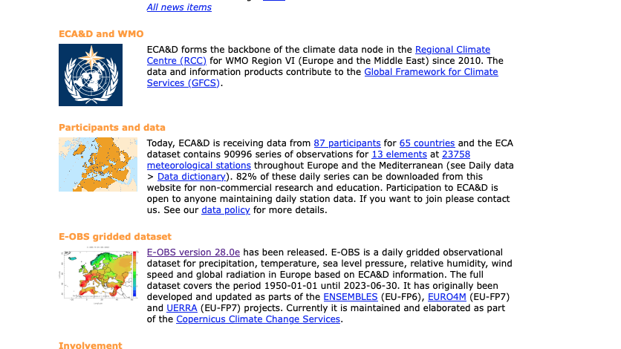
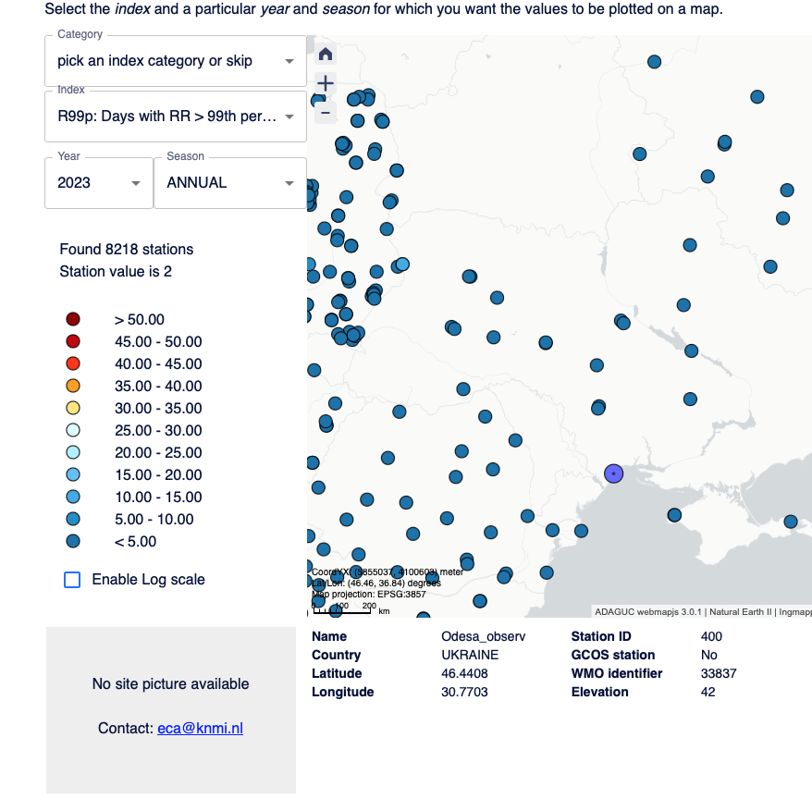
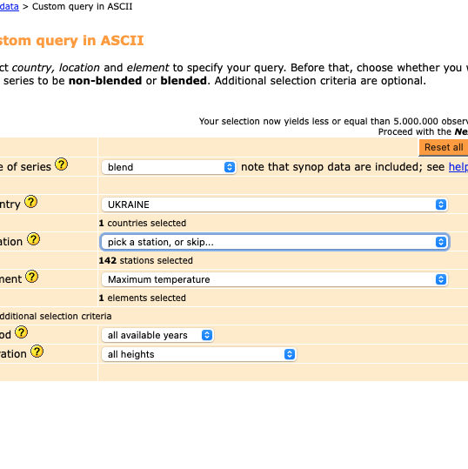
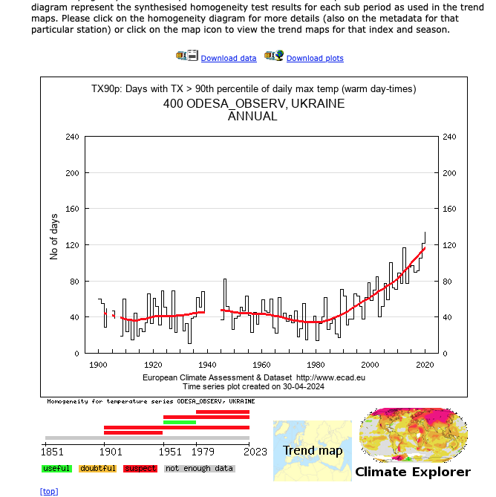

Station Data. International Datasets. ECA&D
More than 100 Ukrainian stations, different variables, different lengths of record and more variables (wind, RH, pressure, radiation, etc.)
Station Data
Climate Indices

Slide 8
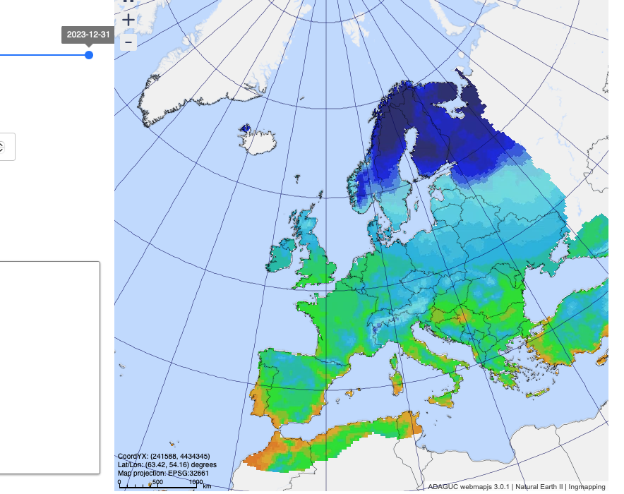
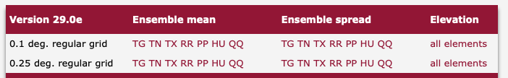
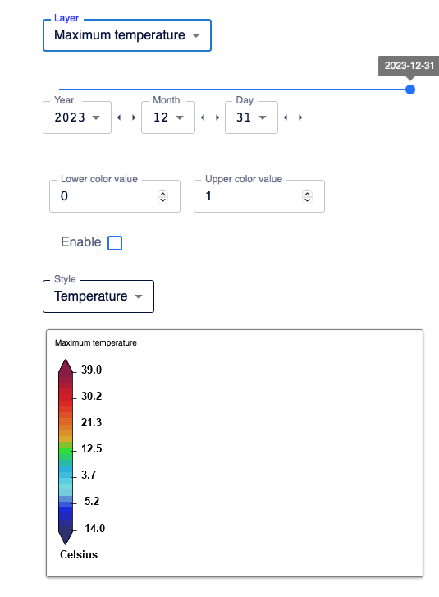
Station data, gridded products: EOBS

