Slide 1

Climate Datasets.
An Overview
Dr. Enric Aguilar, C3/IU-RESCAT/URV

Slide 2
Contents
- Contextualization
- Station Data
- Gridded Data
- Copernicus Climate Data Store

Slide 3
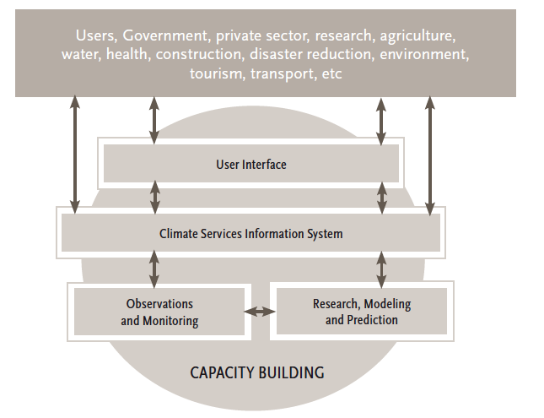


Competencies for the Provision of Climate Services
II. Derive products from climate data
V. Communicate climatological information to users
I. Create and manage climate data sets
III. Create
and/or interpret climate forecasts and model output
IV. Ensure the quality of climate information and services

Slide 4
Project 3 (URV’s Degree in Geography)
Competency | Perfomance Criteria | Learning Outcomes
Create and Manage Climate Data Sets | Assess the location and characteristics of the observation sites against the requirements for a climate observation reference network | Characterize the climate of the area of study and describe its variability and recent changes
 | Apply quality control processes to climate data and resulting time series | Demonstrate computer literacy and the ability to use and adapt commercial and specifically designed software, including office suites, image treatment software, statistical packages, climate database management systems, graphical and geographic information system packages, and specific quality control and homogenization packages
 |  | Demonstrate the ability to key climate data into a computer from images or paper copies and use real-time quality control techniques to avoid errors
 | Assess climate data homogeneity and adjust inhomogeneous time series | Explain the concepts of climate time series quality and homogeneity and the causes of quality problems and inhomogeneities
 |  | Apply quality control and homogenization techniques and evaluate the quality and homogeneity of a climate data network after gathering documentary, statistical and graphical evidences
Derive Products from Climate Data | Identify and retrieve climate data from different sources to generate climate products | Characterize the climate of the area of study and describe its variability and recent changes
 |  | List different sources of climate data inside and outside the organization, including local, regional and global networks
 |  | Retrieve climate data from original sources inside and outside the organization, and organize, store and document them
 | Compute basic climate products, normals and averages, or anomalies defined in relation to a reference period | Produce numeric and graphic summaries, such as scatterplots and box plots
 |  | Explain the meaning and applications of widely used climate indices, such as those included in the RClimdex and Climpact packages
 | Compute climate indices for the monitoring of climate change, climate variability and climate extremes | Demonstrate computer literacy and the ability to use and adapt commercial and specifically designed software, including image treatment software, statistical packages, climate data management systems, geographic information system and graphical packages, and specific packages for the generation of climate indices (RClimdex, Climpact) and other climate products
Select a country, download the data from ECA&D, select suitable stations
Quaity Control (INQC) and Homogenize the data (CLIMATOL)
Compute ETCCDI Indices and analyze trends (Sen slope + MK)
Write a "journal" article
C1
C2

Slide 5
Competency II:
Derive products from climate data
Competency III
Create and/or interpret climate forecasts and model results
Competency I:
Create and manage climate datasets
DATASET PREPARATION
(DARE, Compilation, QC, Homogeneity)
CLIMATE PRODUCTS
CLIMATE SERVICE
CLIMATE ANALYSIS
Competency V:
Communicate climate information with users.
Competency IV:
Ensure the quality of climate information and services

Slide 6
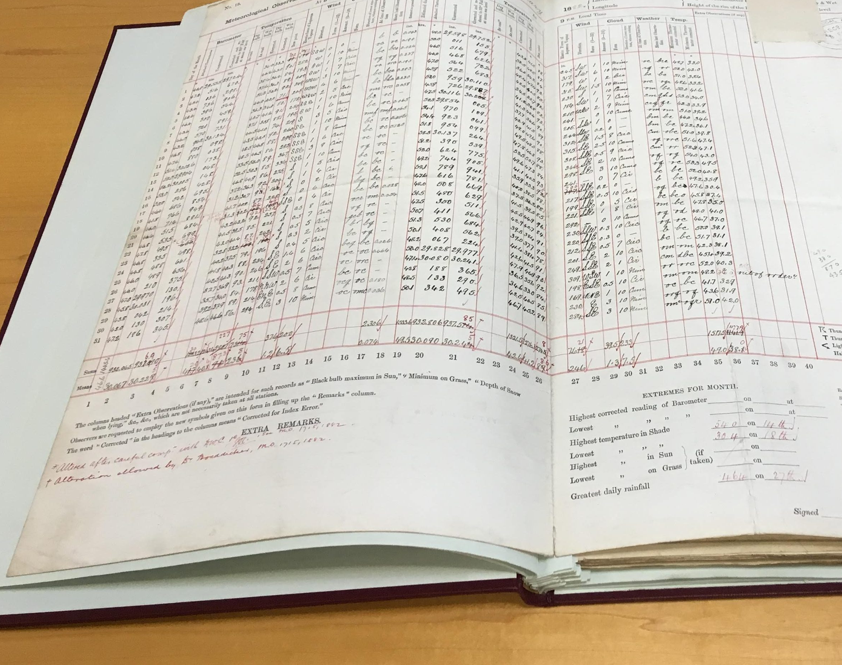
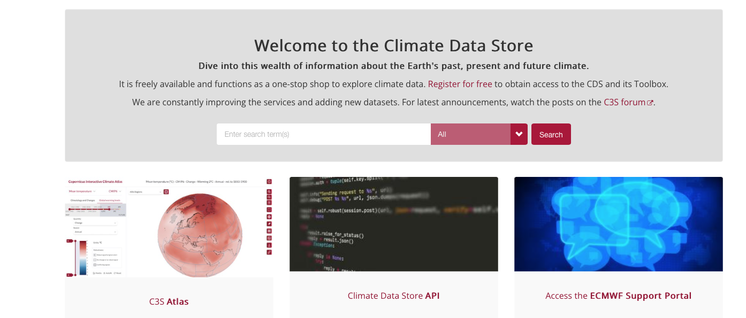
Yesterday vs. Today

Slide 7
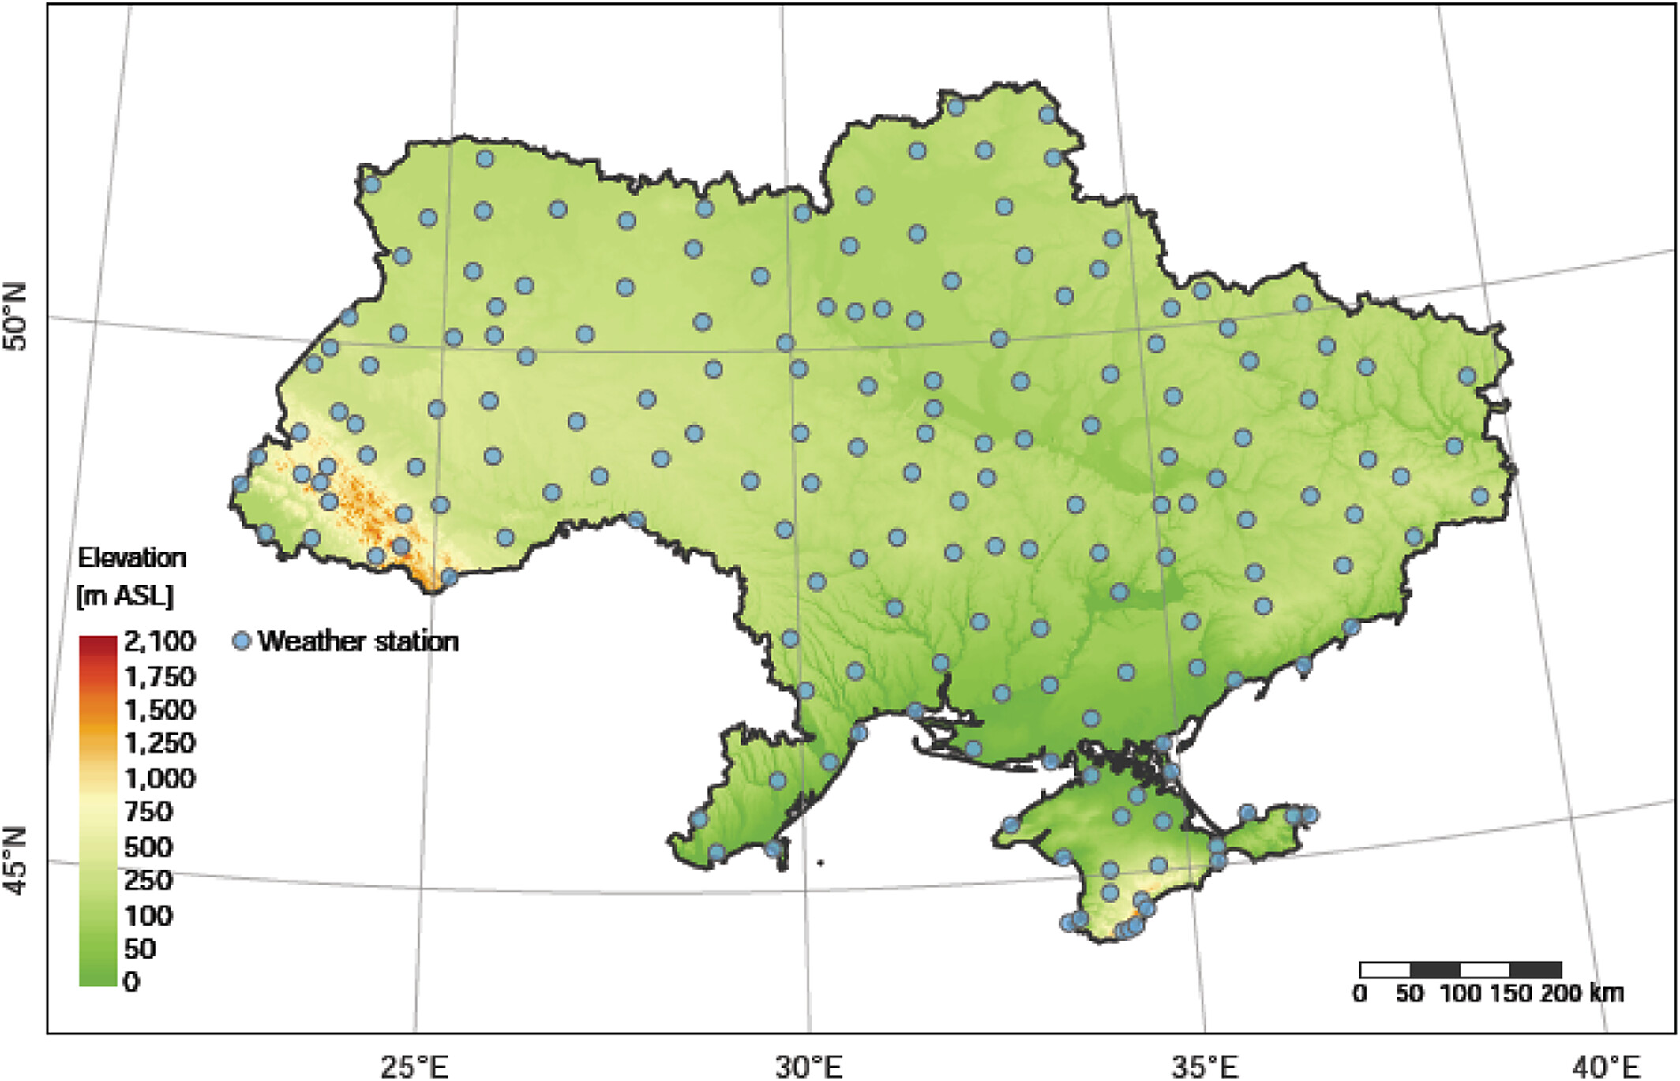
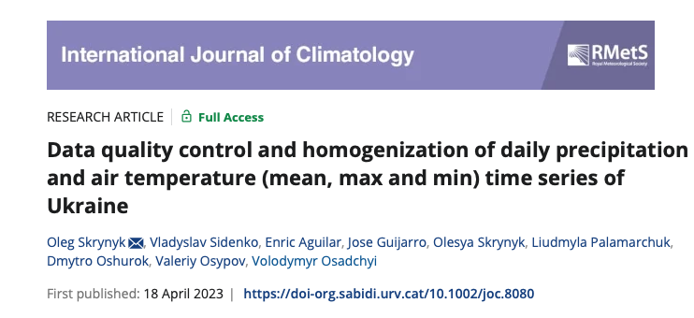
… 147 stations
Notes:
Locations of the climatological/weather stations of Ukraine used in the study
IF THIS IMAGE HAS BEEN PROVIDED BY OR IS OWNED BY A THIRD PARTY, AS INDICATED IN THE CAPTION LINE, THEN FURTHER PERMISSION MAY BE NEEDED BEFORE ANY FURTHER USE. PLEASE CONTACT WILEY'S PERMISSIONS DEPARTMENT ON PERMISSIONS@WILEY.COM OR USE THE RIGHTSLINK SERVICE BY CLICKING ON THE 'REQUEST PERMISSIONS' LINK ACCOMPANYING THIS ARTICLE. WILEY OR AUTHOR OWNED IMAGES MAY BE USED FOR NON-COMMERCIAL PURPOSES, SUBJECT TO PROPER CITATION OF THE ARTICLE, AUTHOR, AND PUBLISHER.

Slide 8
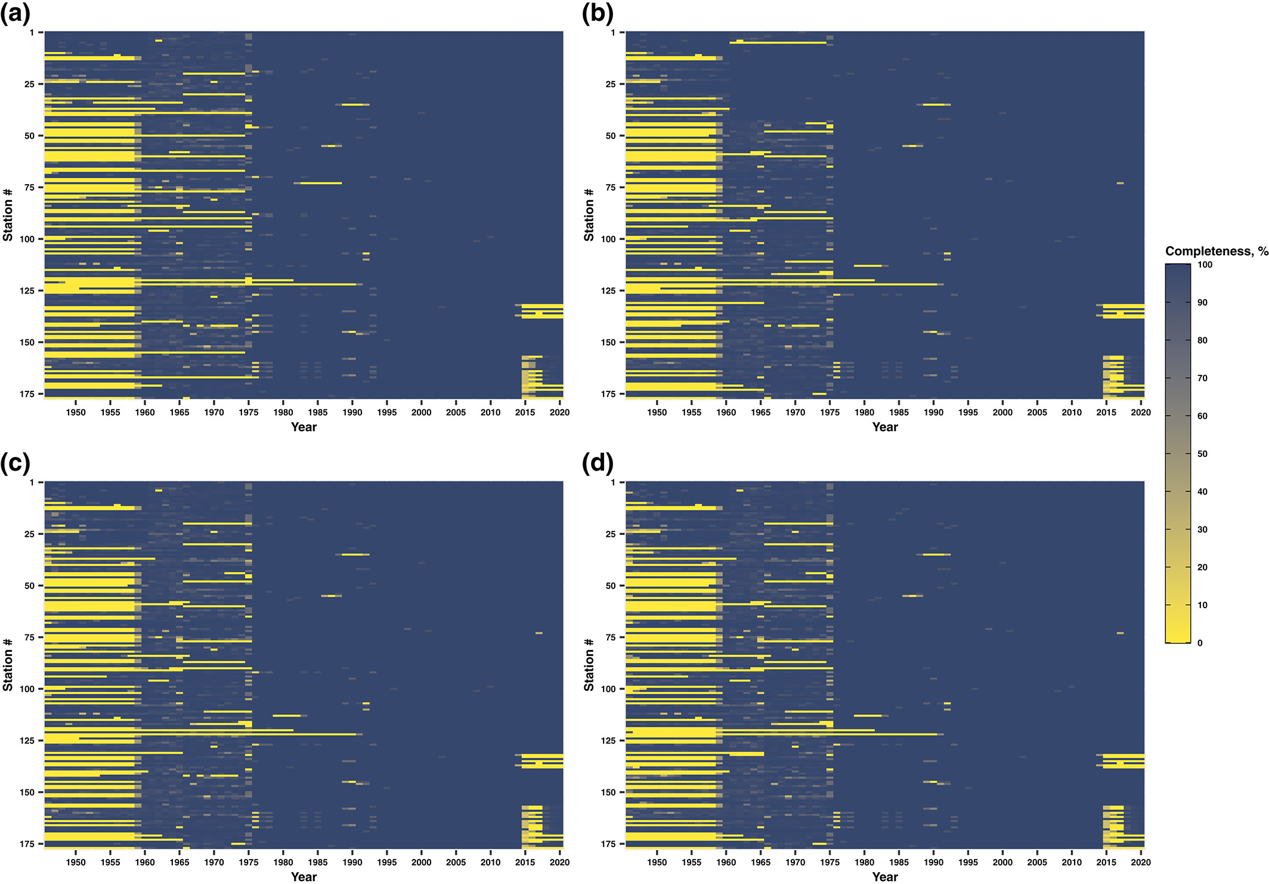
Data quality control and homogenization of daily precipitation and air temperature (mean, max and min) time series of Ukraine
1940s
Data starts in the 1940s,
1975
optimal coverage after 1975,
2015
decaying after 2015
Intl Journal of Climatology, Volume: 43, Issue: 9, Pages: 4166-4182, First published: 18 April 2023, DOI: (10.1002/joc.8080)

Slide 9
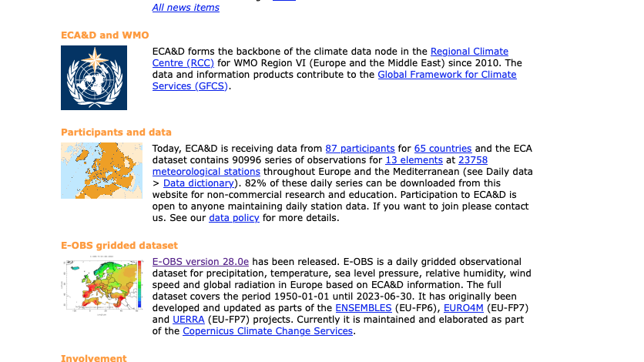
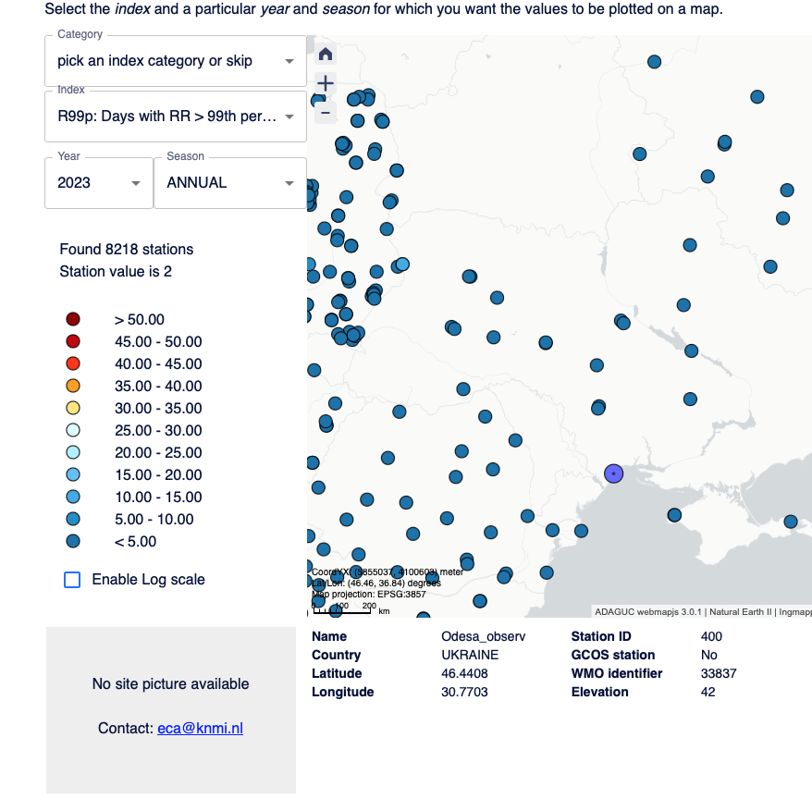
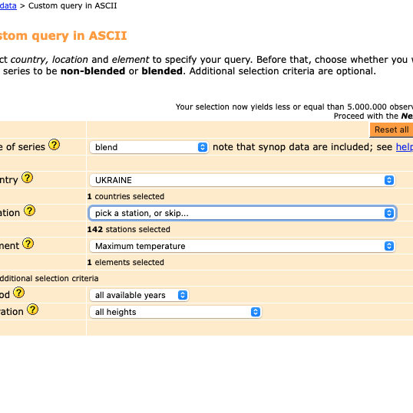
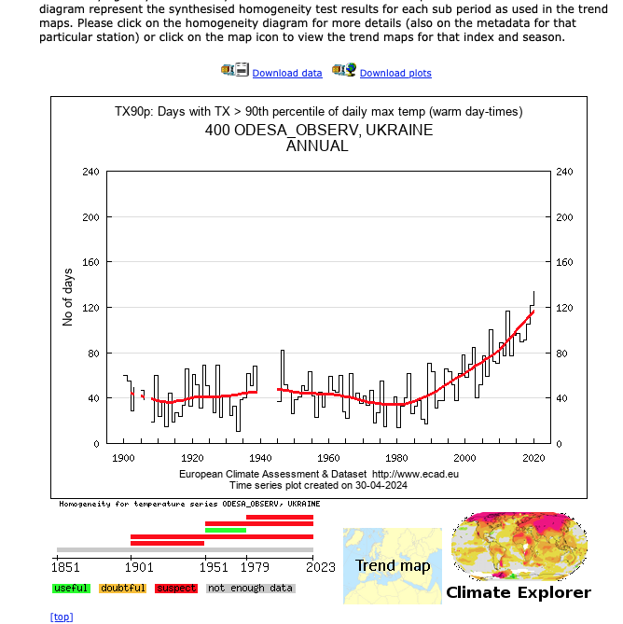

Station Data. International Datasets. ECA&D
More than 100 Ukrainian stations, different variables, different lengths of record and more variables (wind, RH, pressure, radiation, etc.)
Station Data
Climate Indices

Slide 10
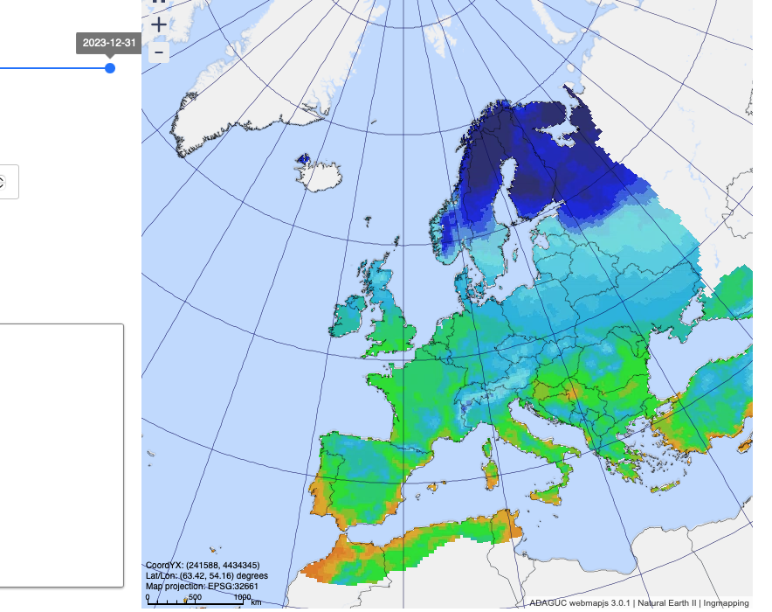
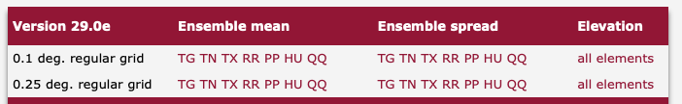
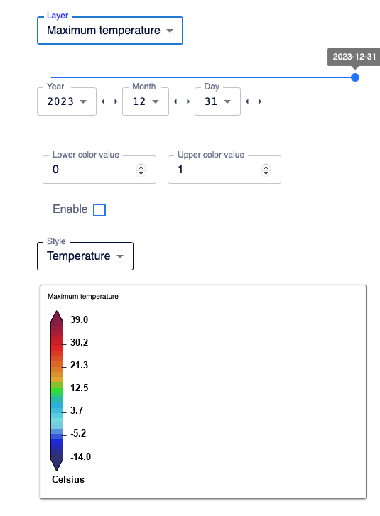
Station data, gridded products: EOBS

Slide 11
Gridded Datasets
# | Name | Temporal coverage | Provided spatial resolution | Reference
1 | ClimUAd (observation based gridded data) | 1946-2020 | 0.1ᵒ×0.1ᵒ | (Osadchyi et al., almost submitted)
2 | E-OBS: 20 ensemble members + ensemble mean (observation based gridded data) | 1950 to present | 0.1ᵒ×0.1ᵒ | (Cornes et al., 2018)
3 | ERA5 single level (global reanalysis) | 1940 to present | 0.25ᵒ×0.25ᵒ | (Hersbach et al., 2020)
4 | ERA5-Land (global reanalysis, only land surface) | 1950 to present | 0.1ᵒ×0.1ᵒ | (Hersbach et al., 2020)
5 | NOAA-CIRES 20th Century Reanalysis V2c (global reanalysis) | 1850-2014 | 2ᵒ×2ᵒ | (Compo et al., 2011)
6 | NOAA-CIRES-DOE 20th Century Reanalysis V3 (global reanalysis) | 1806-2015 | 1ᵒ×1ᵒ | (Slivinski et al., 2019)
7 | NCEP-NCAR Reanalysis 1 (global reanalysis) | 1948 to present | 2ᵒ×2ᵒ | (Kalnay et al., 1996)

Slide 12
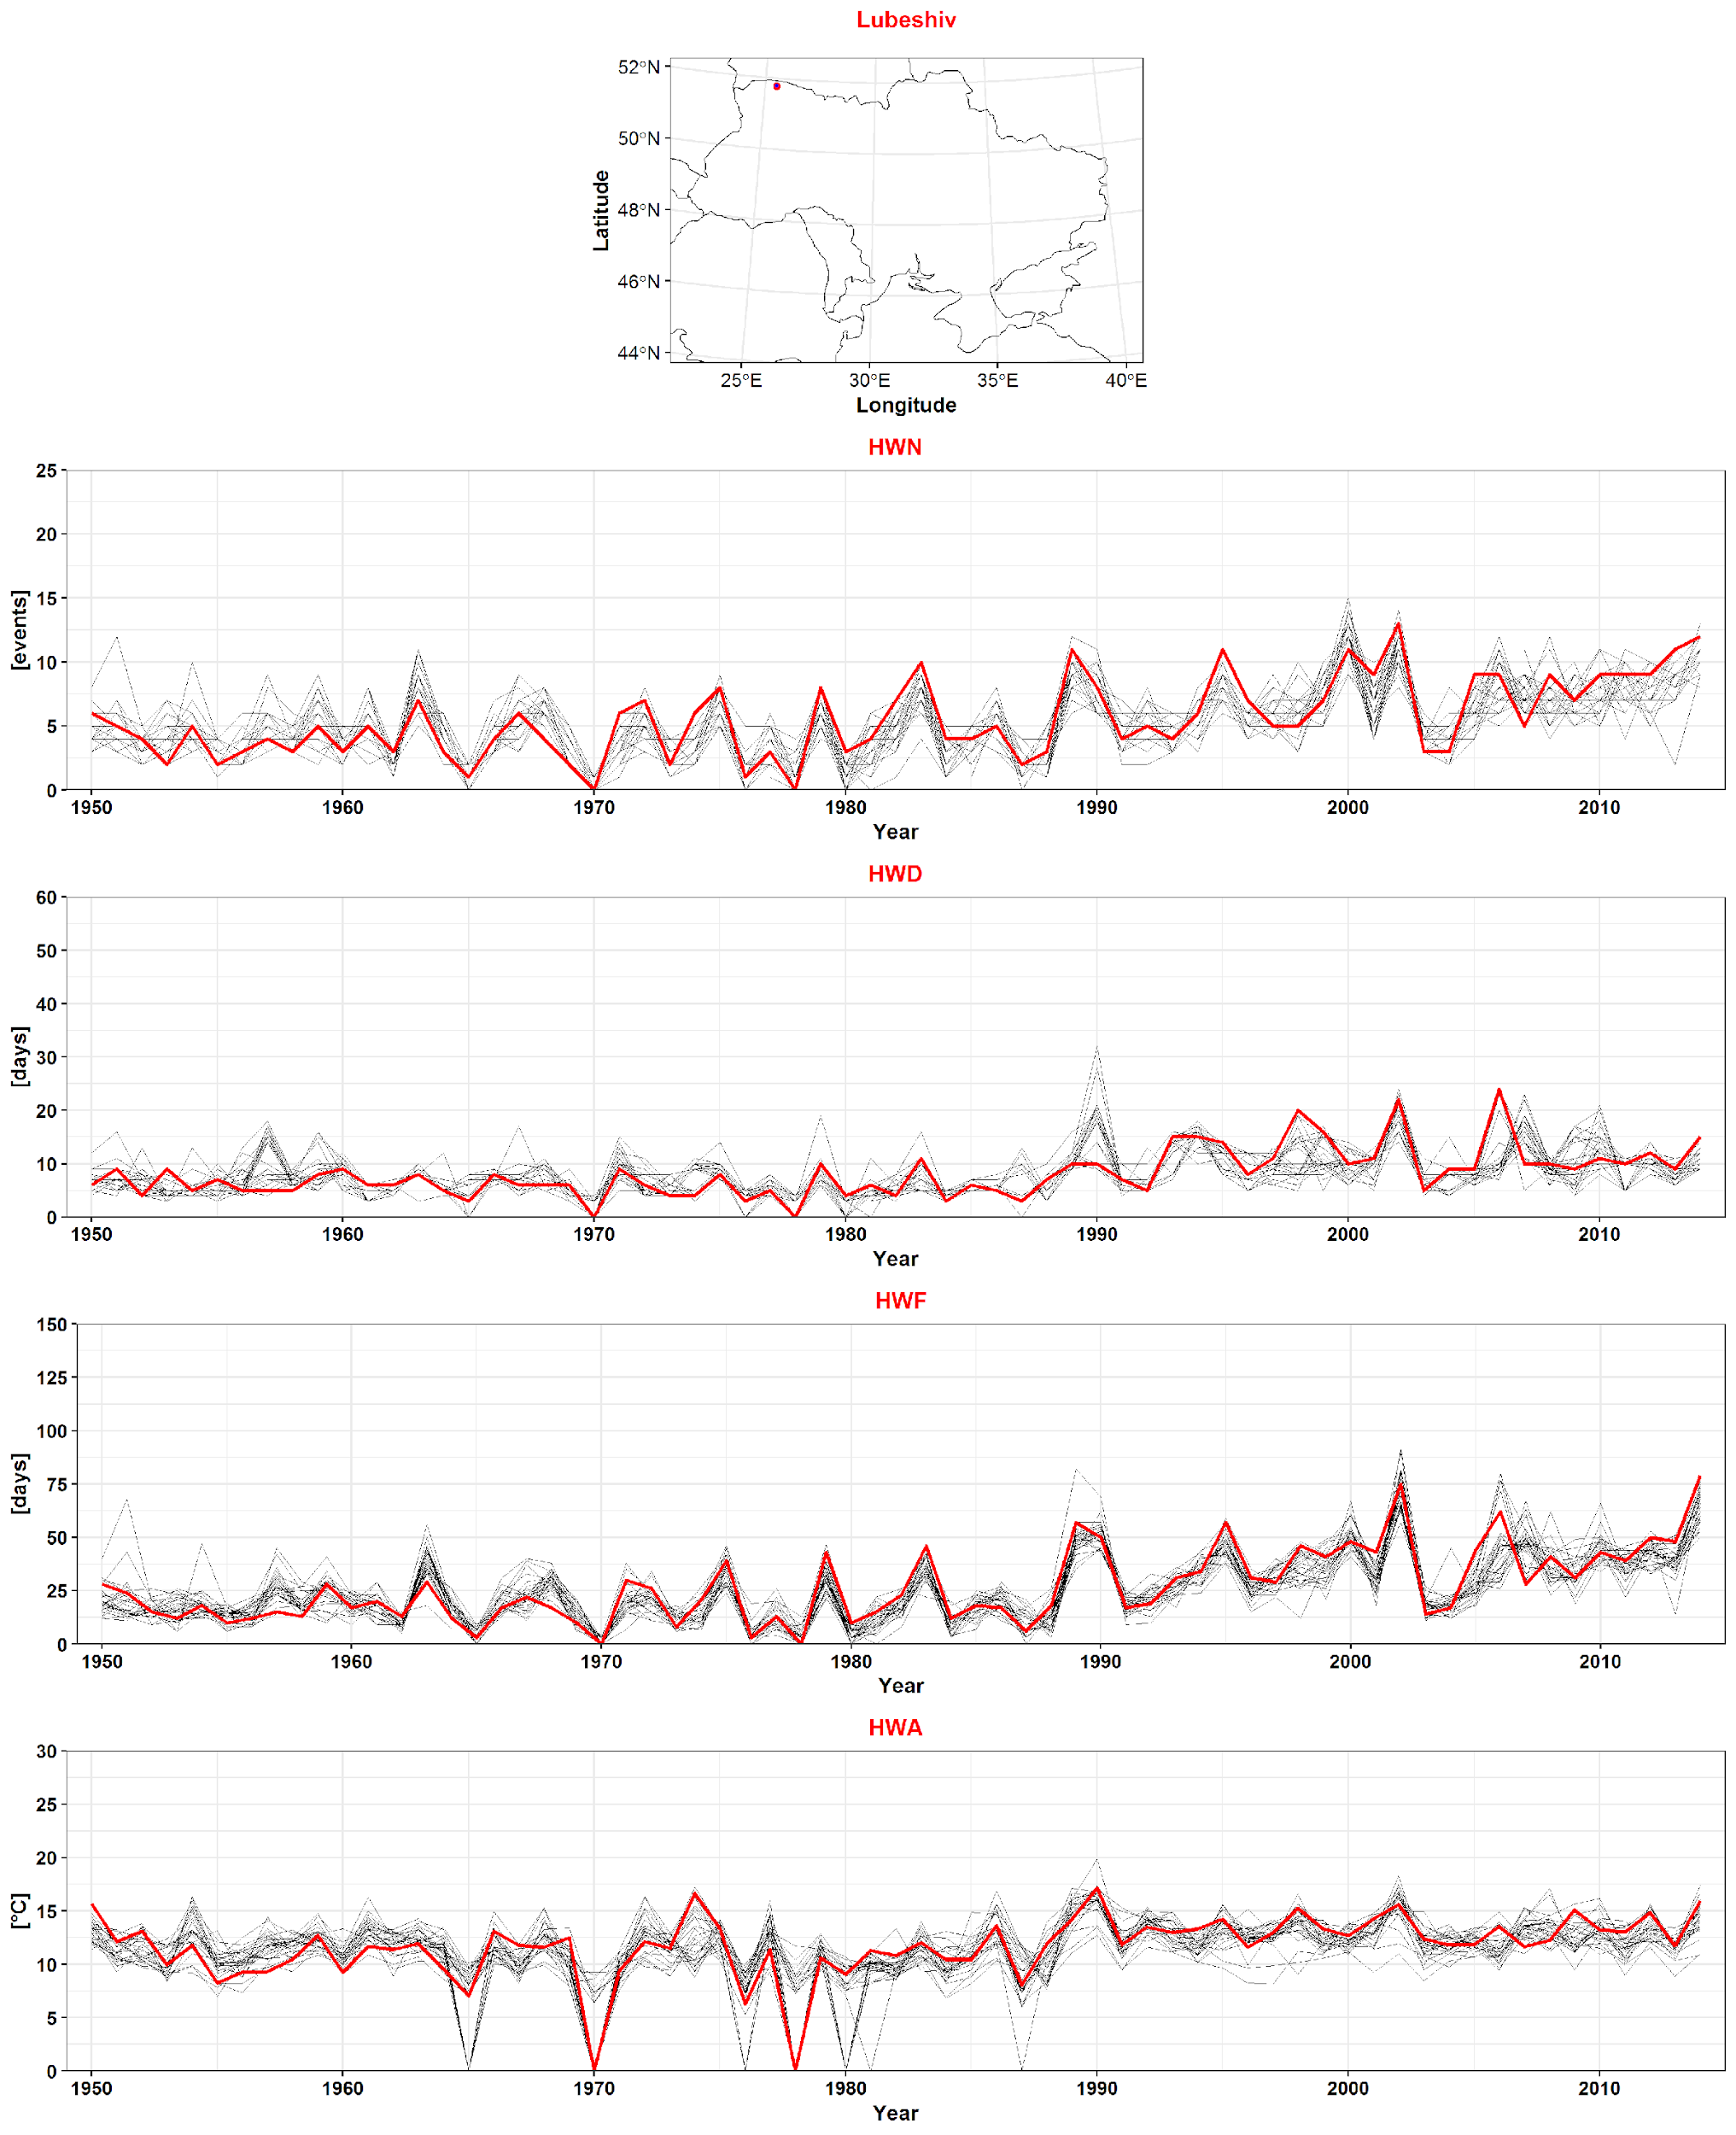
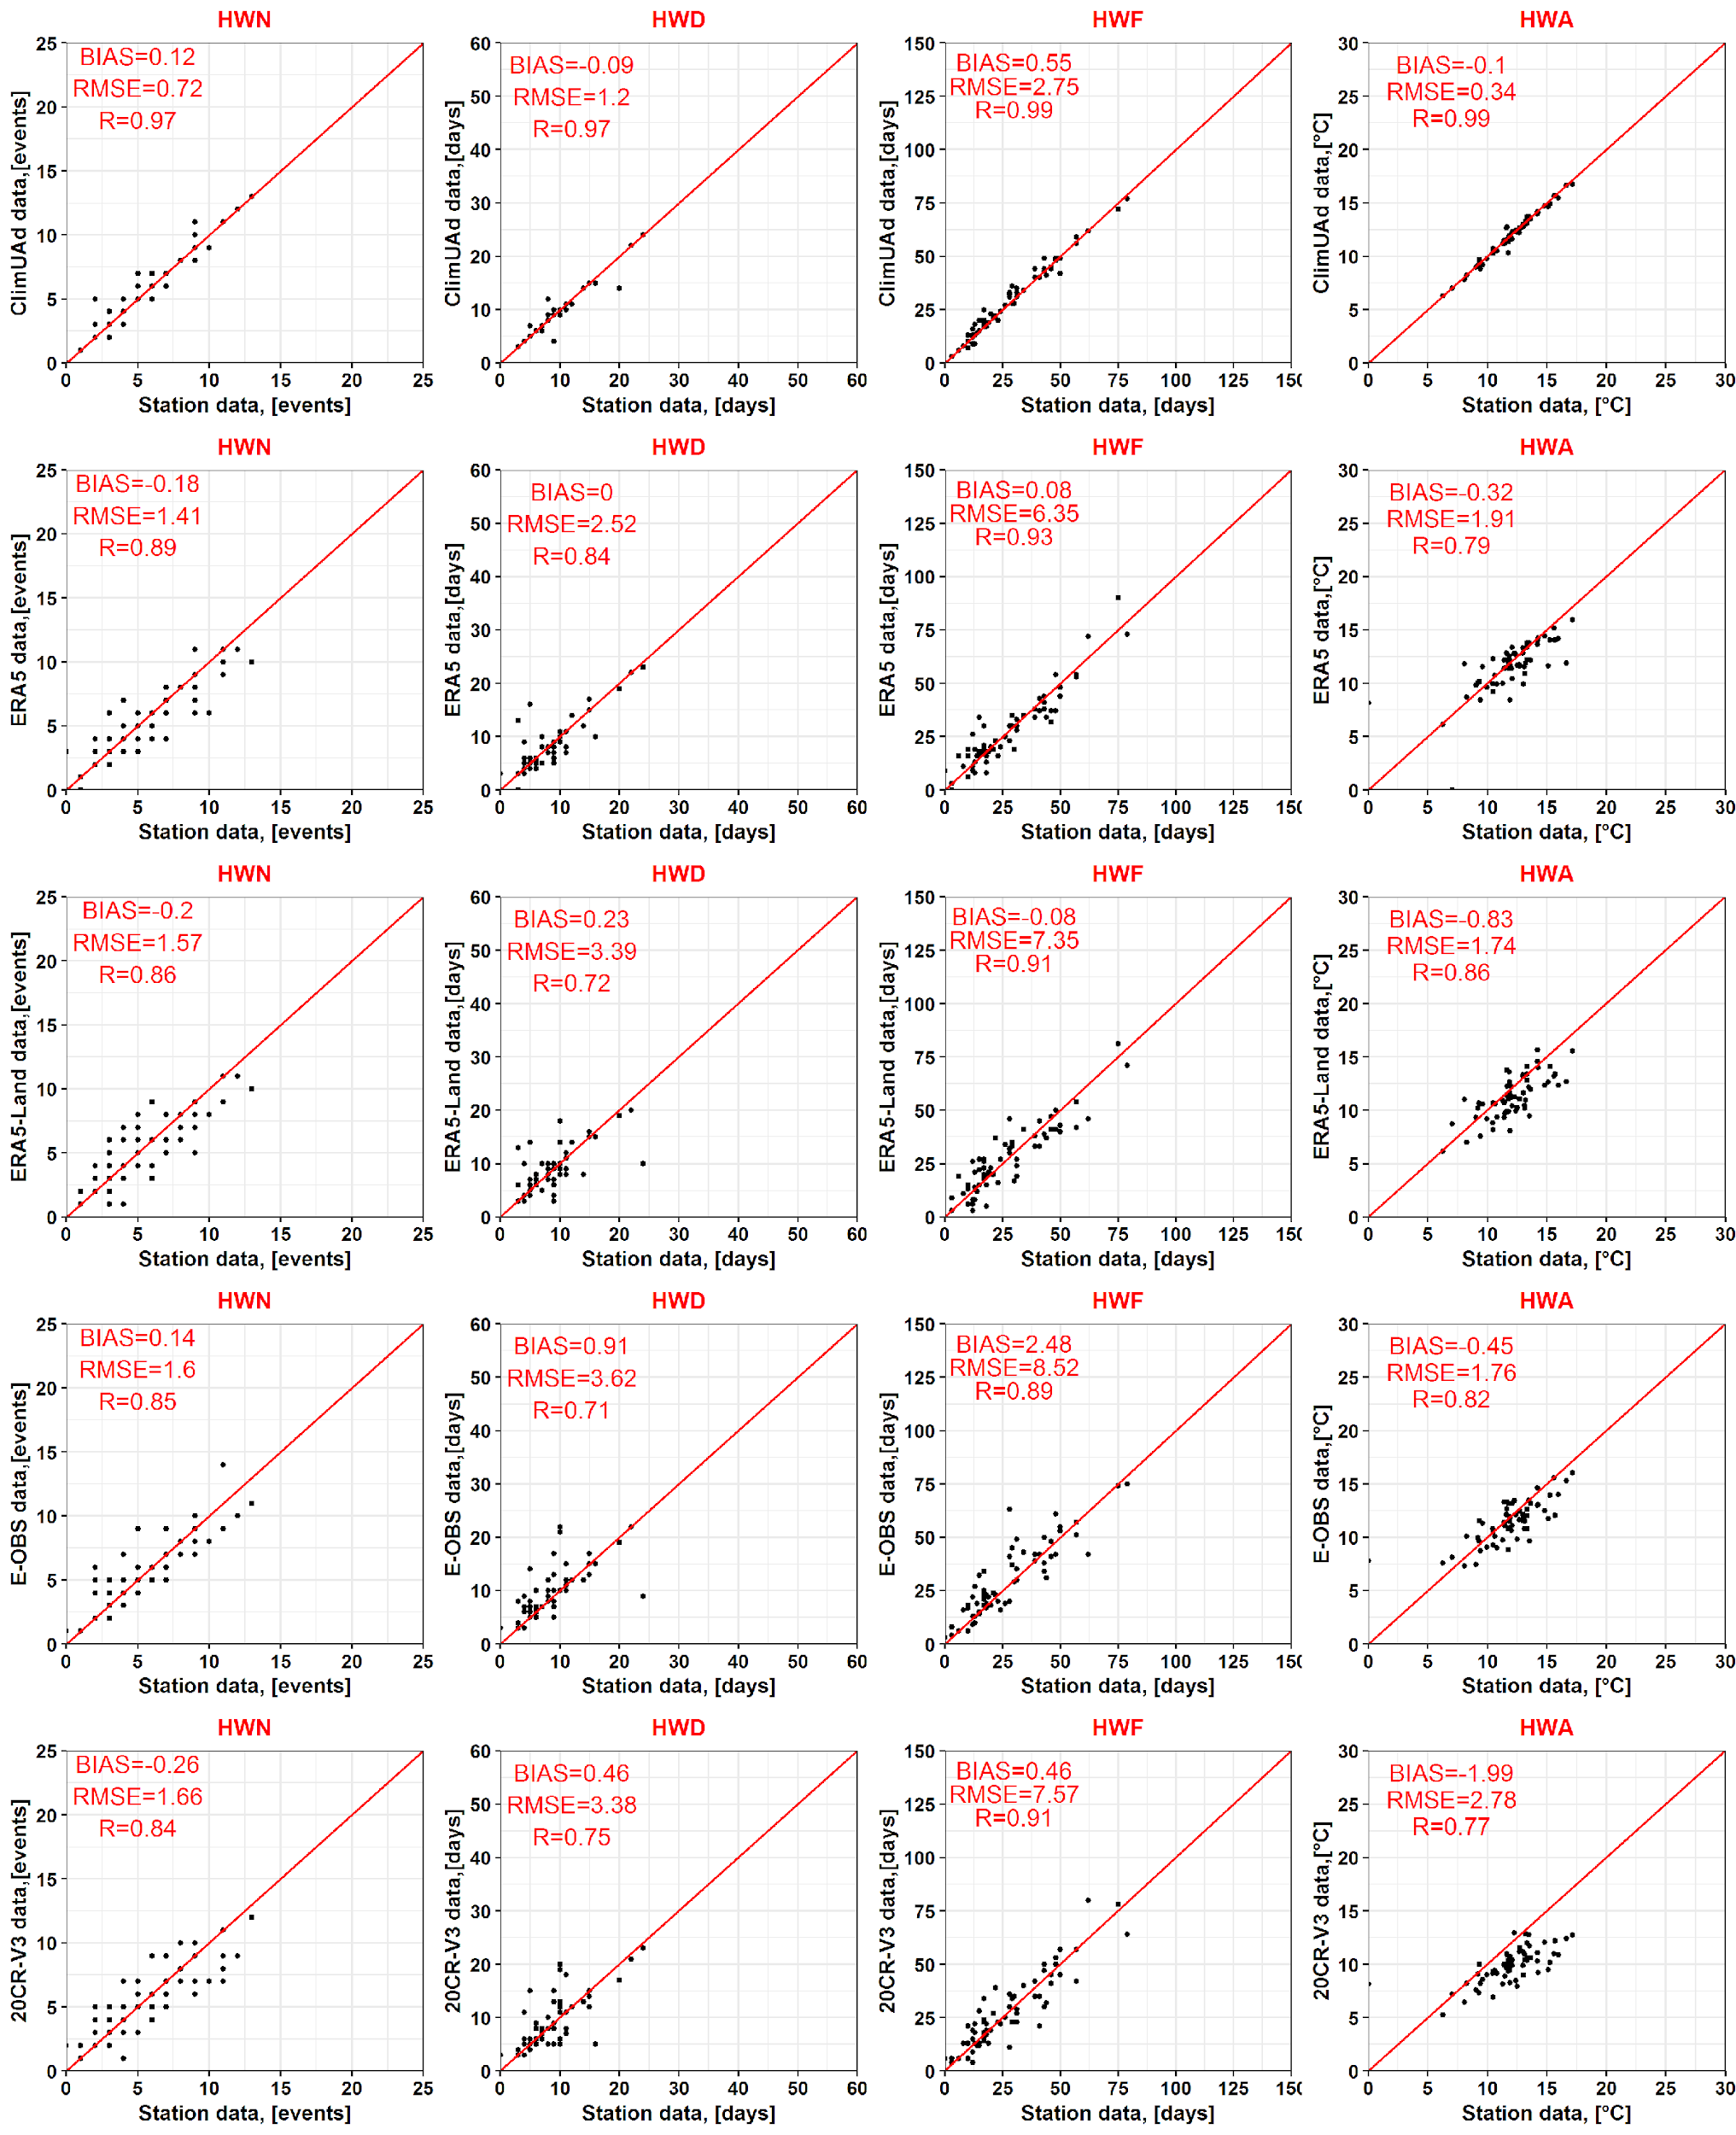




Statistical verification of HW metric calculations against station data

Slide 13
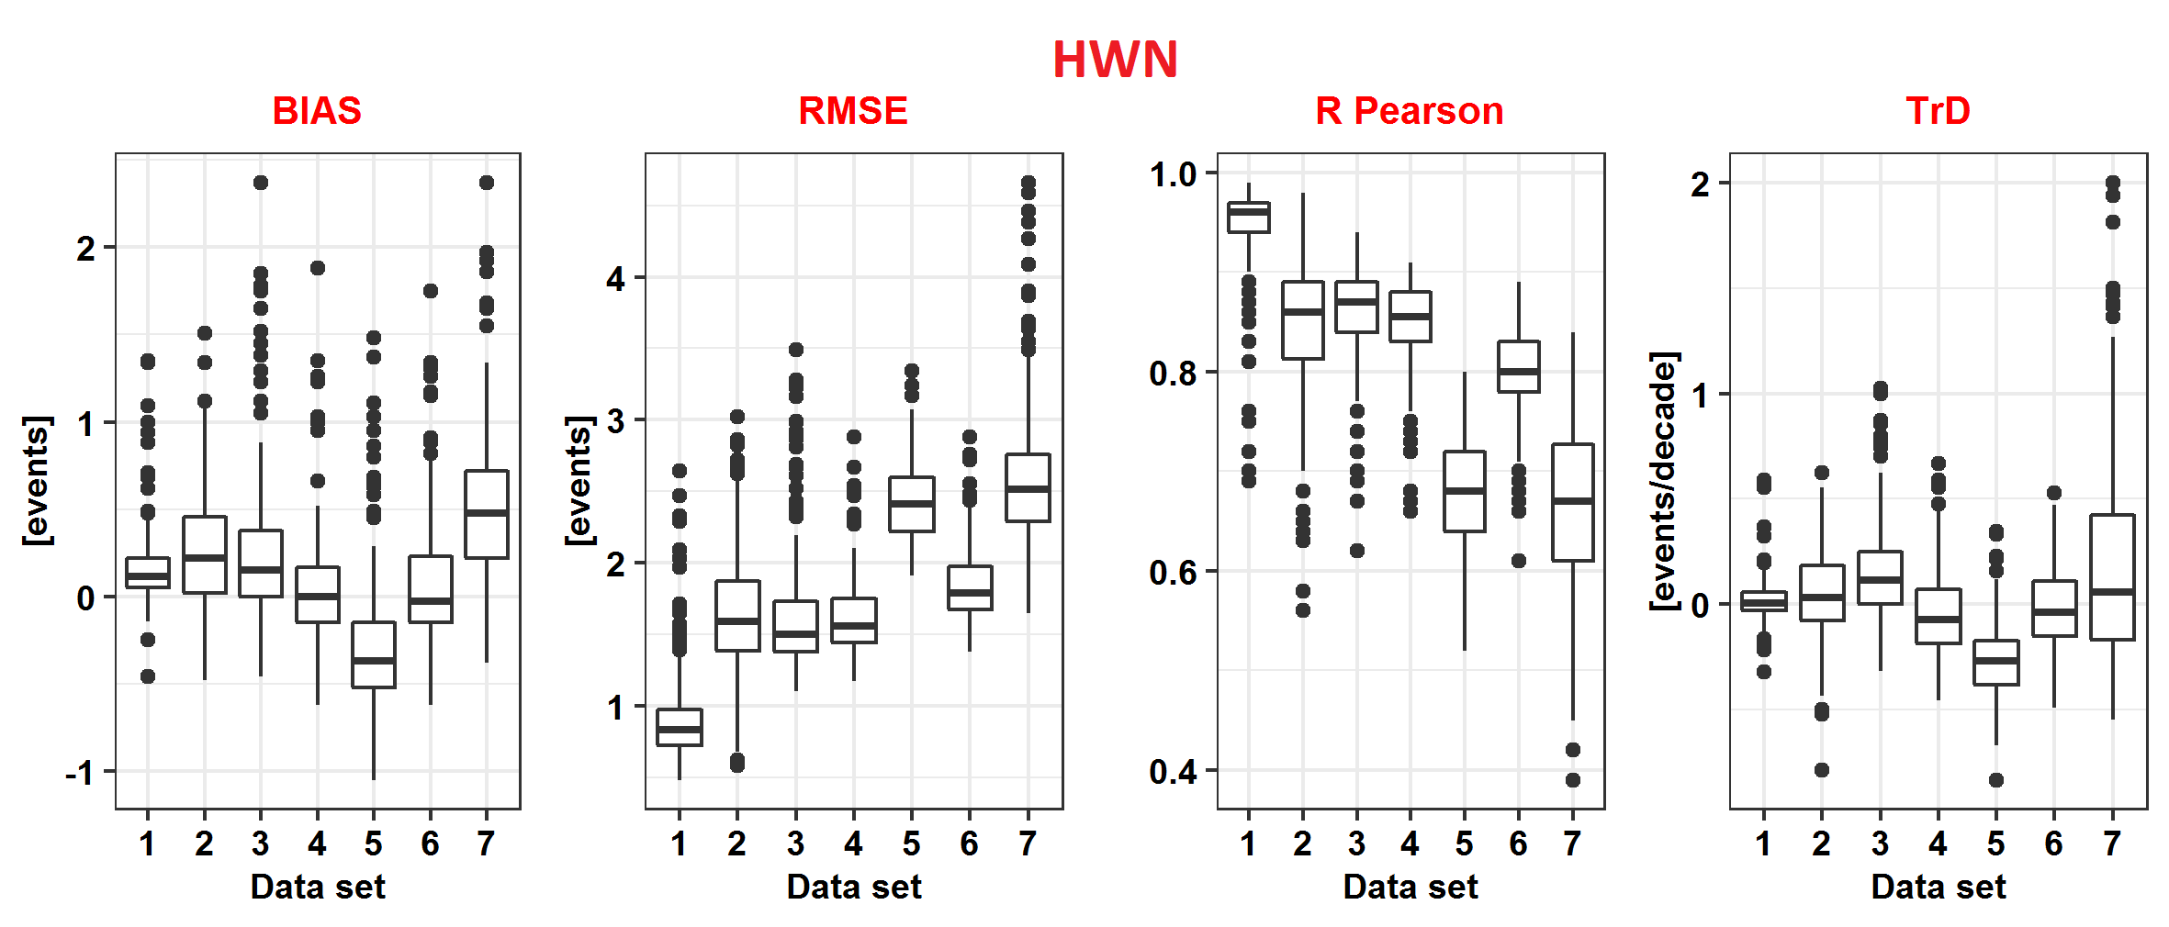
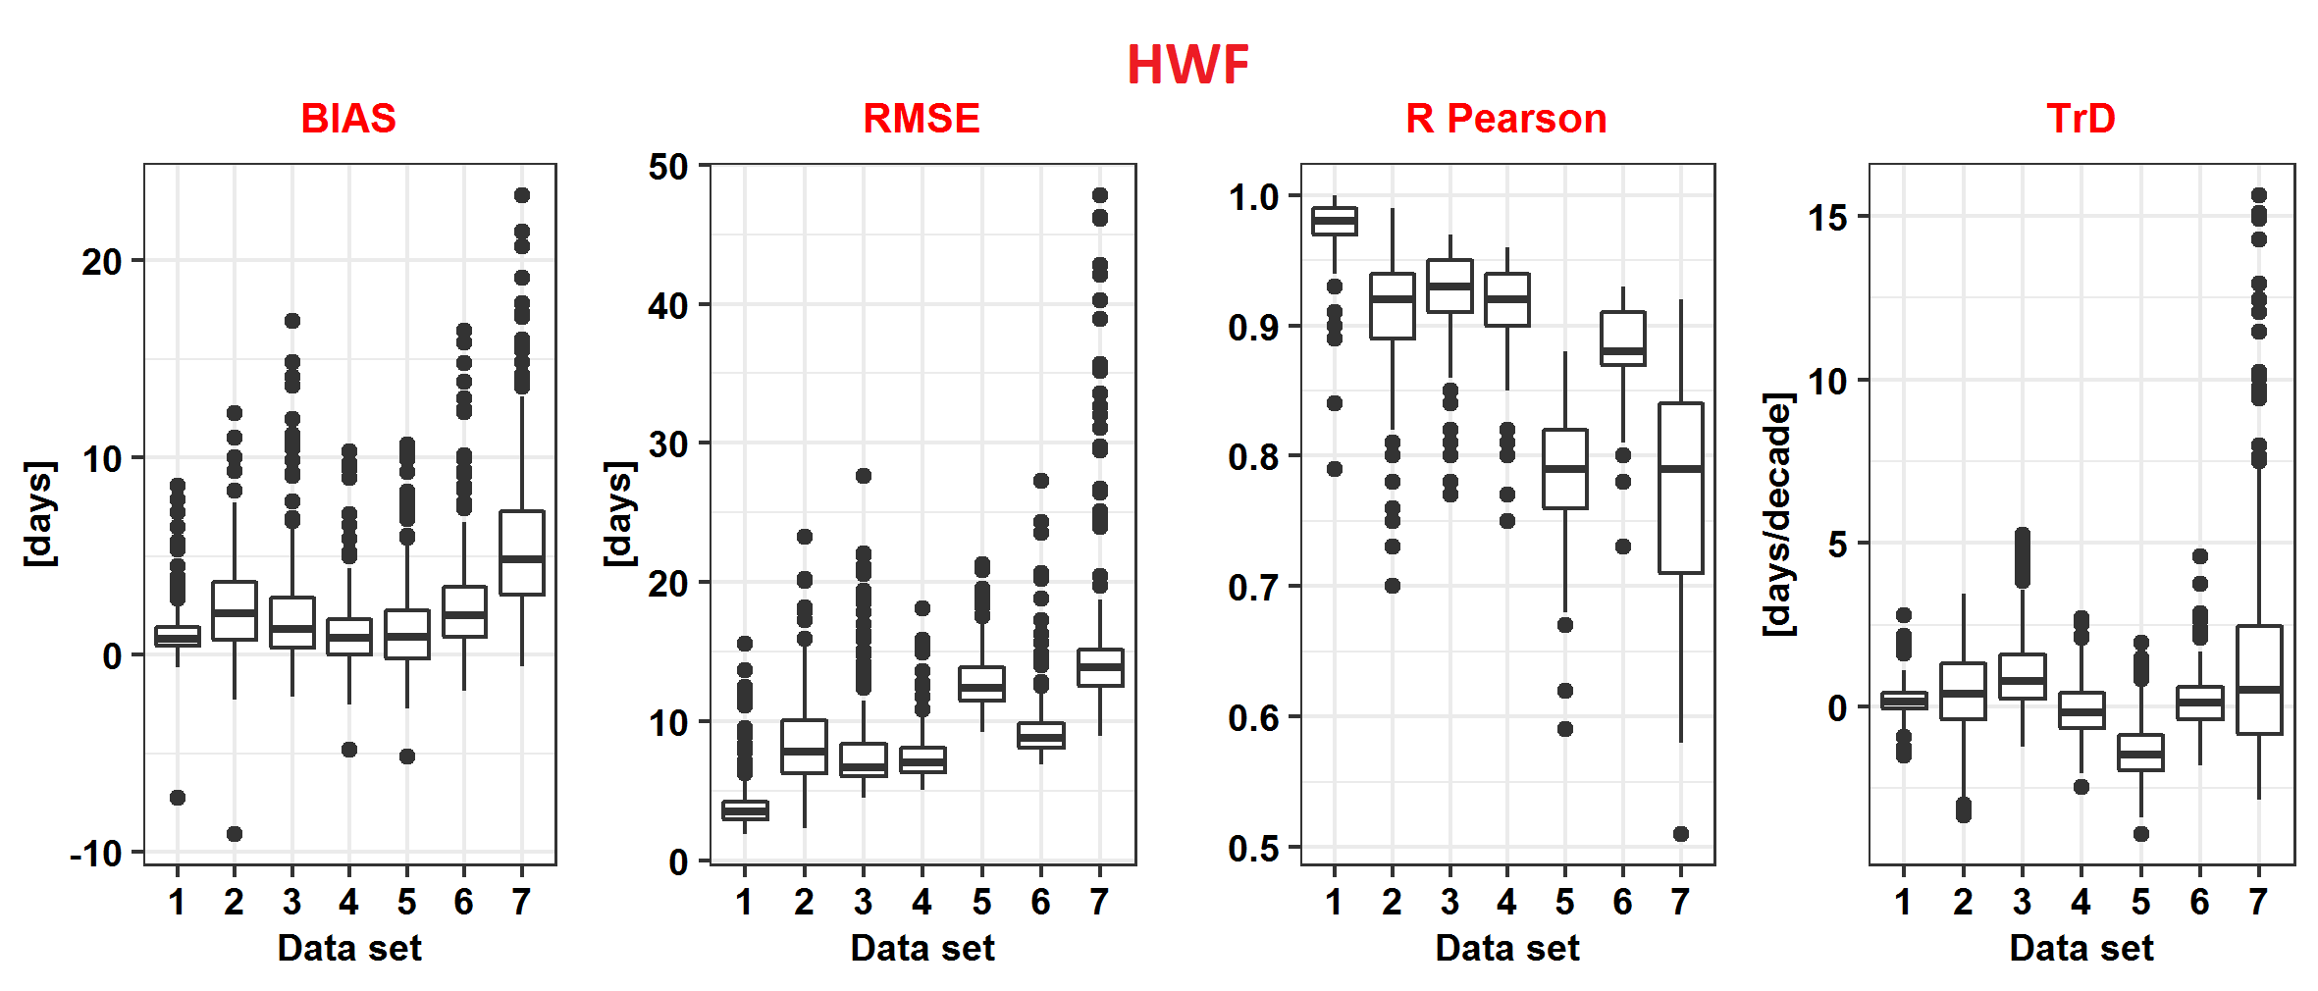
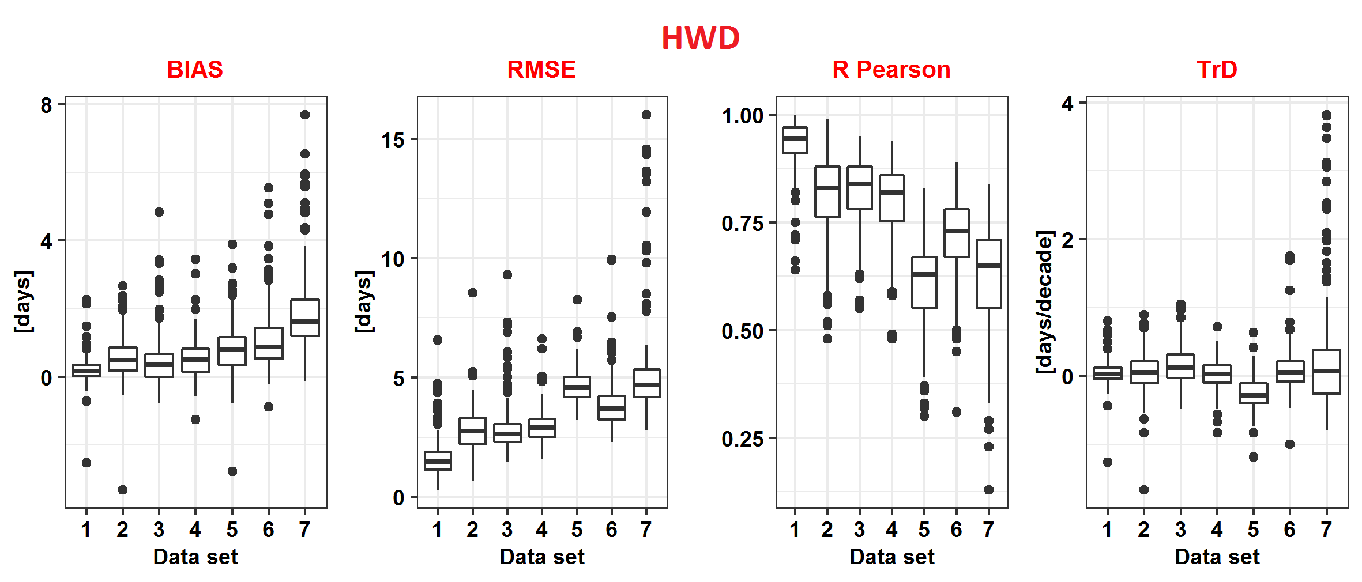
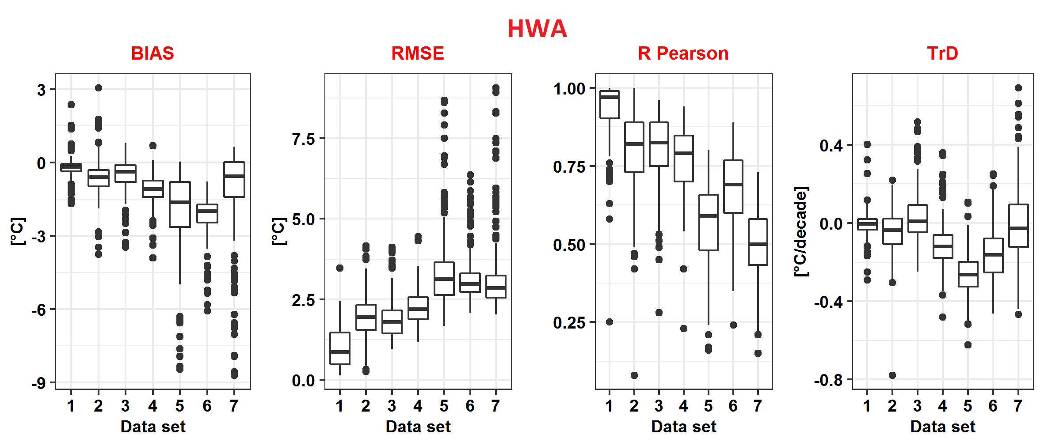
Statistical evaluation of HW metric calculated based on the gridded data against station observation results
The datasets:
1 – ClimUAd; 2 – E-OBS (ensemble mean); 3 – ERA5; 4 – ERA5-Land; 5 – 20CRv2; 6 – 20CRv3; 7 – NCEP R1

Slide 14
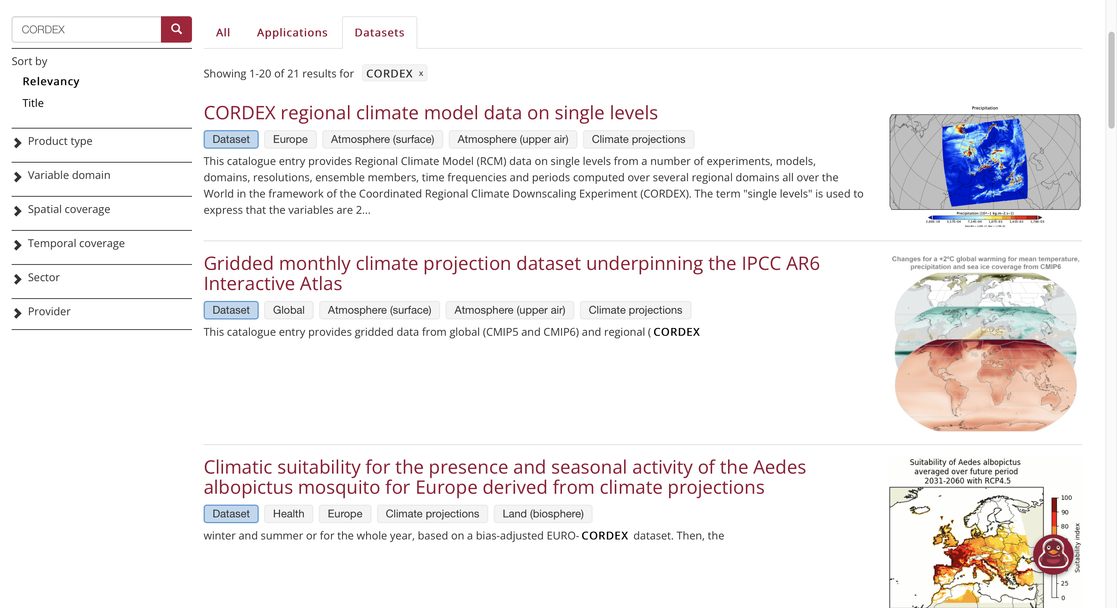
CDS Examples

Slide 15

Thanks for your attention. Any questions?

