Slide 1
619285-EPP-1-2020-1-FI-EPPKA2-CBHE-JP Multilevel Local, Nation- and Regionwide Education and Training in Climate Services, Climate Change Adaptation and Mitigation
“Introduction to work in groups”
Dr Jon Xavier Olano Pozo Institut Universitari de Recerca en Sostenibilitat, Canvi Climàtic i Transició Energètica (IU-RESCAT), Universitat Rovira i Virgili
6 May 2024. ClimED 4th Training

Slide 2
Introducing lecturer
Dr Jon Xavier Olano Pozo
Research Technician in Institut Universitari de Recerca en Sostenibilitat, Canvi Climàtic i Transició Energètica (IU-RESCAT)
Centre for Climate Change
Geography Department, Faculty of Tourism and Geography, Rovira i Virgili University
Bachelor Degree in Sociology (University of Barcelona)
Master Degree in Territorial Planning (Rovira i Virgili University)
PhD in Tourism and Leisure Studies.
Research Focus:
Tourism Destination Evolution (Social, Regional and Ambiental)
Climate Services application (Tourism, Infrastructures, Agriculture, Leisure)
Teaching
Co-Creation of Climate Services, to see in this lecture (Rovira I Virgili, University)
Introduction to Tourism Places (in Open University of Catalonia, UOC).
WMO

Slide 3
General Overview
C4: Ensure Quality of climate information and services
C1: Create and Manage Climate Datasets
C2: Derive products from climate data
C3: Create and interpret climate forecasts, climate projections and model output
C5: Communicate climatological information to users

Slide 4
Objectives of work in groups
Day 1. Competency 1: Create and Manage climate datasets; Competency 2: Derive Products from Climate Data.
Identification and retrieval of Climate Data from different sources for point/city/region in Ukraine to develop further tasks
Tasks
1.1 Select the geographical scope of the project
1.2 Identify different climate databases (ECAD, Copernicus etc…) and retrieve data for geographical selection 1.3 Try to calculate climate indices through Climpact or other tools for selected geographical feature.
1.4 (Complementary). Apply Quality Control or Homogoneization techniques with INQC, Climatol or other tools
Day 2. Competency 5: Communicate Climate Information to Users; Competency 2: Derive Products from Climate Data.
Development of co-creation methodology for climate-dependent sectors considering the needs of different users
Tasks
2.1 Co-creation Workshop (during the day). Allows to know what the user needs
2.2 Analyze the workshop information through templates.
2.3 Theoretical definition of the climate indicator as a base of climate service

Slide 5
Objectives of work in groups
Day 3. Competency 2: Derive Products from Climate Data. Competency 3: Create and interpret climate forecasts, climate projections and model output
Operationalization of climate indicator
Tasks
3.1 Mathematical definitions of climate indices for climate-dependent sectors
3.2 Computation of co-created indices for the dependent sector
3.2.1 Mandatory. Computation of basic indicators for past data
3.2.2 Complementary. Computation of indicator for basic future projections
3.3 (Complementary). Validation of the co-created indices with sectorial data
Day 4. Competency 5: Communicate Climate Information to Users
Prototyp of Climate Service
Tasks
4.1 Communication channel of the information
4.2 Mockup of the tool

Slide 6
Structure of the final presentation
1. The rationale for the selection of the place and the field (1 ‘)
2. Description of the climate data used (1 ‘)
3. Analysis of basic climate indices (2’)
4. Co-creation workshop development (2’)
5. Indicator for climate dependent sector (1’)
6. Indicator behaviour on time (2’)
7. Comunication strategy (Channel + Mockup (2’)
8. Conclusions and general valorisation of the course (2’)
Attendants: Comments and Questions (2’)

Slide 7
Day 1. Resources
Databases
European Climate Data Assessment (ECAD) and E-OBS: https://www.ecad.eu/dailydata/
Station Daily Data on txt files (ECAD); grided daily data for E-Obs
Copernicus Climate Change Service
Requires registration (free and easy)
Netcdf files (requires R or Python) to work
ERA5 hourly database (25km x 25km aprox). https://cds.climate.copernicus.eu/cdsapp#!/dataset/reanalysis-era5-single-levels?tab=form
ERA5-Land database (11km x 11km aprox, only land data). https://cds.climate.copernicus.eu/cdsapp#!/dataset/reanalysis-era5-land?tab=overview
Open – Meteo
A “friendly” Copernicus
API Limitation for free version

Slide 8
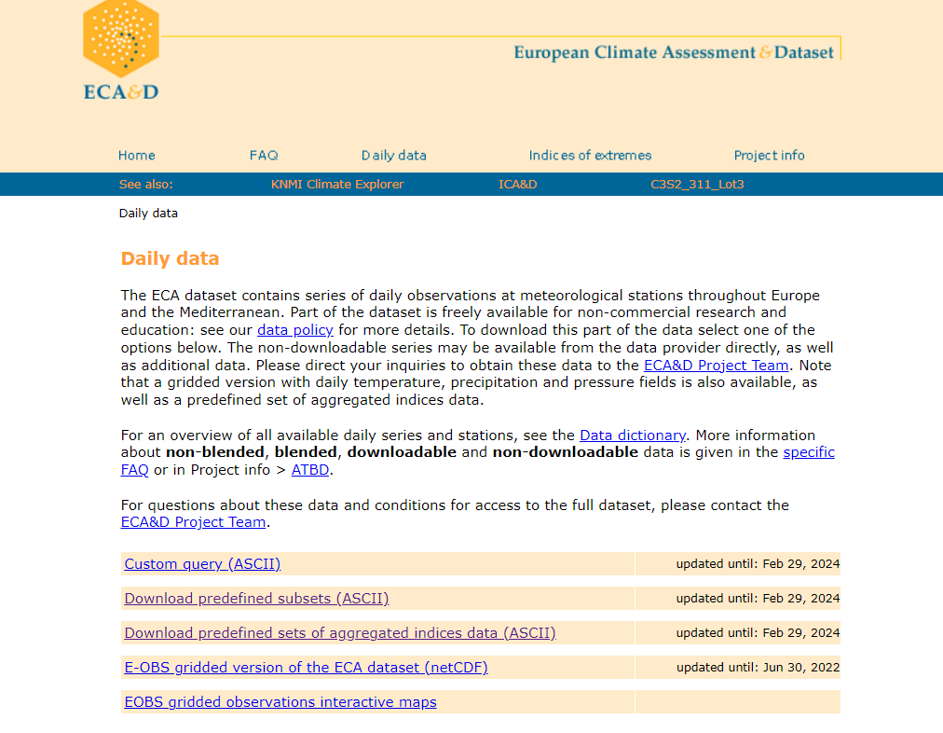
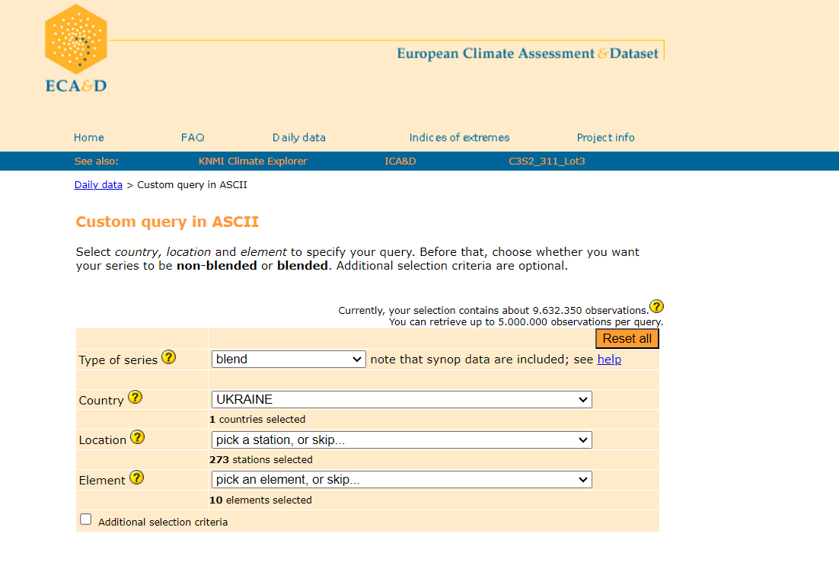
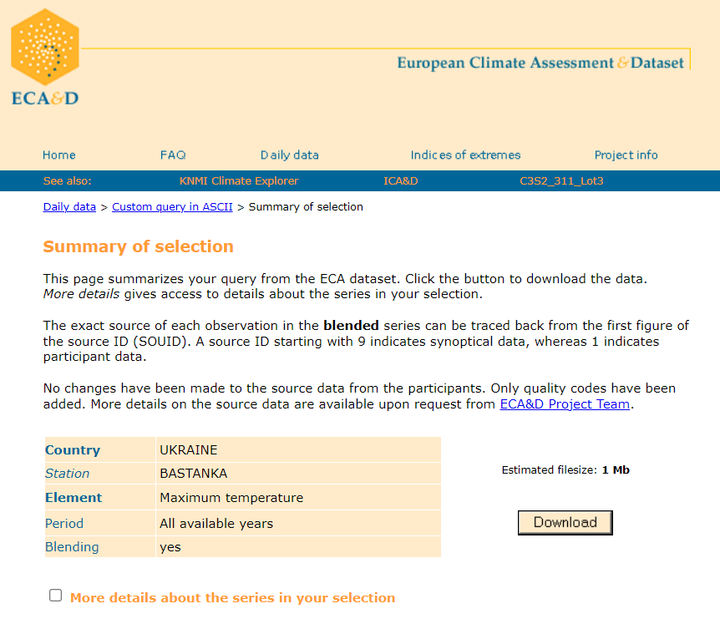
Day 1. Resources
Download data from ECAD or E-OBS

Slide 9
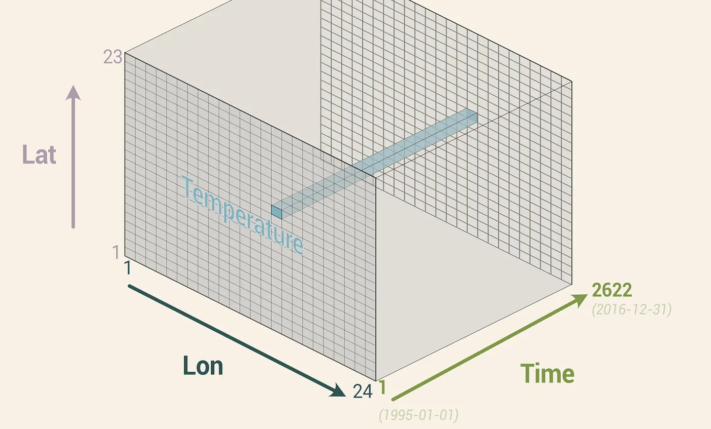
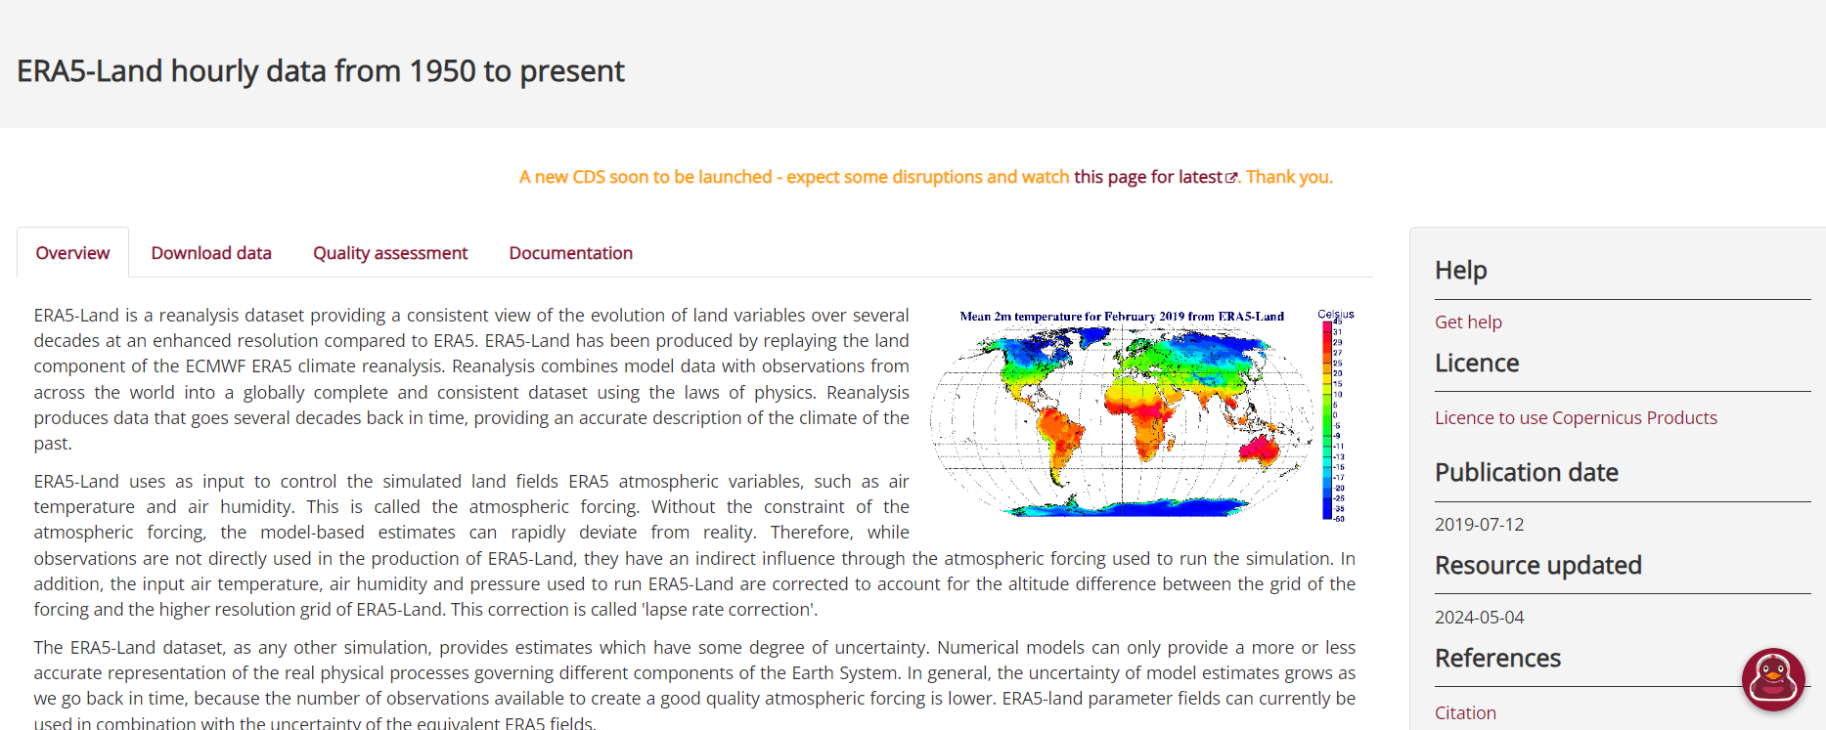
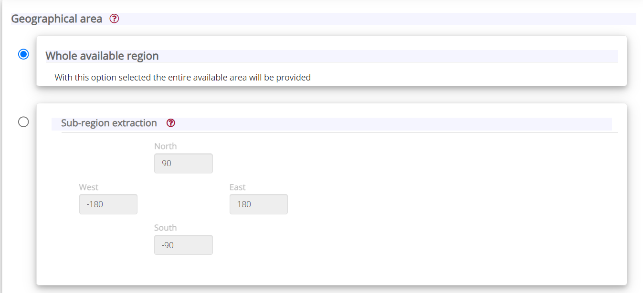
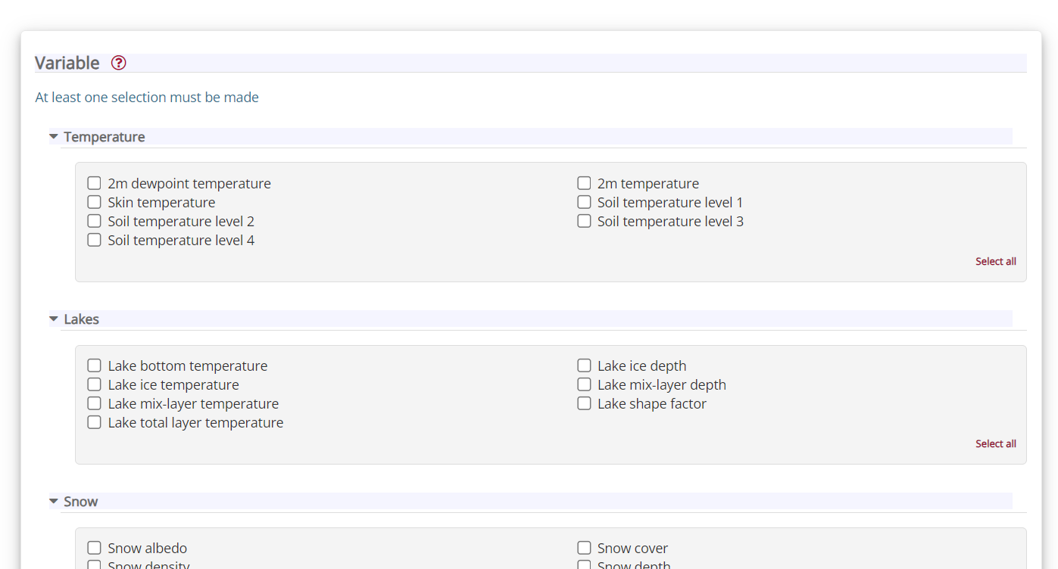
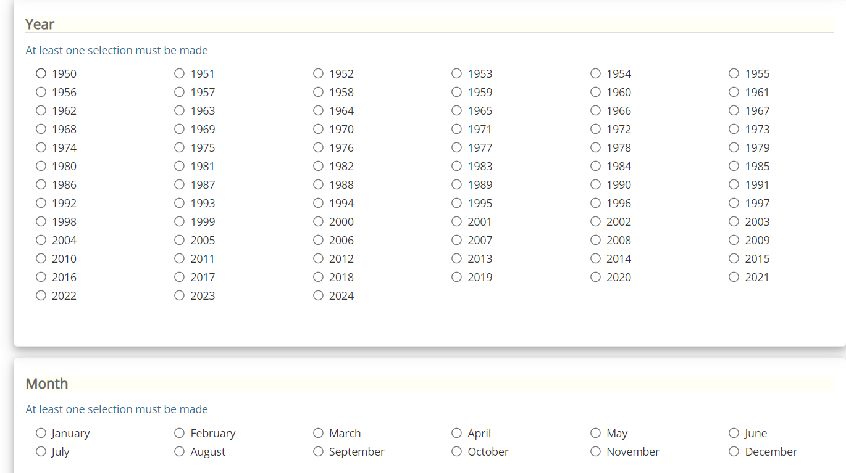
Day 1. Resources
Download data from ERA5
Source: https://towardsdatascience.com/how-to-crack-open-netcdf-files-in-r-and-extract-data-as-time-series-24107b70dcd

Slide 10
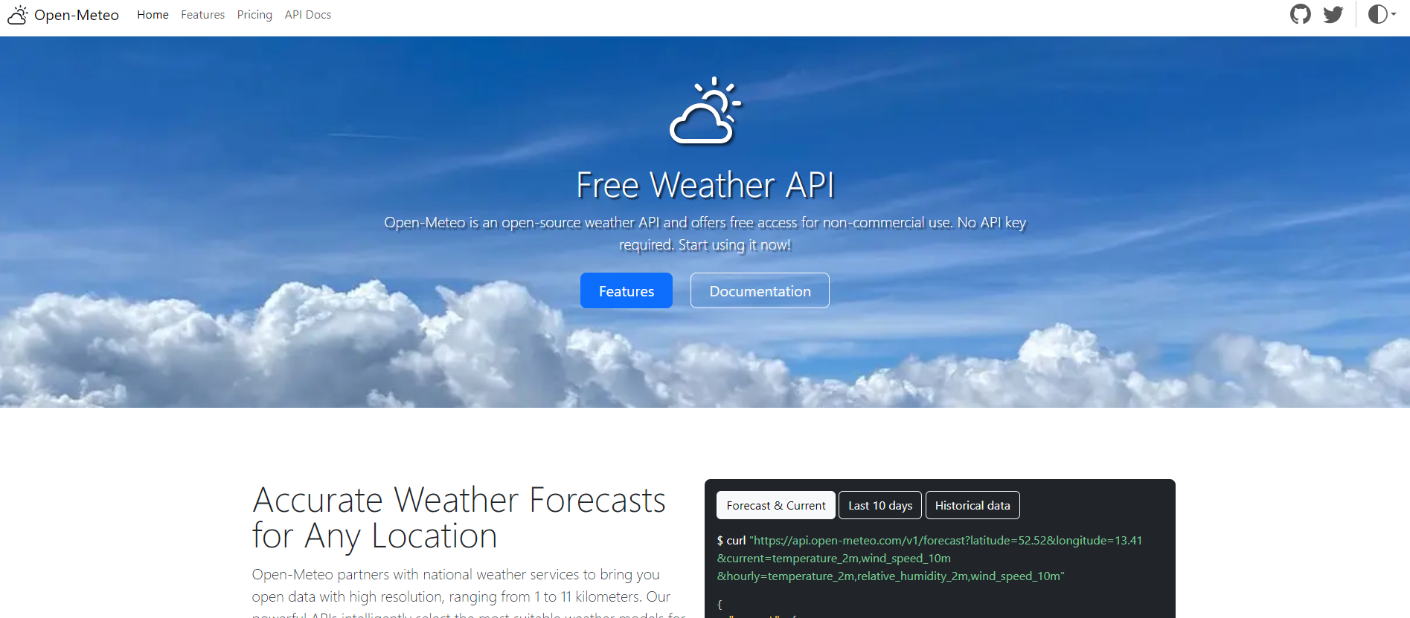
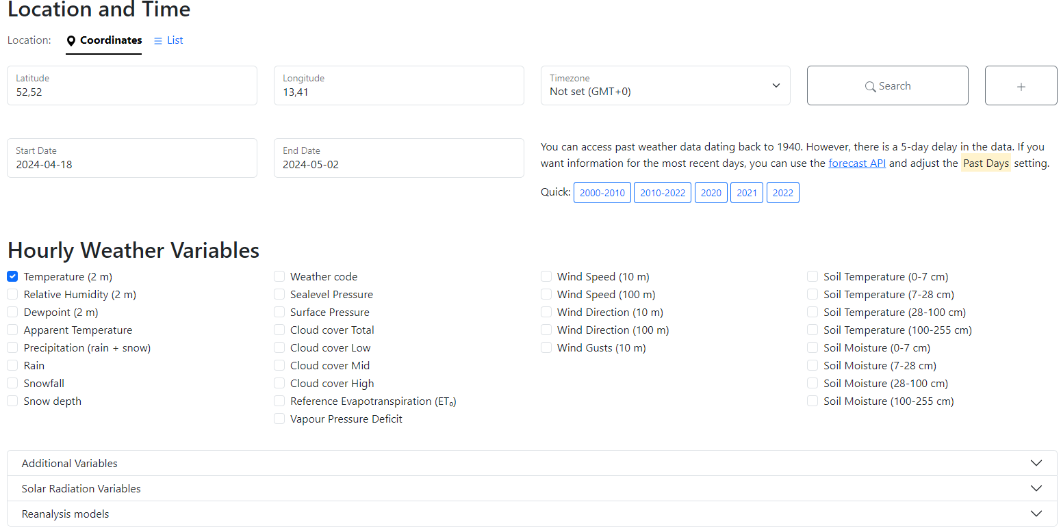
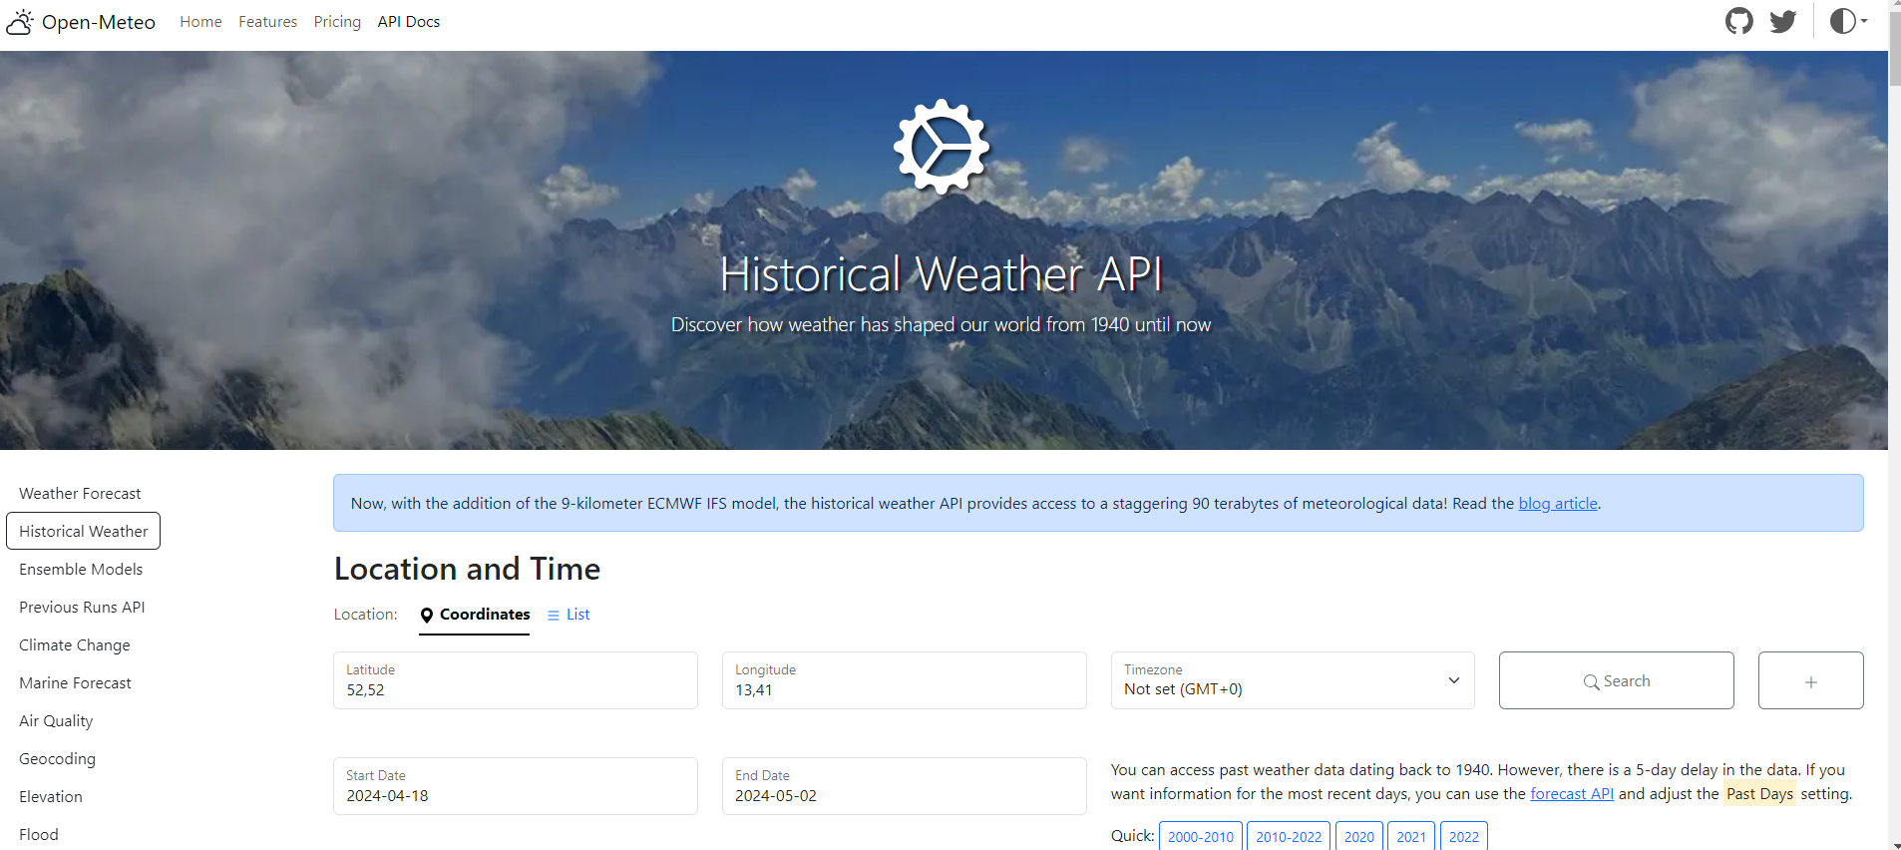
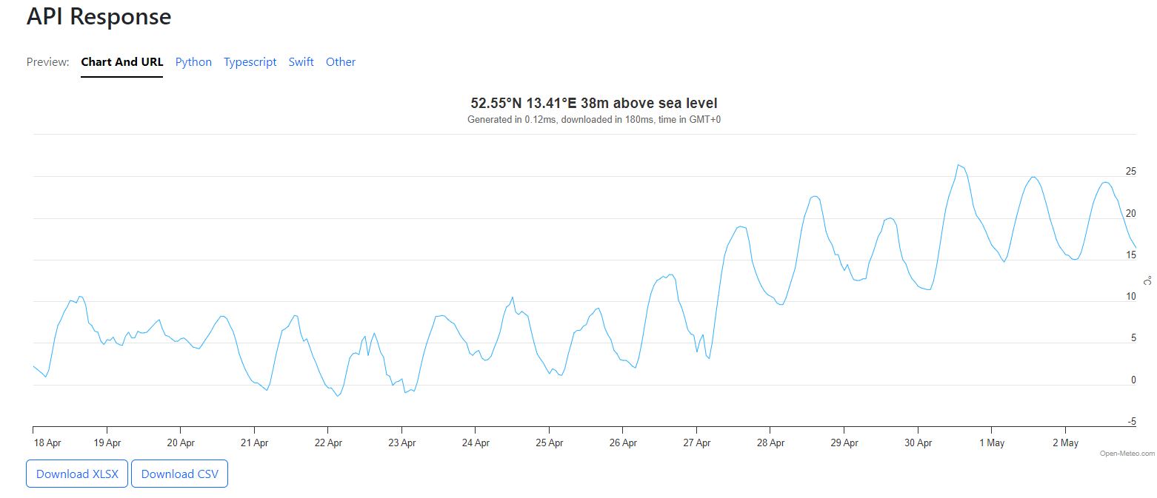
Day 1. Resources
Download data from Open Meteo. com

Slide 11
Thank you!

