Slide 1
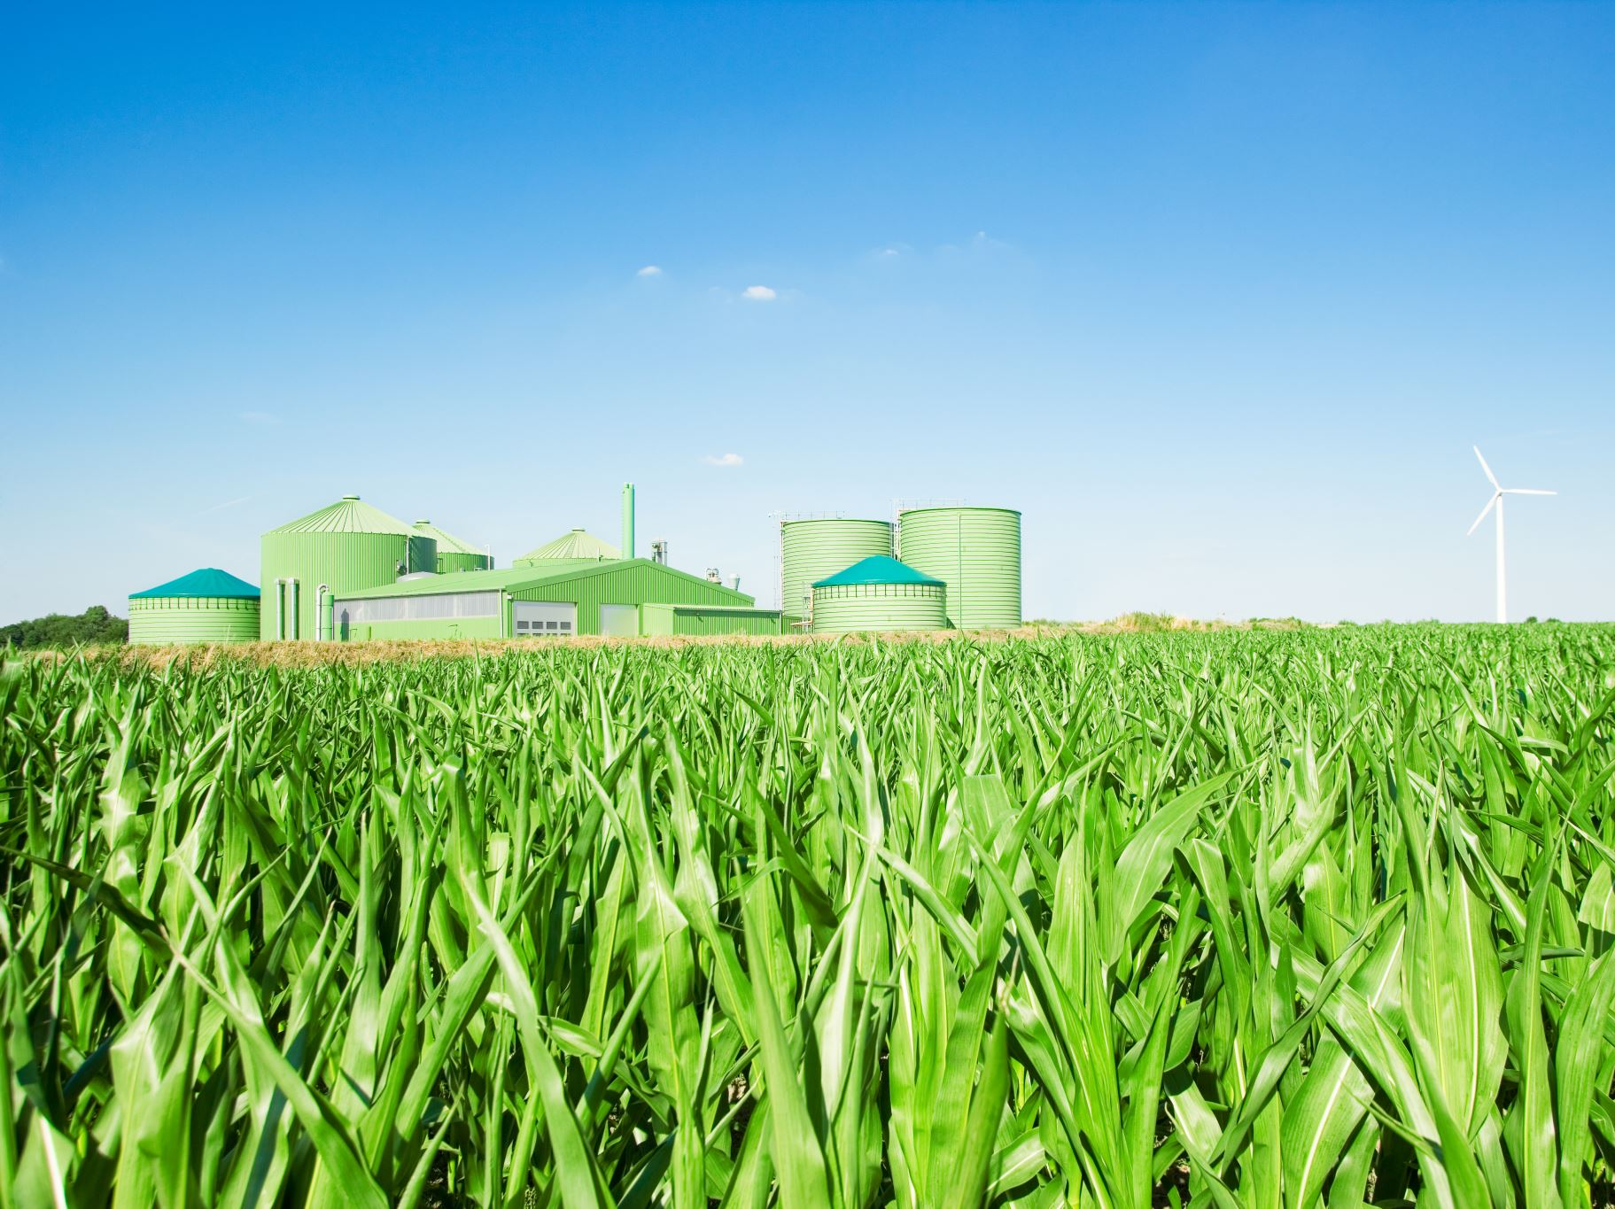
Quality Control
Dr. Enric Aguilar Center for Climate Change (C3)/IU-RESCAT/URV

Slide 2
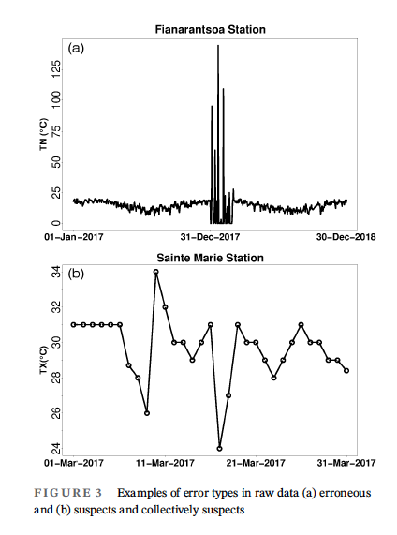
What is Quality Control (QC)?
Quality Control consists in the examination of climate records to detect and, if necessary, correct errors such as those related to digitization issues, database manipulation and extraction, recording practices, etc.
Data manipulation error: rainfall data mistakenly introduced into temperature series
Five consecutive identical values
Source: Randriamarolaza, Aguilar et al. (2021)

Slide 3
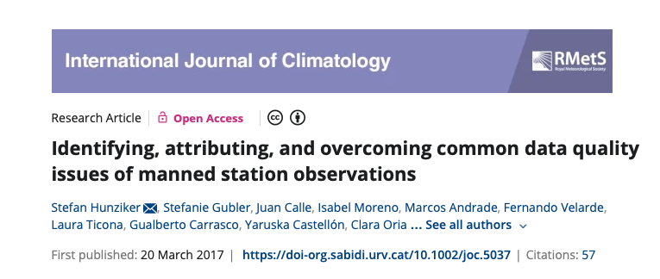
When things go wrong … the crocodrile series
(a) Minimum temperature (TN) time series of Progreso (Peru). Since 2003, a missing temperature interval between approximately −2 and +2 °C is observed. (b) Liquid-in-glass minimum thermometer at the station Progreso. Values to the right of the zero point are positive, to the left negative. The temperature must be read on the right side of the rod (slightly above +2 °C for the case shown). However, if the centre of the rod was below 0 °C, the observer erroneously read the temperature on the rod's left side. Hence, the length of the rod (corresponding to about 4.2 °C) determines the missing temperature range. [Colour figure can be viewed at wileyonlinelibrary.com].
Notes:
(a) Minimum temperature (TN) time series of Progreso (Peru). Since 2003, a missing temperature interval between approximately −2 and +2 °C is observed. (b) Liquid‐in‐glass minimum thermometer at the station Progreso. Values to the right of the zero point are positive, to the left negative. The temperature must be read on the right side of the rod (slightly above +2 °C for the case shown). However, if the centre of the rod was below 0 °C, the observer erroneously read the temperature on the rod's left side. Hence, the length of the rod (corresponding to about 4.2 °C) determines the missing temperature range. [Colour figure can be viewed at wileyonlinelibrary.com].
IF THIS IMAGE HAS BEEN PROVIDED BY OR IS OWNED BY A THIRD PARTY, AS INDICATED IN THE CAPTION LINE, THEN FURTHER PERMISSION MAY BE NEEDED BEFORE ANY FURTHER USE. PLEASE CONTACT WILEY'S PERMISSIONS DEPARTMENT ON PERMISSIONS@WILEY.COM OR USE THE RIGHTSLINK SERVICE BY CLICKING ON THE 'REQUEST PERMISSIONS' LINK ACCOMPANYING THIS ARTICLE. WILEY OR AUTHOR OWNED IMAGES MAY BE USED FOR NON-COMMERCIAL PURPOSES, SUBJECT TO PROPER CITATION OF THE ARTICLE, AUTHOR, AND PUBLISHER.

Slide 4
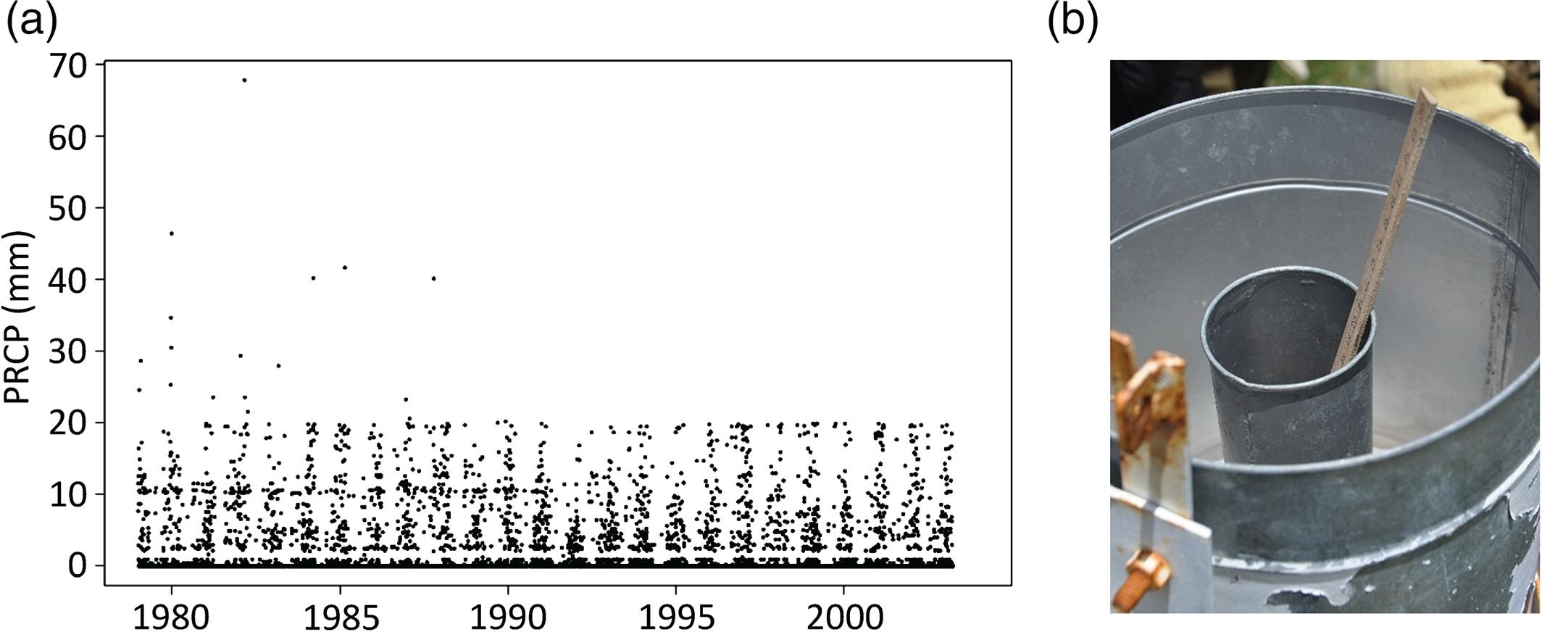
When things go wrong … no more heavy rains?
(a) Precipitation (PRCP) observations of the station in Aguirre (Bolivia). Only a few PRCP values above 20 mm are reported until 1988, followed by a complete truncation. The time series is temporarily affected by further errors, namely an excess of values around 10 mm and a missing interval of values between 1 and 2 mm. (b) Hellmann rain gauge as usually used by SENAMHI Bolivia. It is topped by a cone that directs the precipitation into the inner container of the instrument. Overflowing rainwater of the inner container is collected by the outer container. The observer measures precipitation by sticking a scale into the inner container and reading the water mark on the scale. The volume of the 20 cm high inner container corresponds to 20 mm of precipitation. [Colour figure can be viewed at wileyonlinelibrary.com].
Notes:
(a) Minimum temperature (TN) time series of Progreso (Peru). Since 2003, a missing temperature interval between approximately −2 and +2 °C is observed. (b) Liquid‐in‐glass minimum thermometer at the station Progreso. Values to the right of the zero point are positive, to the left negative. The temperature must be read on the right side of the rod (slightly above +2 °C for the case shown). However, if the centre of the rod was below 0 °C, the observer erroneously read the temperature on the rod's left side. Hence, the length of the rod (corresponding to about 4.2 °C) determines the missing temperature range. [Colour figure can be viewed at wileyonlinelibrary.com].
IF THIS IMAGE HAS BEEN PROVIDED BY OR IS OWNED BY A THIRD PARTY, AS INDICATED IN THE CAPTION LINE, THEN FURTHER PERMISSION MAY BE NEEDED BEFORE ANY FURTHER USE. PLEASE CONTACT WILEY'S PERMISSIONS DEPARTMENT ON PERMISSIONS@WILEY.COM OR USE THE RIGHTSLINK SERVICE BY CLICKING ON THE 'REQUEST PERMISSIONS' LINK ACCOMPANYING THIS ARTICLE. WILEY OR AUTHOR OWNED IMAGES MAY BE USED FOR NON-COMMERCIAL PURPOSES, SUBJECT TO PROPER CITATION OF THE ARTICLE, AUTHOR, AND PUBLISHER.

Slide 5
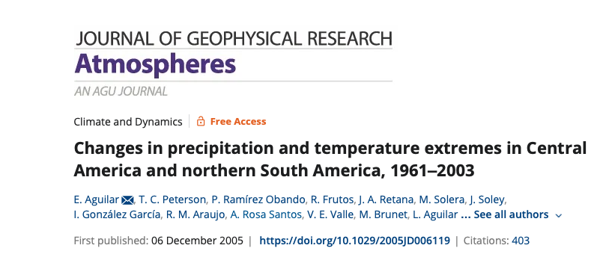
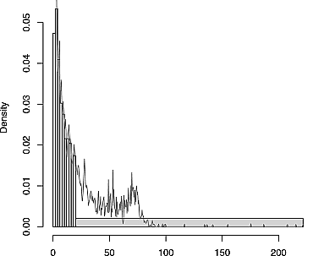
When things go wrong … the dangers of copy & paste …
Example of precipitation successful quality control procedures using R-Climdex. Histogram (vertical bars) and Kernel-filtered density (line), showing an unexpected high density around 70–80 mm. It was found that relative humidity was erroneously digitized instead of rainfall values. The participants were able to replace the wrong data by the correct observations immediately.
Notes:
(a) Minimum temperature (TN) time series of Progreso (Peru). Since 2003, a missing temperature interval between approximately −2 and +2 °C is observed. (b) Liquid‐in‐glass minimum thermometer at the station Progreso. Values to the right of the zero point are positive, to the left negative. The temperature must be read on the right side of the rod (slightly above +2 °C for the case shown). However, if the centre of the rod was below 0 °C, the observer erroneously read the temperature on the rod's left side. Hence, the length of the rod (corresponding to about 4.2 °C) determines the missing temperature range. [Colour figure can be viewed at wileyonlinelibrary.com].
IF THIS IMAGE HAS BEEN PROVIDED BY OR IS OWNED BY A THIRD PARTY, AS INDICATED IN THE CAPTION LINE, THEN FURTHER PERMISSION MAY BE NEEDED BEFORE ANY FURTHER USE. PLEASE CONTACT WILEY'S PERMISSIONS DEPARTMENT ON PERMISSIONS@WILEY.COM OR USE THE RIGHTSLINK SERVICE BY CLICKING ON THE 'REQUEST PERMISSIONS' LINK ACCOMPANYING THIS ARTICLE. WILEY OR AUTHOR OWNED IMAGES MAY BE USED FOR NON-COMMERCIAL PURPOSES, SUBJECT TO PROPER CITATION OF THE ARTICLE, AUTHOR, AND PUBLISHER.

Slide 6
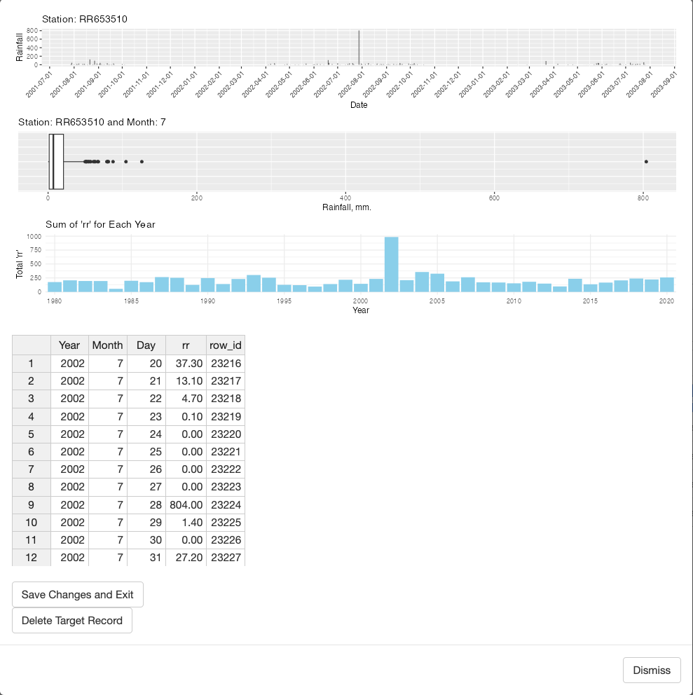
When things go wrong … pointless rainfall!
On July, 7th 2002, the daily accumulated rainfall in this Togolese station was registered omitting the decimal point. A rainfall of 80.4 mm was recorded as 804 mm. Graphical and numerical tests included in INQC and its GUI’ded version can detect these issues an act accordingly
Notes:
(a) Minimum temperature (TN) time series of Progreso (Peru). Since 2003, a missing temperature interval between approximately −2 and +2 °C is observed. (b) Liquid‐in‐glass minimum thermometer at the station Progreso. Values to the right of the zero point are positive, to the left negative. The temperature must be read on the right side of the rod (slightly above +2 °C for the case shown). However, if the centre of the rod was below 0 °C, the observer erroneously read the temperature on the rod's left side. Hence, the length of the rod (corresponding to about 4.2 °C) determines the missing temperature range. [Colour figure can be viewed at wileyonlinelibrary.com].
IF THIS IMAGE HAS BEEN PROVIDED BY OR IS OWNED BY A THIRD PARTY, AS INDICATED IN THE CAPTION LINE, THEN FURTHER PERMISSION MAY BE NEEDED BEFORE ANY FURTHER USE. PLEASE CONTACT WILEY'S PERMISSIONS DEPARTMENT ON PERMISSIONS@WILEY.COM OR USE THE RIGHTSLINK SERVICE BY CLICKING ON THE 'REQUEST PERMISSIONS' LINK ACCOMPANYING THIS ARTICLE. WILEY OR AUTHOR OWNED IMAGES MAY BE USED FOR NON-COMMERCIAL PURPOSES, SUBJECT TO PROPER CITATION OF THE ARTICLE, AUTHOR, AND PUBLISHER.

Slide 7
Quality Control
Detected Problem
Correct
Validate
Set to missing
Tolerate

Slide 8
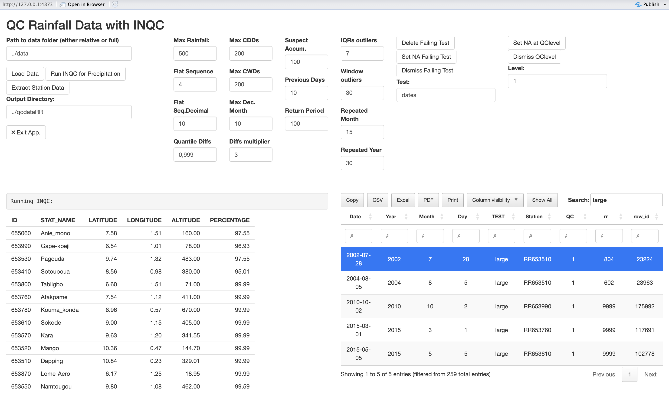
Quality Control
Interface to INQC tests (next slides)
Individual apps for rainfall, maximum and minimum temperatures
Inputs non-qc’d data, outputs qc’d data
Semi-automatic, adequate for small to mid sized networks
1: Wrong. Correct or set to missing value. Negative precipitation
3: Suspect: a statistical outlier. Validate, correct, set to missing with great caution. 70 mm, representing P75+4 IQR
2: Most likely wrong. Verify, correct, validate, set to missing. 300 mm precipitation.
4: Correct value but collectively suspect. Only act if it is very clear. (For example, 20 consecutive values with 0.5 mm)

Slide 9
QC tests for precipitacion data (I)
Label | Parameter (default) | Meaning (Category)
large | Max Rainfall (500) | If a precipitation value exceeds the specified value, it is labeled as wrong (1)
small | Non-parameterizable(0) | If a precipitation value does not reach this value, it is labeled as wrong (1)
dryseq | Max CDDs (200) | Maximum number of dry days allowed. If a sequence exceeds it, all values involved are labeled(4)
wetseq | Max CWDs (200) | Same for wet days(4)
susacum | Suspect Accum (100) + Previous Days (10) | If we find a precipitation value equal to or greater than the first preceded parameter of a number of days equal to or greater than the second parameter, it is considered as potential accumulation over different days (2)
iqrout | IQR Outliers (7) + Window outliers (30) | Outliers determined as exceedance of P75/P25 +/- the number of IQRs determined by the first parameter, using a window of days around the day evaluated dimension determined by the second parameter(3)

Slide 10
QC tests for precipitacion data (II)
Label | Parameters (default) | Meaning (Category)
flat | Flat Sequence (4) | If a number of consecutive days is located with identical precipitation value (excluding 0.0) greater than that determined by the parameter, the entire sequence is labeled(4)
flatfloat | Flat Seq. Decimal (10) | Same as above, but only for the decimal part: 5.4 and 4.4 share sequence(4)
toomonth | Repeated Month (15) | If a value repeated the times indicated by the parameter is detected, excluding 0.0, the sequence is labeled(4)
tooyear | Repeated Year (30) | Same, for a whole year (4)
pareto | Return Period (100) | Outliers to a fitted Pareto distribution (3)
roundprec | Non-parameterizable(10) | If 10 values are found in a row with the same decimal, the sequence is labeled(4)

Slide 11
QC tests for temperature data
Label | Parameters (default TX/TN) * | Meaning (Category)
large | Max Val (60/40) | If a temperature value exceeds the specified value, it is labeled as wrong (1)
small | Min Val (-10/-20)* | If a temperature value does not reach this value, it is labeled as wrong (1)
jumpsABS | ABS jump (15) | Maximum interday difference allowed (2)
jumpsQUANT | QUANT jump (0.999) /Quant Multiplier (2) | After computing al interdiurnal diffs., it calculates the quanile specified by the frist paremeter times the second parameter and labels all exeeding differences (2)
newfriki | No parametritzable | Calculates the differences between consecutive extreme values of the empirical distribution. If they exceed q .999, label them. (2)
txtn | No parametritzable | Label cases where tx < = tn(1)
Tests flat, flatfloat, toomonth, tooyear, rounding are present with the same meaning as described in precipitation. In temperature, 0.0 is not excluded
* Defaults might be changed in the code according to different world regions
.

Slide 12
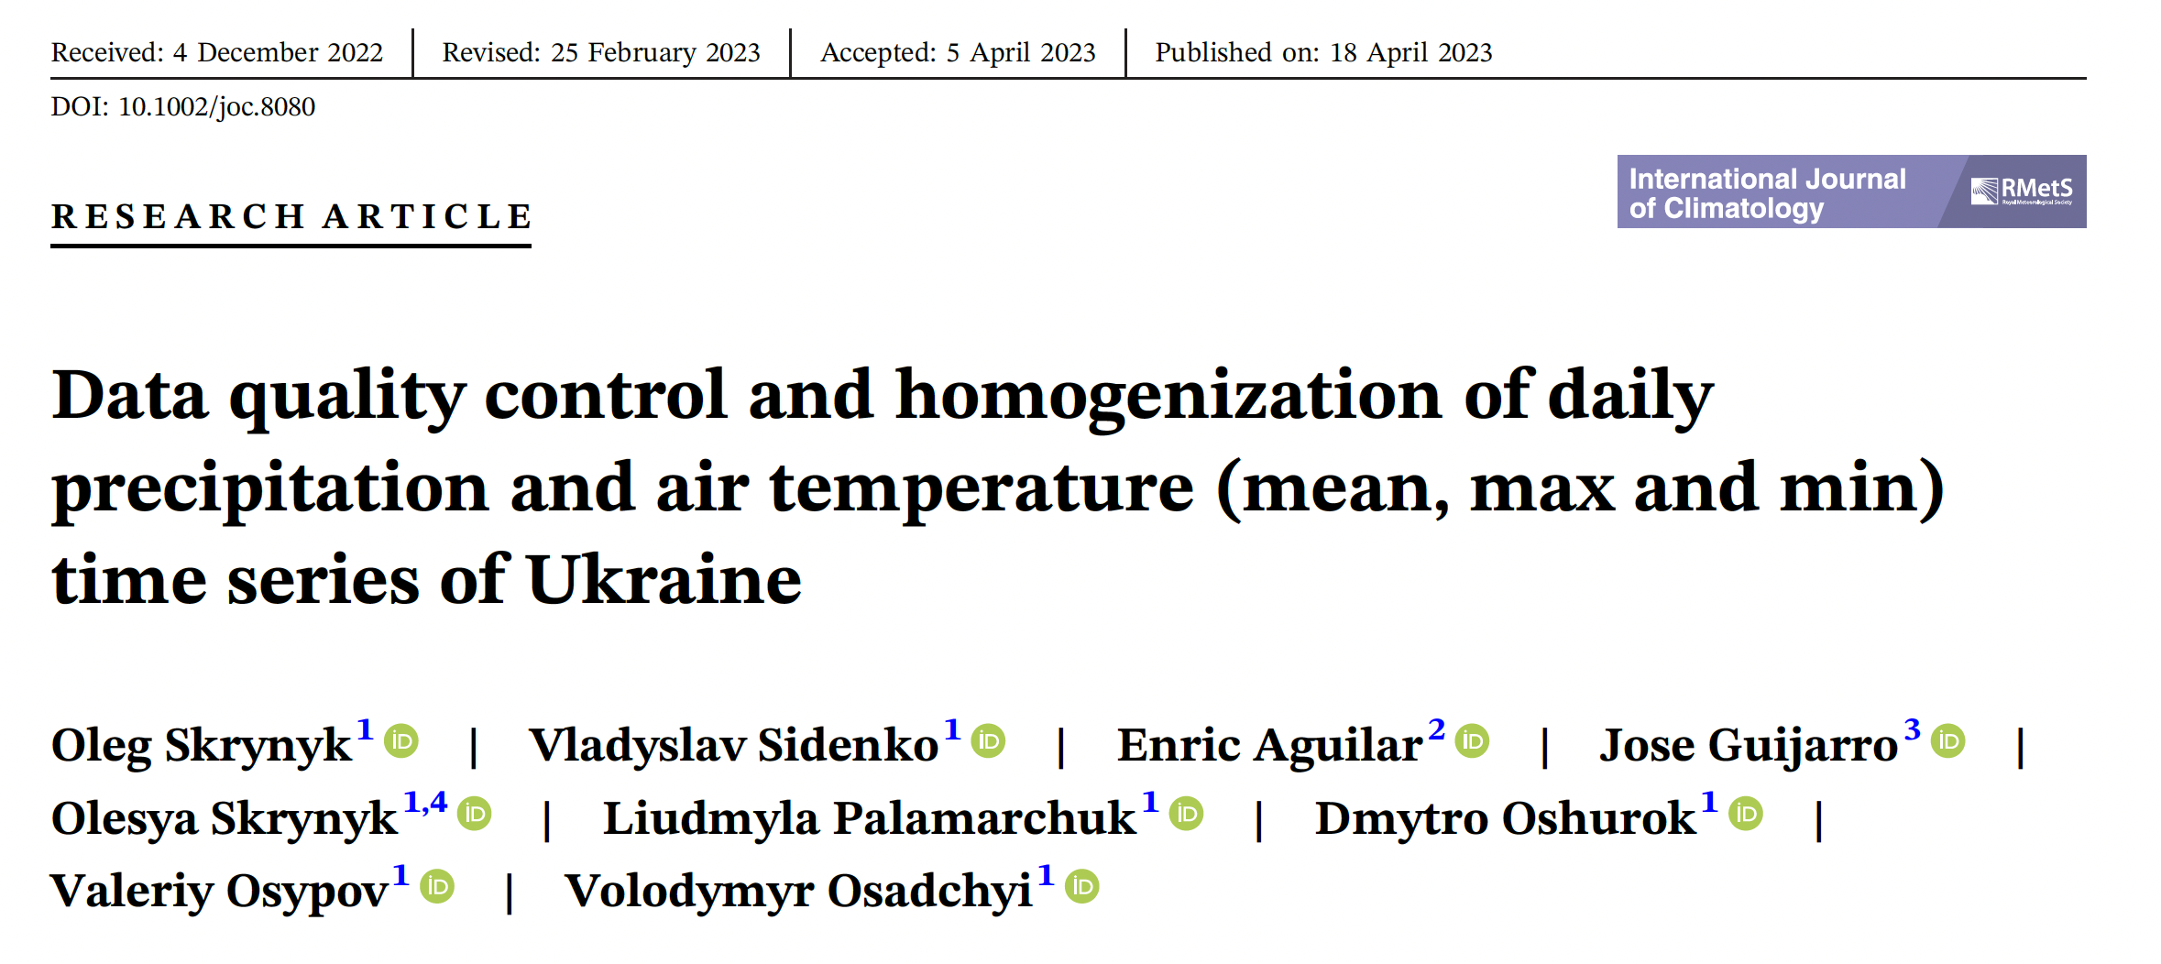
Aplication to Ukranian Stations

Slide 13
Thanks for your attention. Any questions?

