Slide 1
Climate Services for Intangible Heritage. Human Towers in Catalonia
Anna Boqué, Jon Olano and Òscar Saladié
ClimEd 4th Training
Faculty of Tourism and Geography - URV
9th May 2024

Slide 2
Content
1
Background
2
Objectives
3
Methodology
4
Results
5
Conclusions

Slide 3
1. Background
GGH concentration - ERB
CLIMATE CHANGE
IMPACTS ON CONTRIBUTION TO
SOCIOECONOMIC ACTIVITES

Slide 4
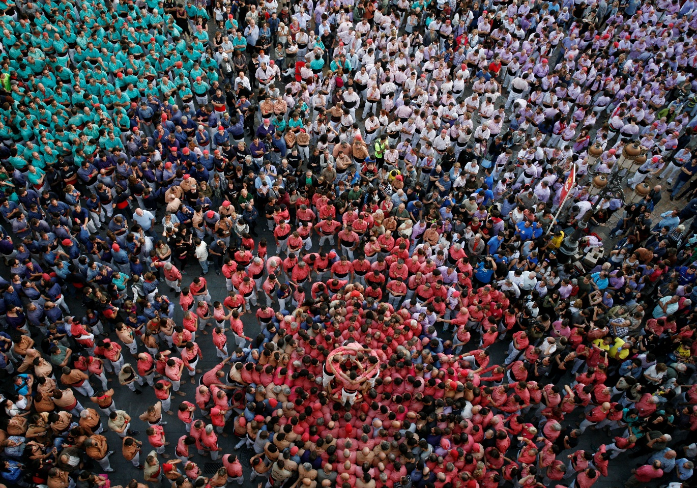
1. Background
OUTDOOR ACTIVITES
HUMAN
TOWERS
INTANGIBLE HERITAGE
Source: Pere Toda
https://www.google.com/search?client=firefox-b-e&sca_esv=7fd248ba2150affe&sca_upv=1&sxsrf=ADLYWIJQzmWczsIFE6vfWlyx_XfbQ2-0Cw:1715084669461&q=DIADA+CASTELLER+DE+SANT+FELIX+VILAFRANCA&tbm=vid&source=lnms&prmd=invbz&sa=X&ved=2ahUKEwi0lu6jxPuFAxW8VKQEHZ4cA1UQ0pQJegQICxAB&biw=1280&bih=595&dpr=1.5#fpstate=ive&vld=cid:e6438f21,vid:qi5i9ewp-do,st:0
1h37 a 1h41’’

Slide 5
2. Objectives
Analyzing temperature trend during selected Human Tower exhibitions over the last 70 years.
2) Determining the best/worst weather conditions.
3) Proposing adaptative measures.
4) Analyzing weather conditions during exhibitions.
5) Co-creating climate service

Slide 6
3. Methodology
O1: ERA5 LAND reanalysis / Copernicus
O2 and O3: workshop with “castellers”
O4: temperature - relative humidity sensors
O5

Slide 7
4. Results
O1
Valls – 24th June – 12/15h

Slide 8
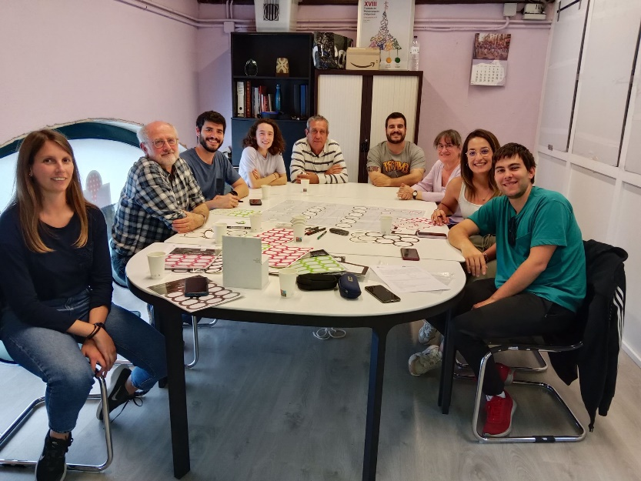
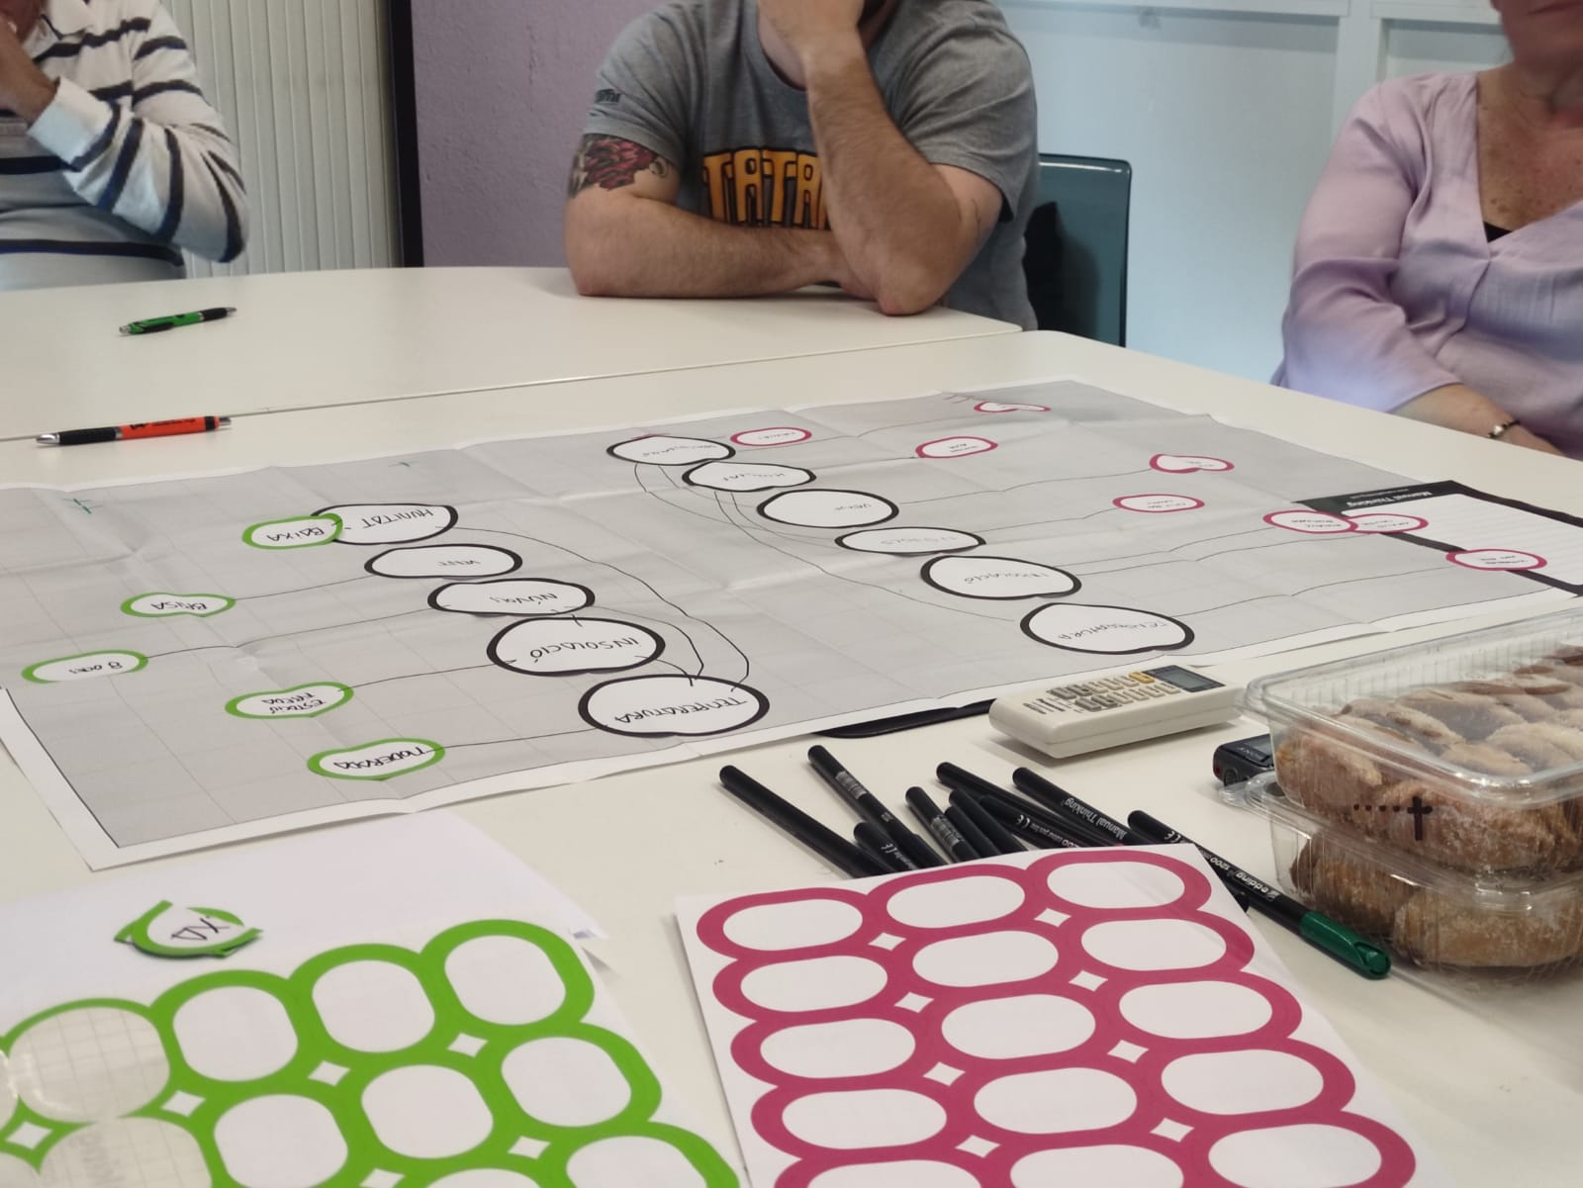
4. Results
O2 & O3
1st Workshop – Tarragona / 8th May 2024
Colla Joves Xiquets de Tarragona

Slide 9
5. Conclusions
We (will) establish temperature ranges linked to good or adverse conditions for the human tower exhibitions by means of participatory processes with the castellers. Engaging directly with the casteller groups in participatory processes will provide invaluable first-hand insights into the perception of the effect of weather conditions on building human towers and the negative impact of climate change that leads to an increase in the frequency of adverse meteorological events on human-tower exhibitions.
We (will) design, prioritize, and execute in a co-creation process the required strategies to adapt exhibitions to new climate conditions. This can include developing health-and-safety guidelines, instituting emergency-response protocols, generating shadows in the square, and modifying the exhibition duration and schedule.

Slide 10
5. Conclusions
We (will) determine real weather conditions before, during, and after human tower exhibitions in the squares. This will also allow us to model the past weather conditions in the squares and make projections.
Main goal: to prioritize participant safety while striving to preserve the rich cultural heritage and identity that these festivals embody; this goal will only be achieved with the cooperation of castellers, the organizers of human-tower exhibitions, and policymakers by emphasizing the importance of anticipating the impact of climate change.

Slide 11
Climate Services for Intangible Heritage. Human Towers in Catalonia
Anna Boqué, Jon Olano and Òscar Saladié
ClimEd 4th Training
Faculty of Tourism and Geography - URV
9th May 2024

