Slide 1
619285-EPP-1-2020-1-FI-EPPKA2-CBHE-JP Multilevel Local, Nation- and Regionwide Education and Training in Climate Services, Climate Change Adaptation and Mitigation
Relationship between climate and agriculture
(cultivation of winter wheat)
Tetyana Dyman, Olena Barsukova, Nataliia Vovkotrub, Oksana Volvach
10 May 2024. ClimED 4th Training

Slide 2
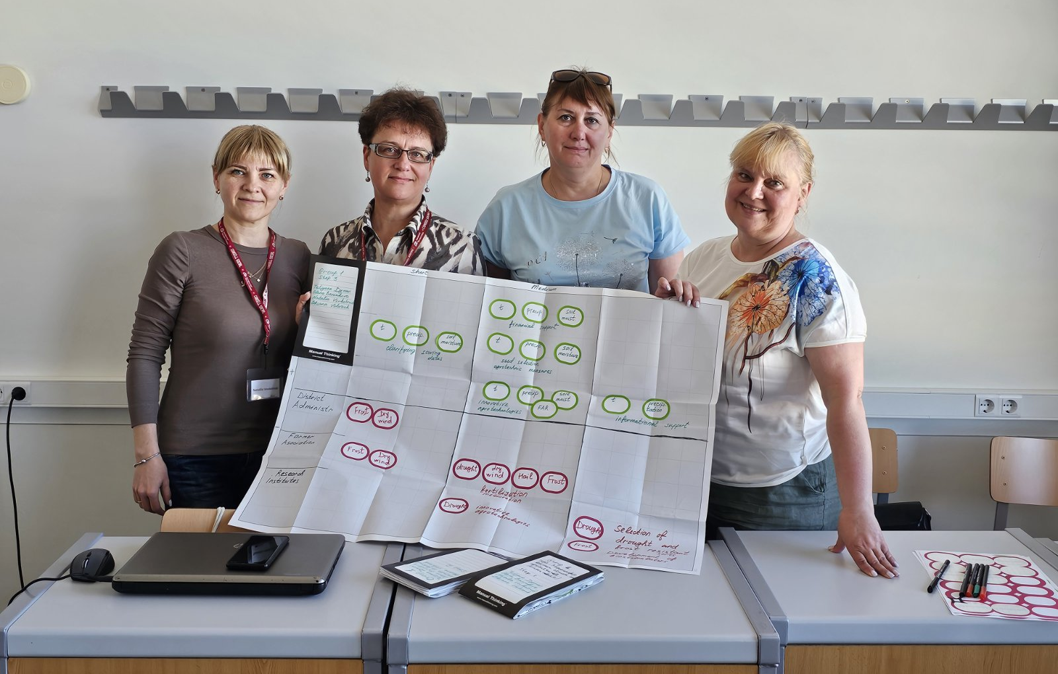
Presentation of the group
Name | Affiliation | Position
Tetyana Dyman | BTNAU, Ukraine | Dr. Sci., Prof.
Olena Barsukova | OSENU, Ukraine | PhD, Ass. Prof.
Nataliia Vovkotrub | BTNAU, Ukraine | PhD, Ass. Prof.
Oksana Volvach | OSENU, Ukraine | PhD, Ass. Prof.

Slide 3
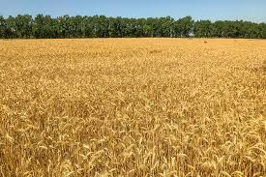
Topic of the working group
Agriculture, cultivation of winter wheat
Wheat is a valuable crop which determines the food security.
Winter wheat is the leading crops in Ukraine in terms of exports and cultivated areas. It accounts for 10% of total global exports. Last year 6.4 million ha were planted to winter wheat.
Soil-climatic conditions in Ukraine are favorable for winter wheat growing.

Slide 4
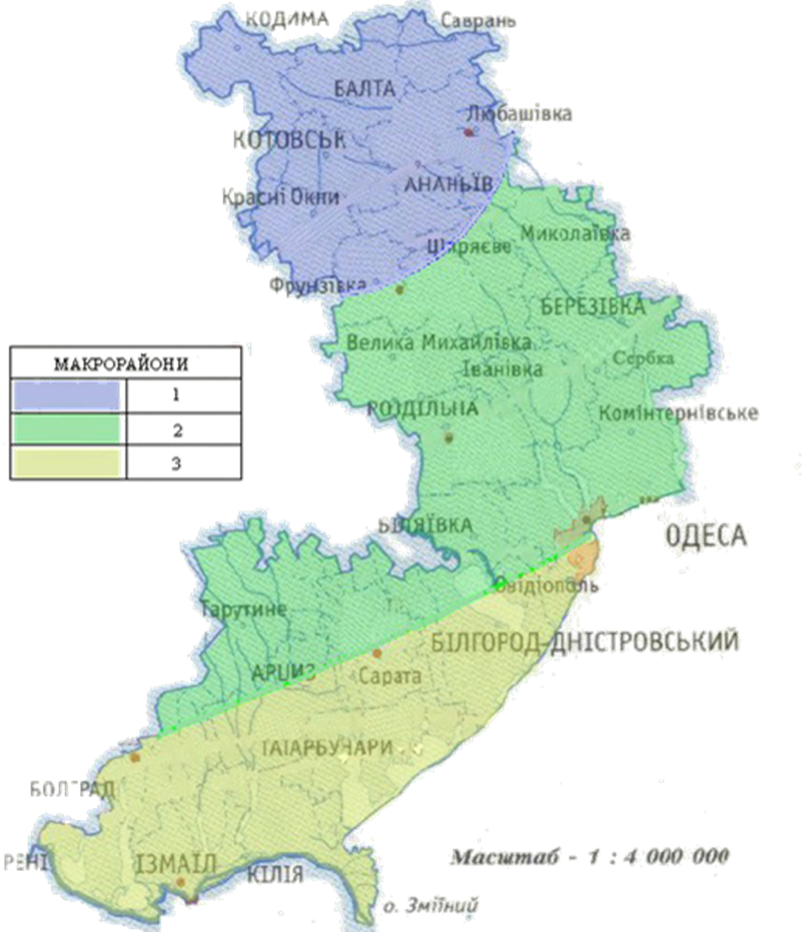
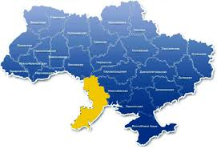
Region of study: Odesa region, Southern Ukraine
The main problem for agriculture in Odesa Region in the context of current climate change is the increase of aridity.

Slide 5
Indicator proposal
Description of the indicator
Temperature (Σt = 2870 ⁰C)
Precipitation
PHAR
Data needed to compute the indicator
1. Temperature conditions:
Average daily soil temperature (at the depth of seed placement) 4-6°C
T_{opt} for germination - 10°C (< 4°C and >12°C)
T_{opt} for leaf development - 14^{о}С (< 12 and > 16 ° C)
T_{opt} for crop maturation - 20^{о}С (< 16°C and > 25°C)
2. Radiation conditions:
Sum of photosynthetic active radiation - 29.2 MJ/m²
3. Total precipitation during the growing season - 650 mm (< 600 mm and > 700 mm)

Slide 6
According to the Ukrainian Hydrometeorological Centre and on the recommendation of the World Meteorological Organisation, aridity in Ukraine is assessed using the Selianinov Hydrothermal Coefficient (HTC),

Slide 7
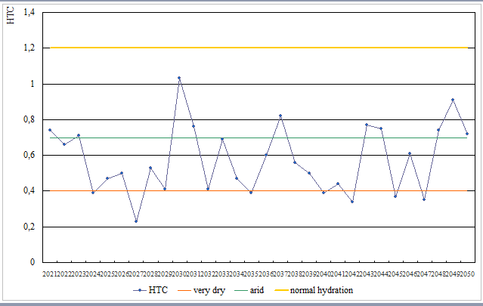
HTC Forecast till 2050

Slide 8
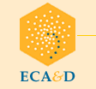
Indicator proposal
Location of the data to compute the indicator
Ukrainian Hydrometeorological Service
ECA&D - European Climate Assessment & Dataset
http://www.fao.org/nr/water/cropinfo_wheat.html
Possible end users of the indicator
Research institutes
State territorial administration
Farmer associations
Location of the data to compute the indicator
Ukrainian Hydrometeorological Service
ECA&D - European Climate Assessment & Dataset
http://www.fao.org/nr/water/cropinfo_wheat.html
Possible end users of the indicator
Research institutes
State territorial administration
Farmer associations

Slide 9
Channels for communication
Face to face
Round tables, workshops, conferences, consultations
Virtually
Website, e-mail, social-media (WhatsApp, Viber, Facebook, Telegram), newsletters, guidelines, information posters

Slide 10
Conclusions
All the lessons were useful and interesting.
We will use acquired competences in the educational process on different study programs in our universities.
Thank you for attention!

