Slide 1
619285-EPP-1-2020-1-FI-EPPKA2-CBHE-JP Multilevel Local, Nation- and Regionwide Education and Training in Climate Services, Climate Change Adaptation and Mitigation
Green Infrastructure in Odesa, Ukraine
Group D2: Halyna Borovska, Kateryna Husieva, Ivan Tymchuk, Andriy Sereda
6 May 2024. ClimED 4th Training

Slide 2
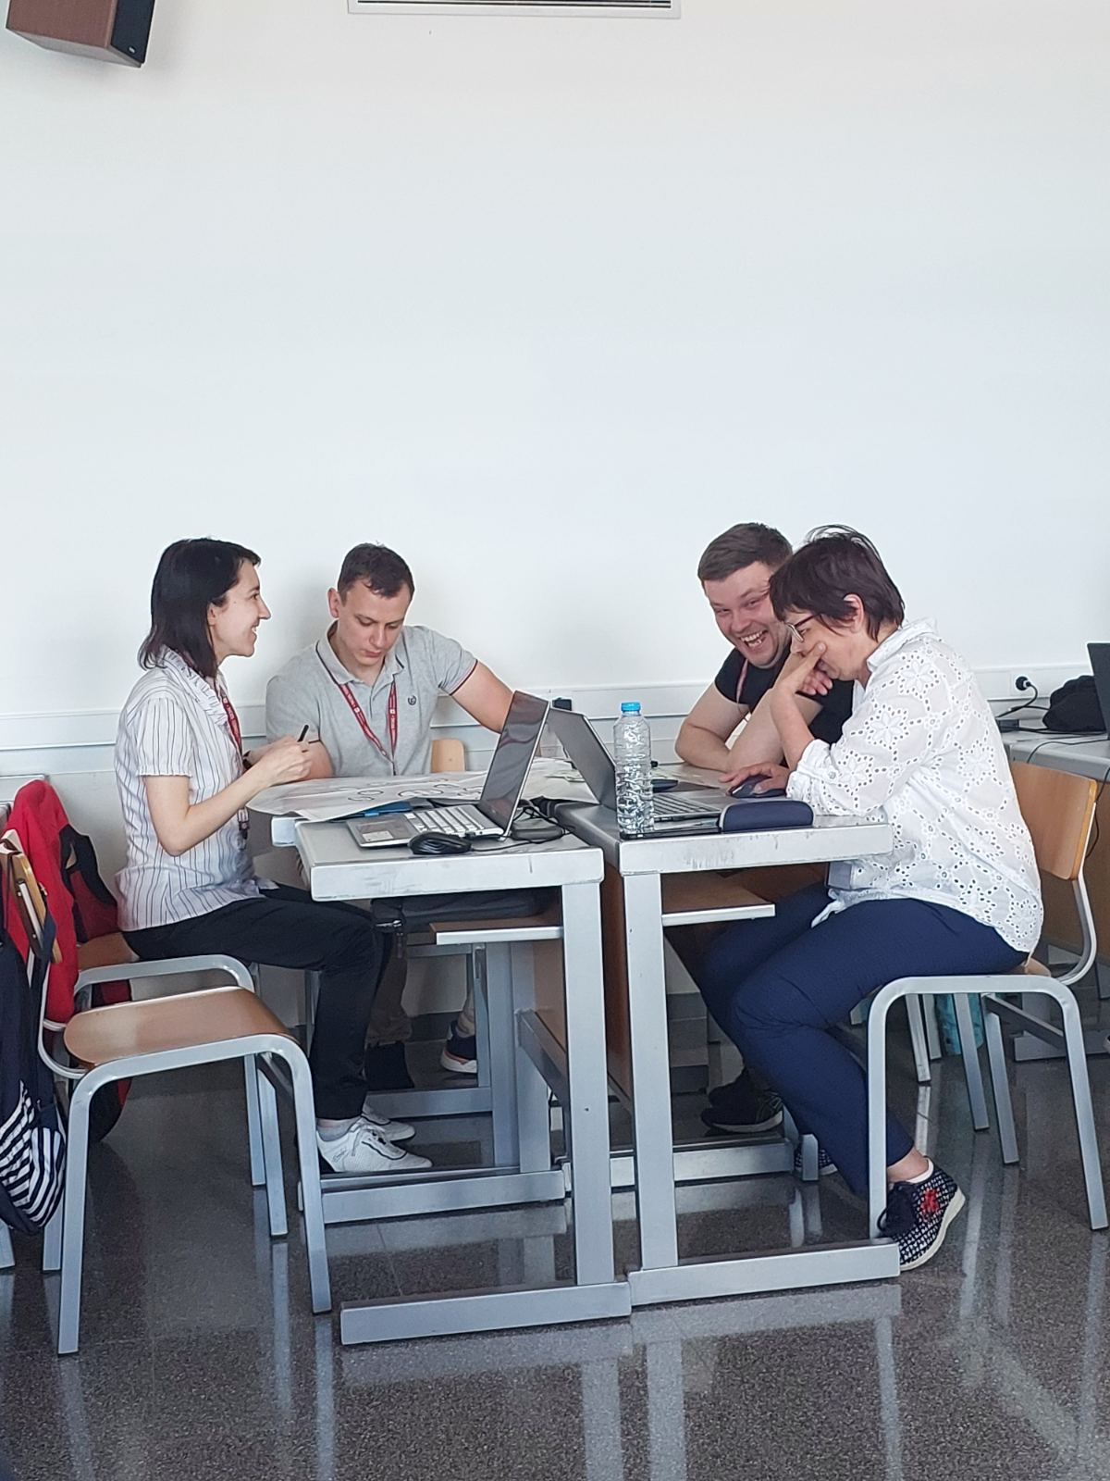
Presentation of the group
Name | Affiliation
Halyna Borovska | OSENU | bga6319@gmail.com
Kateryna Husieva | OSENU | kate.gusyeva@gmail.com
Ivan Tymchuk | LPNU | i.s.tymchuk@gmail.com
Andriy Sereda | LPNU | seredaa92@gmail.com

Slide 3
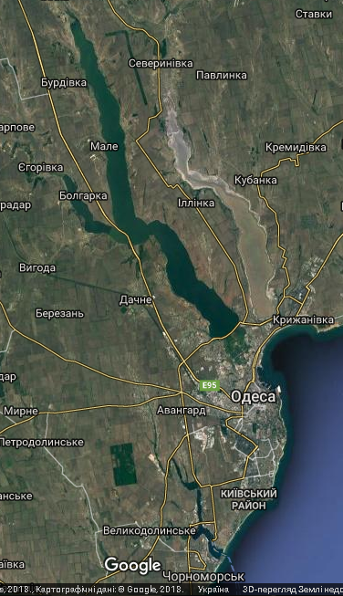
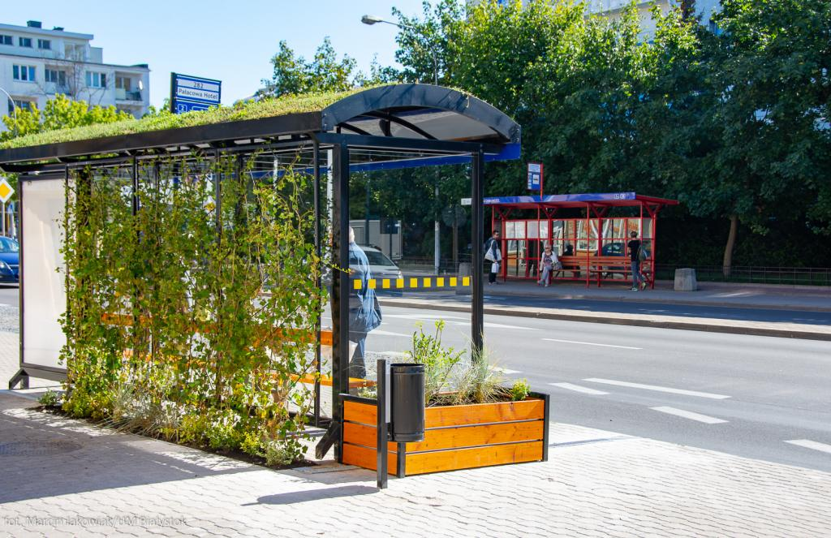
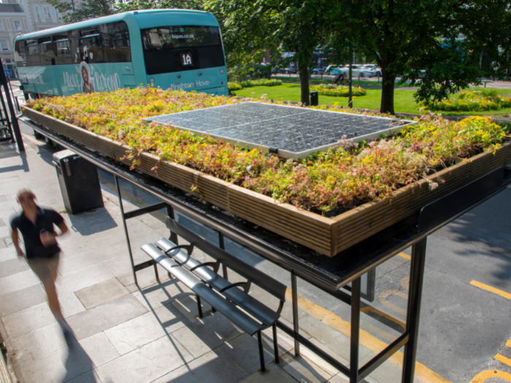
Topic of the working group
Topic: Green Infrastructure: Green Stop of Public Transport
Region of study: Odesa, Ukraine
https://www.themayor.eu/en/a/view/the-green-stops-in-bialystok-receive-architecture-recognition-5142
https://www.brighton-hove.gov.uk/news/2021/brighton-hove-bee-bus-stop-first-south-england

Slide 4
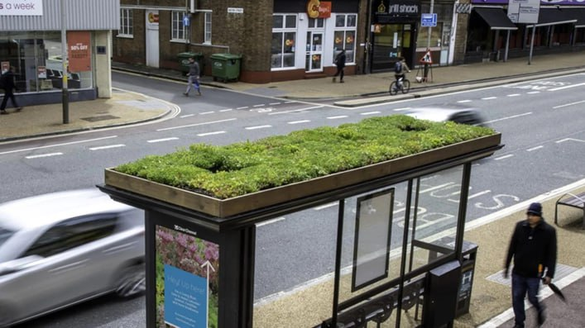
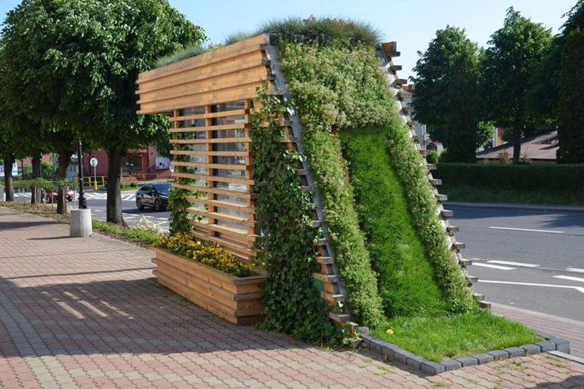
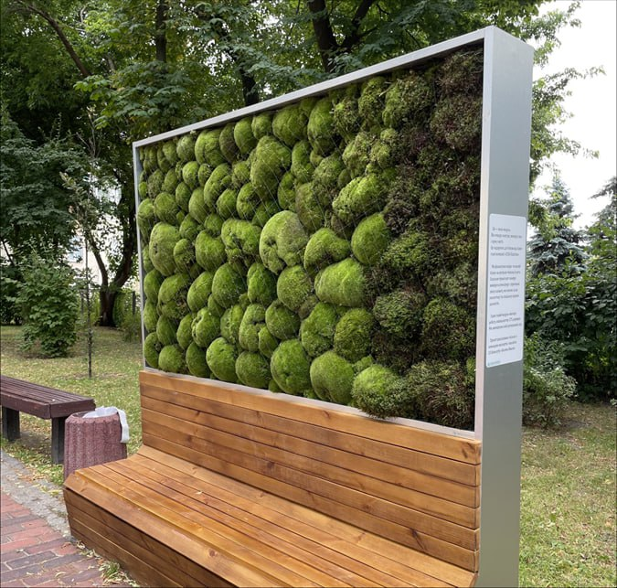
Topic of the working group
Examples of green stops: visualization

Slide 5
Indicator proposal
With the current process of climate change, Ukraine is expected to face major challenges in order to adapt to and mitigate the consequences of severe weather conditions (e.g. heat and cold waves, floods, droughts, wildfires and windstorms).
The urban climate often differs from the surrounding rural countryside as it is generally more polluted, warmer, rainier and less windy.
Green infrastructure solutions such as green roofs, rain gardens and green stops have been shown to reduce local flooding, economical loss and discomfort at storm events with medium or frequent return periods.

Slide 6
Indicator proposal
Description of the indicator: Green Stop. The effect of climate change with the predicted increase in temperature and decrease in precipitation will be experienced to a greater extent in urban areas compared to the surrounding landscape. The urban temperature is dependent on global development but is in general highly influenced by, e.g. the urban heat island effect.
Data needed to compute the indicator: Temperature and Precipitation
Location of the data to compute the indicator: www.ecad.eu, https://open-meteo.com/, https://wisemeteo.com and www.yr.no
Possible end users of the indicator: City administration, Transport enterprises, etc.

Slide 7
STEP 1
Negative Influence
Air humidity
Soil moisture
Global warming
CO₂ emissions
Global warming
Precipitation
Min Temperature
Acid rains
High air humidity
GREEN INFRA-STRUCTURE
Hazardous weather events
Urban area
Soil erosion
Max Temperature
Mean Temperature
Aridity of climate
New introductive species
Solar radiation
Positive Influence

Slide 8
STEP 2
Climate aridity
High air humidity
Heavy weather (Frost, hale)
Rain
less 20 mm/hour
Urban heat island
Duration of solar shining

Slide 9
Indicator proposal
The name of the indicator: Green Stop
The variables that build the indicator: Temperature and Precipitation
The weight of the variables: Wt = 0.5, Wp = 0.5
The categories of the variables: Min t, Max t, Mean t, Precipitation

Slide 10
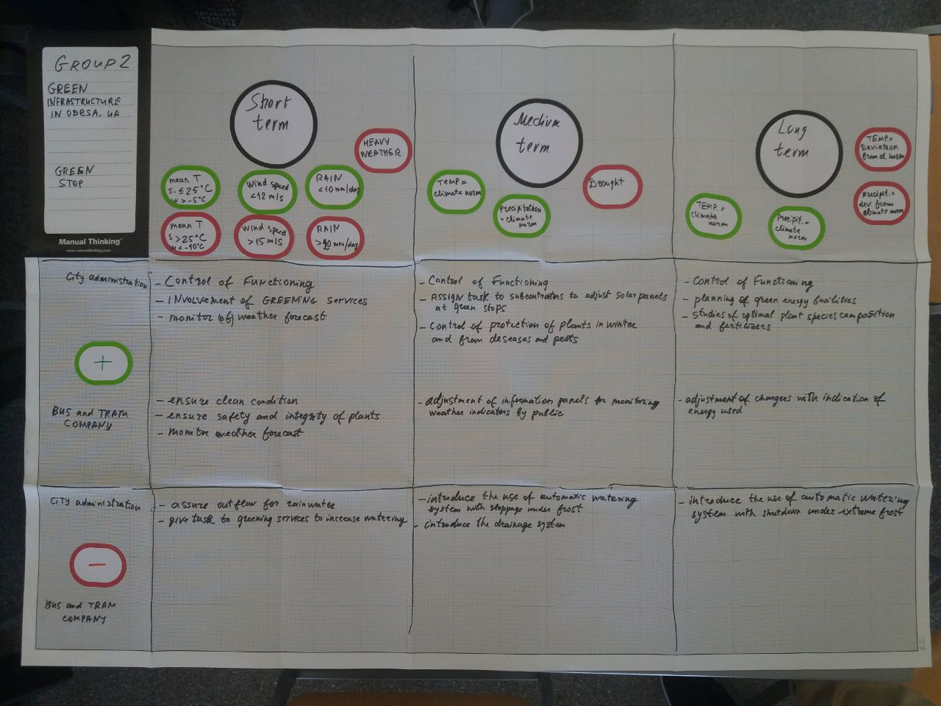
STEP 3
Conditions that benefit
Conditions taht harm

Slide 11
Number of the variable | Name of the variable | Definition | Unit of Measurement | Range | Value | Ponderation (in case that is needed) | Indicator (in case it is needed) | Source of the data
GS 1 | Temperature | Air temperature | Cº | <-10 Cº | 0 | -- | Conditions | YR.NO meteo.gov.ua Wisemeteo open-meteo
 |  |  |  | -10 ... 10 Cº | 1
 |  |  |  | 10 ... 25 Cº | 3
 |  |  |  | 25 ... 35 Cº | 1
 |  |  |  | >35 Cº | 0
GS 2 | Precipitation | Precipitation | mm/month | <3 | 0 | -- | Conditions | YR.NO meteo.gov.ua Wisemeteo open-meteo
 |  |  |  | 3 ... 10 | 2
 |  |  |  | 10 ... 50 | 4
 |  |  |  | 50 ... 100 | 2

Slide 12
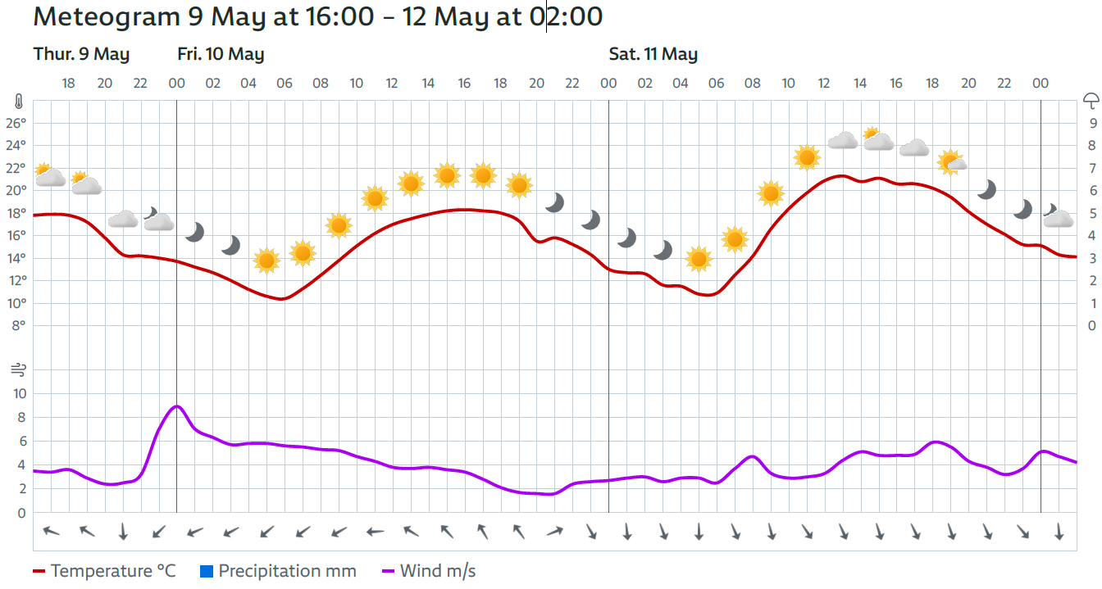
Short-term parameters
https://www.yr.no/en/print/forecast/2-698740/Ukraine/Odessa/Odeskyi%20Raion/Odesa

Slide 13
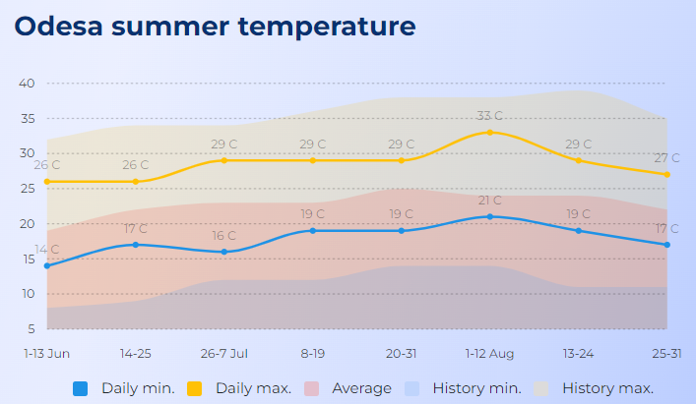
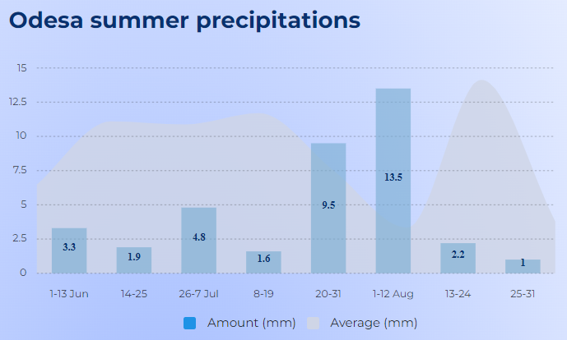
Medium-term parameters
Summer weather of 2024 is predicted to be stable, cold with precipitation deficit. Average temperature is expected to be lower by 1°C than in 2023 season - around 23°C. Seasonal average precipitation expected is about 4 days, mostly occurring in July. Typical summer starts on 1st June, the temperature will change up to 23°C. [https://wisemeteo.com/en/country/ukraine/region/odessa-oblast/city/odesa/season/summer]

Slide 14
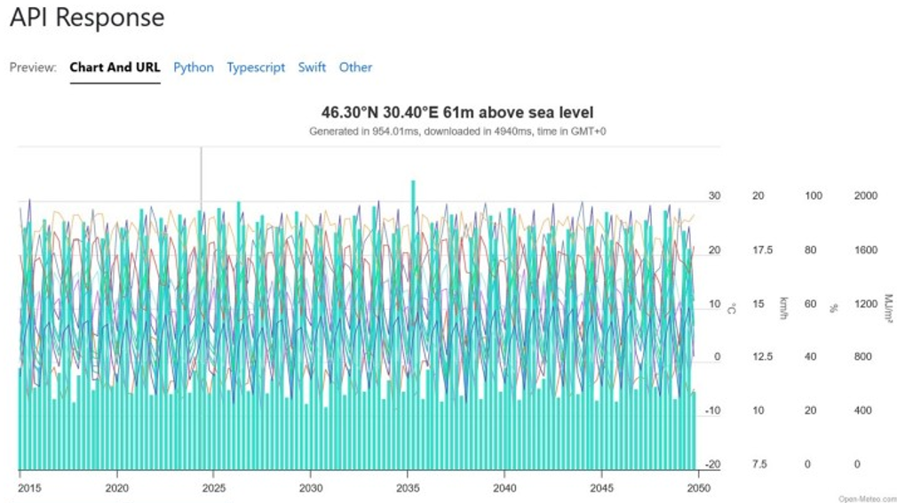
Long-term parameters
https://open-meteo.com/

Slide 15
Communication proposal
The main users of the CS: public transport users (commuters), local population
The channel for communication the CS: a dedicated website, app, external advertisements
The format to communicate the CS: simple language, maps, pictures, figures

Slide 16
Communication proposal
The value proposition for CS:
Green stops increase attractiveness of an urban space, stimulate people to use public stops, rise climate awareness and promote sustainability. Moreover, they reduce air temperature, ensure filtration of air pollutants, absorption of CO₂, contribute to improvement of human physical and mental health, as well as provide cultural benefits and inspiration

Slide 17
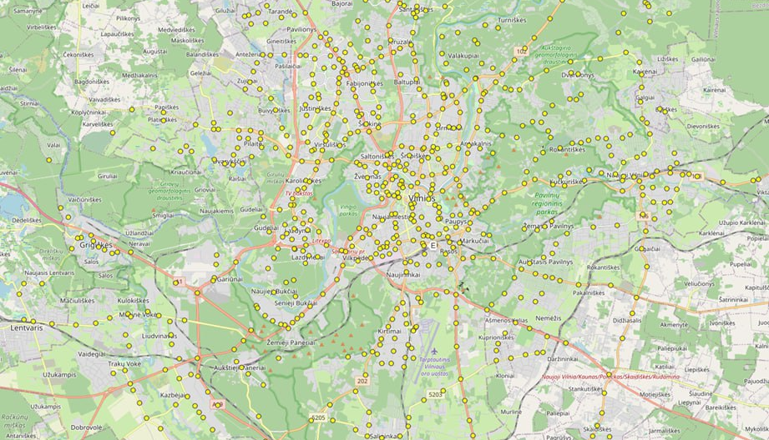
The mock-up of the website
The main attributes should include:
the header: Green Stop of Public Transport in Odesa
the slider
figures for energy efficiency
maps of green stop network
recommendations for climate change adaptation
contacts of CS providers

Slide 18
Future needs
There is a need to create new working network for building and design of green stops in various Ukrainian cities
For control of functioning of the green stops to be built, there is a need for short-term and seasonal weather forecasts
There is a need to create new projects to develop the green stop network in Odesa and Lviv in the near future for the call such as Climate Change Adaptation (LIFE-2024-SAP-CLIMA-CCA), with involvement of 40% of city budget costs

Slide 19
Conclusions
This week course made it possible for us to learn:
a retrieval of climate data from various sources
the needs of different users of climate services
identification of the climate indicator
the use of various communication channels
experience exchange in a team
joint creation of mind maps
More training materials and open databases would be useful for future developments in the topic

Slide 20
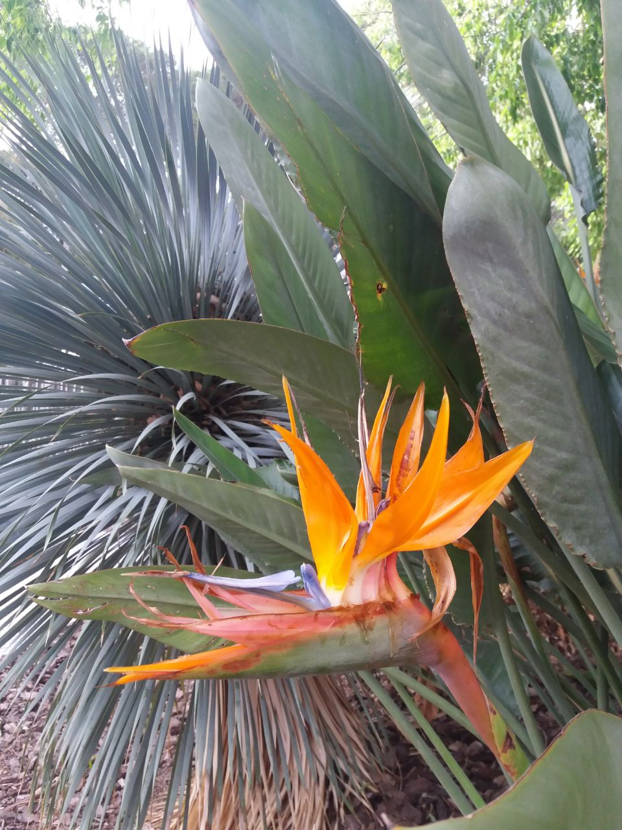
Thank You very much for Your kind attention!

