Slide 1
619285-EPP-1-2020-1-FI-EPPKA2-CBHE-JP Multilevel Local, Nation- and Regionwide Education and Training in Climate Services, Climate Change Adaptation and Mitigation
URBAN PLANNING. GREEN ROOFTOPS IN THE “KM ZERO CONCEPT”
on the example of Odesa city, Ukraine
Inna Khomenko, Alona Perebynos, Yuliia Bereznytska, Olena Verenych
10 May 2024. ClimED 4th Training

Slide 2
Presentation of the group
Name | Affiliation
Inna Khomenko | Odesa State Environmental University (Odesa, Ukraine)
Alona Perebynos | Kyiv National University of Construction and Architecture (Kyiv, Ukraine)
Yuliia Bereznytska | Kyiv National University of Construction and Architecture (Kyiv, Ukraine)
Olena Verenych | Kyiv National University of Construction and Architecture (Kyiv, Ukraine)

Slide 3
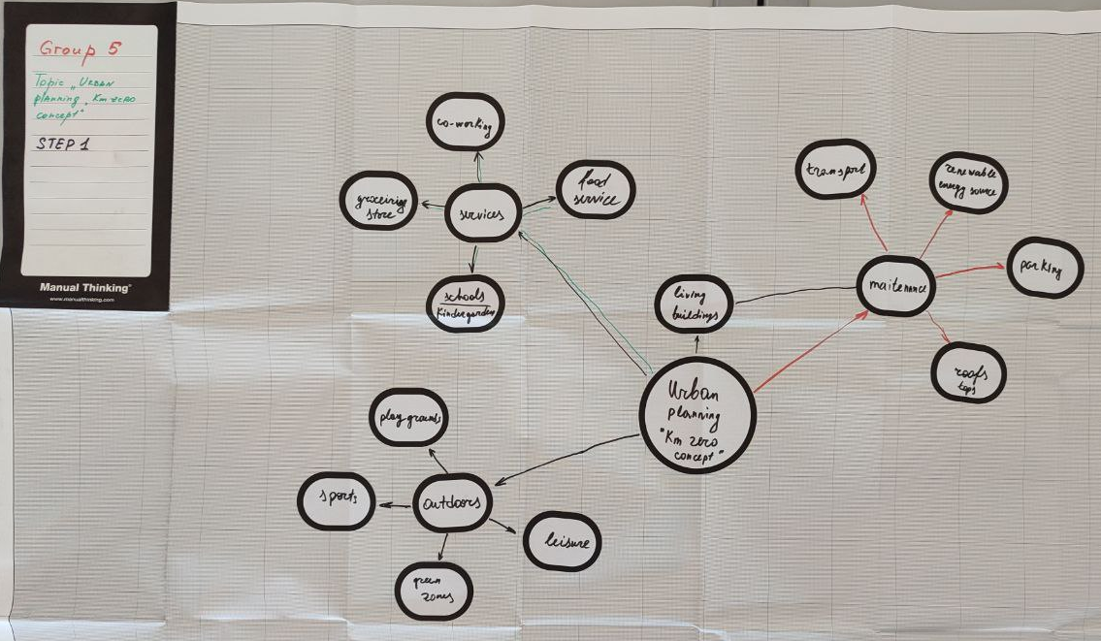

Slide 4
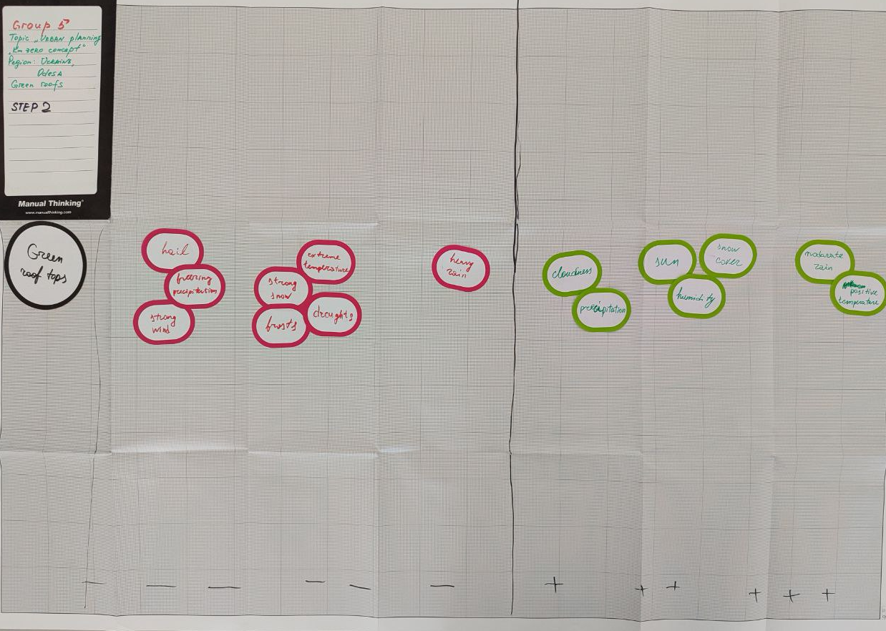

Slide 5
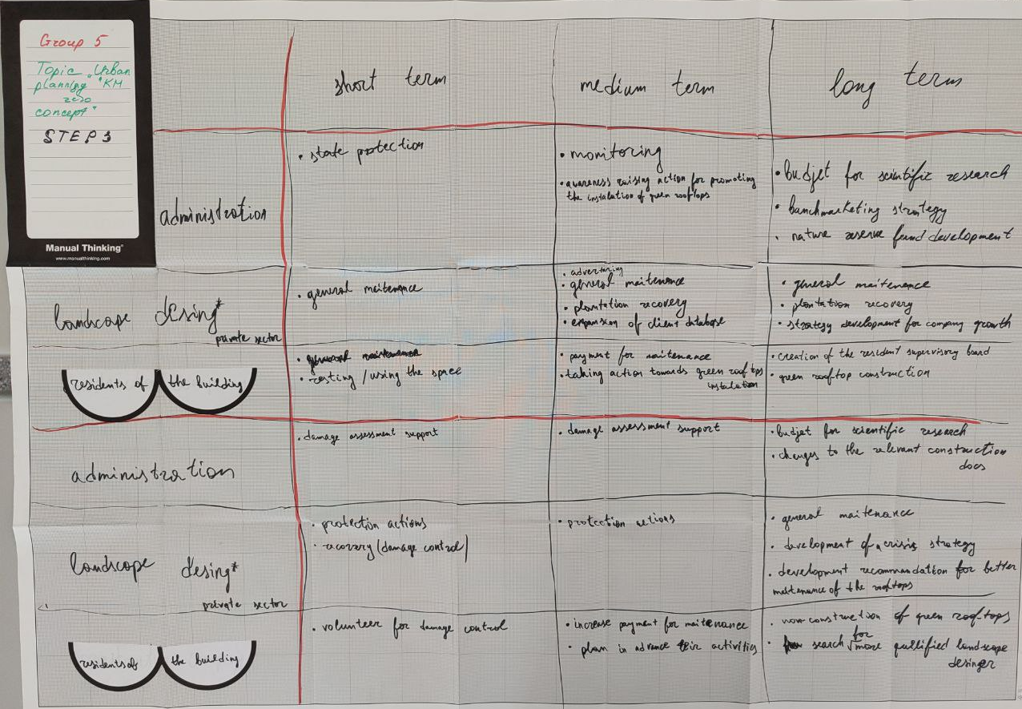

Slide 6
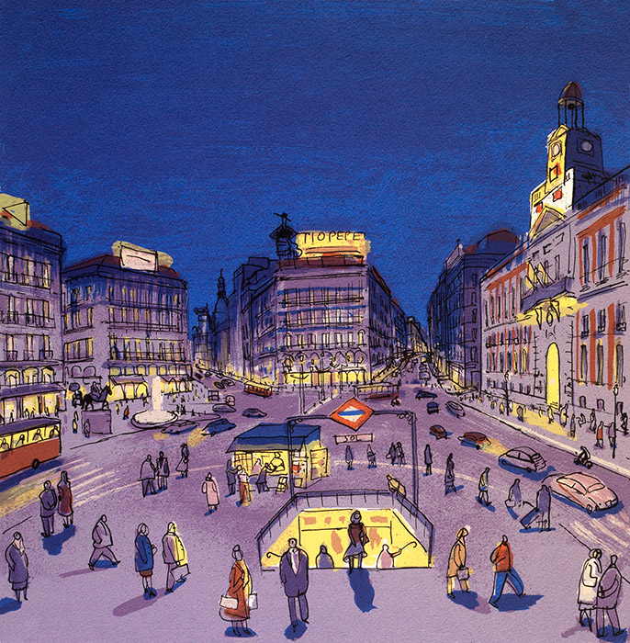
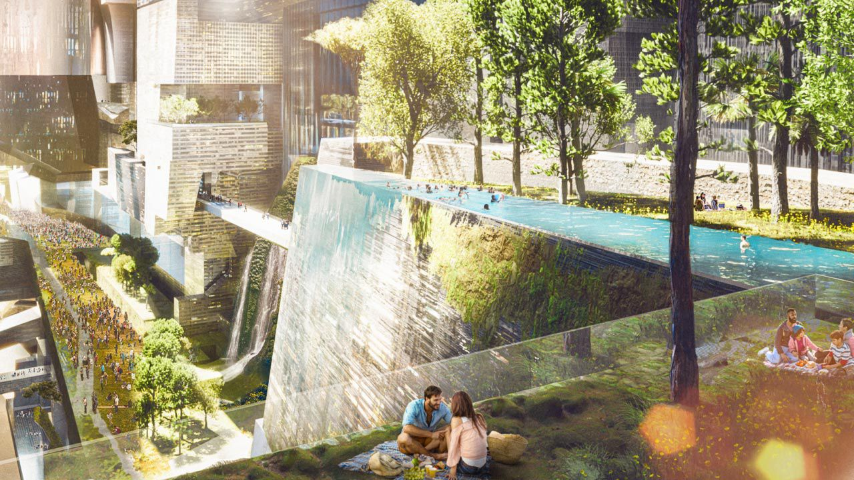
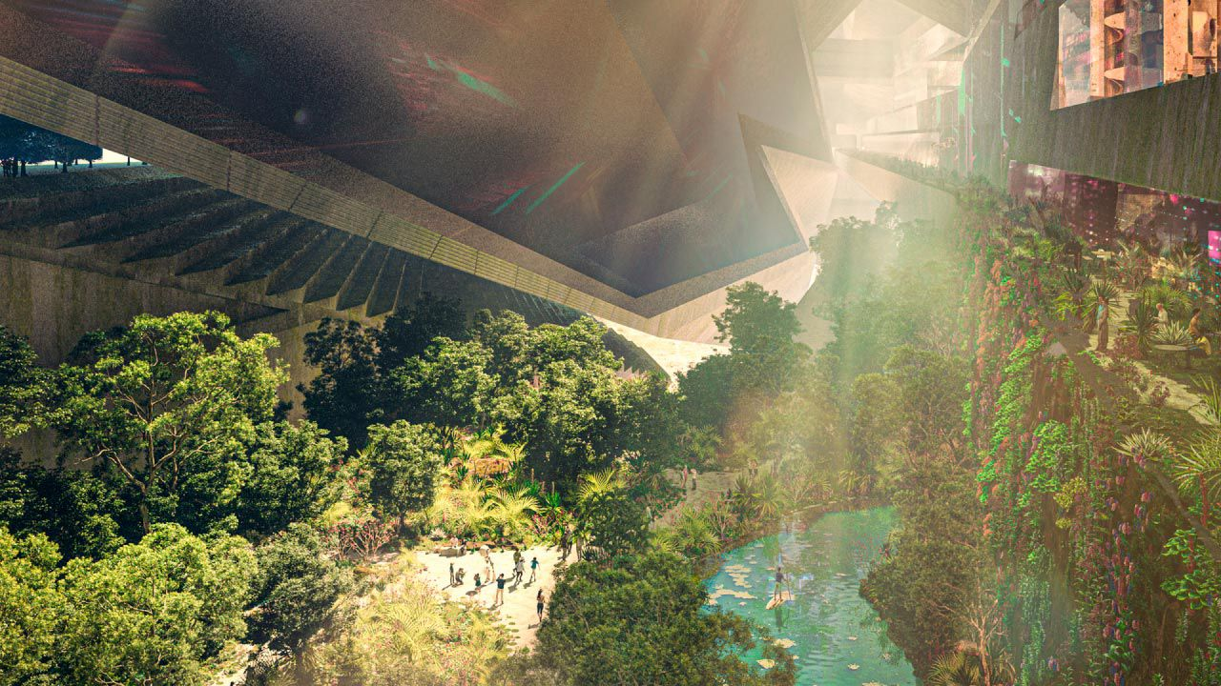
Topic: Urban planning “Km zero concept”
Region of study: Odesa city, Ukraine

Slide 7
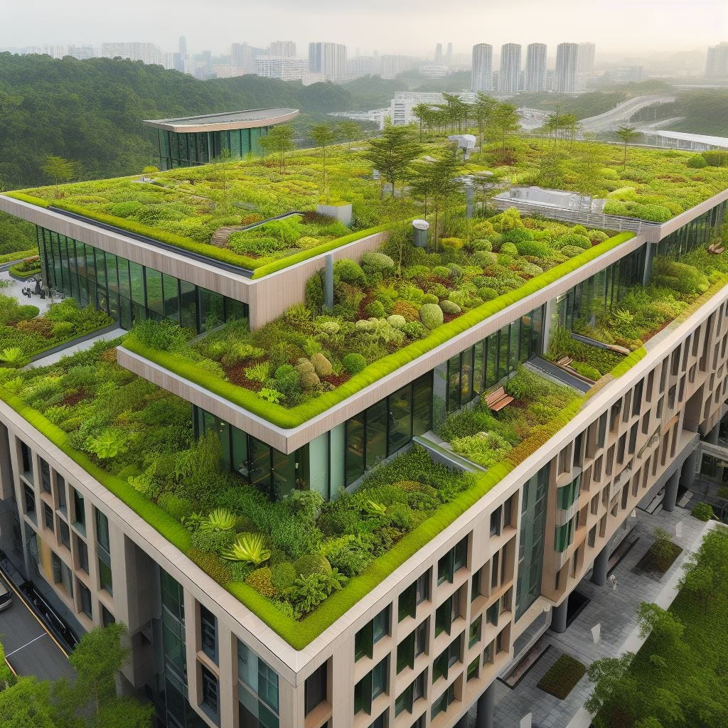
Indicator proposal
Description of the indicator: the indicator that characterizes the possibility of building green rooftops in residential buildings of the "zero kilometer" type concept
Data needed to compute the indicator: temperature, precipitation, wind speed

Slide 8
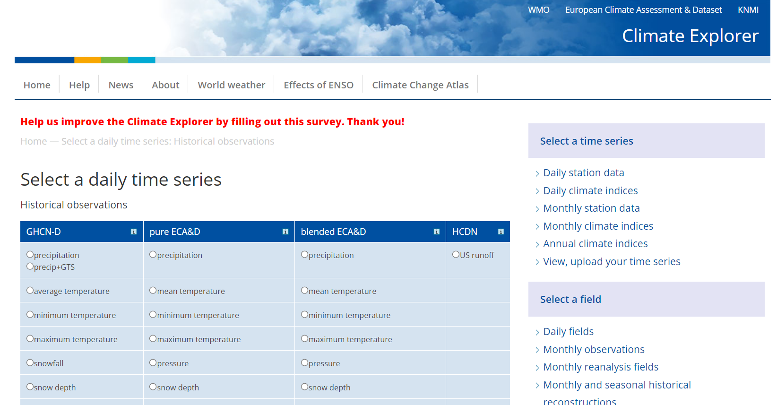
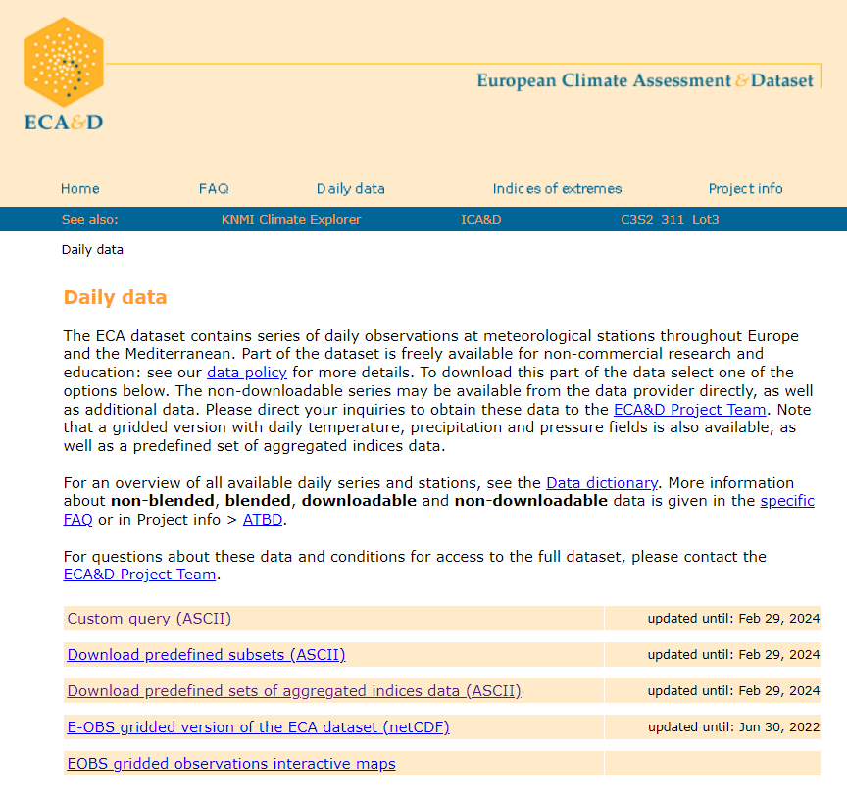
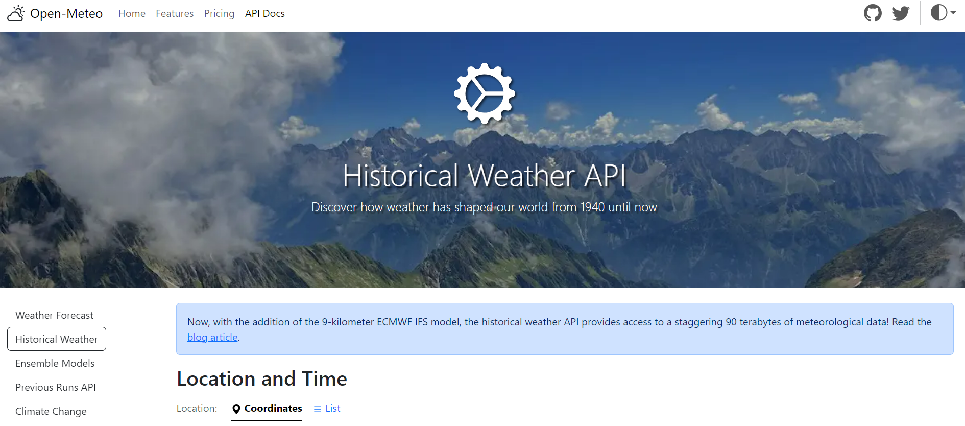
Indicator proposal
Location of the data to compute the indicator:
https://www.ecad.eu/
https://climexp.knmi.nl/start.cgi
https://cds.climate.copernicus.eu/#!/home
https://open-meteo.com/

Slide 9
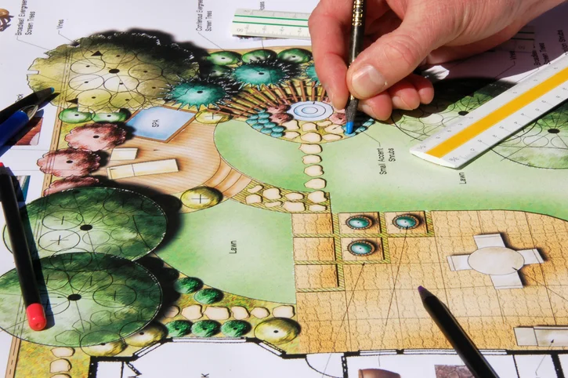
Indicator proposal
Possible end users of the indicator:
government (administration)
private sector (landscape designers)
public sector (citizens)

Slide 10
Number of the variable | Name of the variable | Unit of Measurement | Range | Value | Indicator (in case it is needed) | Source of the data
GRN1 | Temperature | ºC | ≤(-10) | -2 | Daily Max temperature | https://www.ecad.eu/ https://climexp.knmi.nl/start.cgi https://cds.climate.copernicus.eu/#!/home
 |  |  | (-10 ) – (-5) | -1
 |  |  | (-5) –(+10) | 0
 |  |  | 10-20 | 1
 |  |  | 20-25 | 0
 |  |  | 25-35 | -1
 |  |  | ≥35 | -2
GRN2 | Rain amount | mm | ≤ 1 | 0 | Daily rain amount
 |  |  | 1-9 | 3
 |  |  | 10-19 | 2
 |  |  | 20-29 | 1
 |  |  | ≥30 | 0
GRN3 | Wind speed | m/s | ≥15 | -1 | Gust wind speed
 |  |  | 10-15 | 0
 |  |  | 9-0 | 1
GREEN (GRN)

Slide 11
The construction of the GRN indicator
Number of variables | Name of variables | Formula | Definition | Range
GRN1 | Temperature | GRN1 + GRN2 + GRN3 | optimal | >1
GRN2 | Rain |  | threshold | - 1 … 1
GRN3 | Wind |  | extreme | < -1

Slide 12
Communication proposal
The main users of the CS: landscape companies, residents of building, construction and engineering companies, maintenance companies, administrations (local governments, policy- and decision makers) and others.
Identify the channel for communication the CS: website, app, sms, newsletter
Identify the format to communicate the CS: simple language, emojis, maps...

Slide 13
Future needs
Identify if there is a need to create new working networks: project/product managers, IT-developers, marketing specialists, financial specialists, climate service specialists, financial resources.
Identify if there is a need to create a new project to develop the CS started during this week YES
Write other issues of interest bridging the gaps between climatologists and end-users of climate service

Slide 14
Conclusions
Identify the more interesting lessons from this week course: all lectures
State if you need more training materials related with the work done during this week

Slide 15
THANK YOU!

