Slide 1
THE IMPACT OF CLIMATE CHANGE ON THE ENERGY EFFICIENCY OF BUILDINGS (OBJECT - KYIV CITY)
Group: Stepanenko S.N. (OSENU)
Voloshkina O.S. (KNUСA) Kovalova A. V. (KNUСA) Malovanyy M.S. (NU”LP”)
10 May 2024. ClimED 4th Training

Slide 2
1.1 Select the geographical scope of the project
Since our focus group is included two representatives of Kyiv National University of Civil Engineering and Architecture, whom we will further consider as stakeholders whose activities are affected by climate change. We select city of Kyiv as the geographic region of project and construction industry as the sector of our project.
The construction industry is currently considered one of the main sectors triggering the acceleration of climate change and the depletion of natural resources. These changing environmental effects can have a substantial impact on the behavior and performance of a building throughout its life cycle.

Slide 3
It was decided to focus research on the impact of climate change on energy consumption indicators of apartments in the city of Kyiv. The importance of this indicator has two aspects – firstly, ensuring comfortable and healthy living conditions and, secondly, changes in energy consumption directly affect greenhouse gas emissions, enhancing or mitigating the anthropogenic impact on the Earth's climate system.
As you know, there are two peaks of house energy consumption - heating of apartments in the winter period, when the ambient temperature is much lower than that which is comfortable for residential and office premises. The second peak occurs in the summer months, when, on the contrary, the ambient temperature is much higher than comfortable. Therefore, it is necessary to condense the room, wasting energy.

Slide 4
Scheme for selecting a research subject among various aspects of the climate change impact on construction industry

Slide 5
1.2 Identify different climate databases and retrieve data for geographical selection
To carry out the research, we used the ECA&D climate data base (www.ecad.eu), as well as the Kyiv climate data base of Central Geophysical Observatory (http://cgo-sreznevskyi.kyiv.ua/uk/diialnist/klimatolohichna/klimatychni-dani-po-kyievu)
A climate index describes a weather see-saw that occurs in a particular part of the world.
As climatic indicators for solving the task, we chose:
- average temperature for winter and summer periods
- daily minimum temperatures for the winter period
daily maximum temperatures for the summer period
daily speed of wind and other…

Slide 6
The main climatic indicators for calculating the building's energy consumption are temperature and wind speed

Slide 7
The first database (ECA&D climate data base) was used to calculate the dynamics of changes in energy consumption for heating in the winter period. To do this, we used series of daily minimum temperatures in Kyiv for January-February 1942 and 2012.
The calculation showed that climate change led to a reduction in energy consumption for two winter months for a conventional house with a wall area of 200 square meters by 45.7 kW or by almost 16%

Slide 8
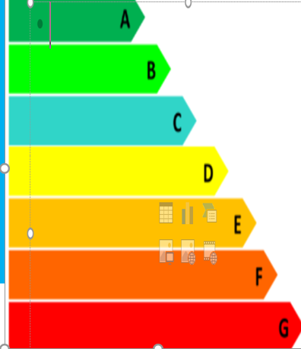
The energy efficiency of buildings is developed according to the calculation of energy consumption during heating, hot water supply, cooling, ventilation, lighting) in accordance with the standard DSTU B A.2.2-12:2015 and the Law of Ukraine "On Energy Efficiency". The difference between the new standard and the previous one is the inclusion in the energy balance of the building of energy consumption for cooling, taking into account EU legislation Indicators of energy efficiency of buildings are: - Specific annual energy demand for heating, cooling and hot water supply; - Specific energy consumption; - Primary energy; - Greenhouse gas emissions
The scale of energy efficiency classes is from 44 kW*h/m² and less (class A) to 153 kW*h/m2 and more (class G)

Slide 9
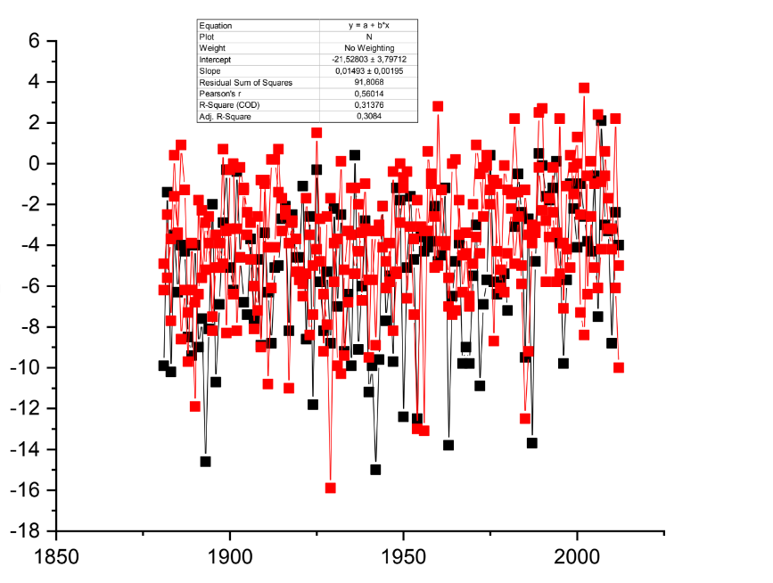
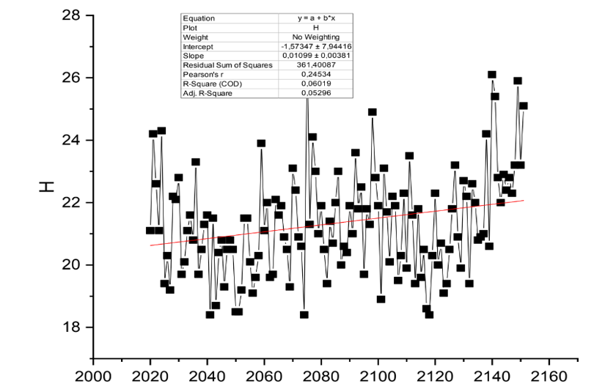
With the help of the software product OriginPro8, an analysis of changes in temperature indicators in the territory of the city of Kyiv during the period 1881-2020 and forecast estimates until the year 2160 for the city of Kyiv were made. As an example, this slide shows the average monthly temperature trends for the month of July

Slide 10
THE IMPACT OF RISING GLOBAL TEMPERATURES ON ENERGY CONSUMPTION FOR COOLING BUILDINGS IN KYIV
The generalized heat transfer coefficient, which takes into account the heat transfer by transmission and ventilation, between the conditioned volume/zone and the external environment through the unconditioned volume/room of the greenhouse type, W/K, is calculated by the formula
H_{u}=H_{ІU}b_{U}
where H_{IU} is the direct generalized heat transfer coefficient between the conditioned volume/zone and the unconditioned volume/greenhouse-type room, W/K.
The correction factor b_{U} is calculated for each month by the formula
b_{U} = (Θ_{І} - Θ_{U})/ (Θ_{І} - Θ_{e})
where Θ_{І} is the calculated (set) temperature of the conditioned volume/zone, °C
Θ_{е} is the average monthly ambient temperature, °C
Θ_{U} is the temperature of the unconditioned greenhouse-type volume/room, ºС, calculated on the basis of the heat balance in stationary conditions.
In accordance with the regulatory document, this value is determined according to Appendix A for different cities of Ukraine
The predicted temperature dynamics according to conventional and wet thermometer in July at the end of different periods are as follows: 2021-2030 - 24.136°С and 26.24°С; 2030-2050 - 26.371°C and 28.918°C, respectively, other things being equal in the urban environment

Slide 11
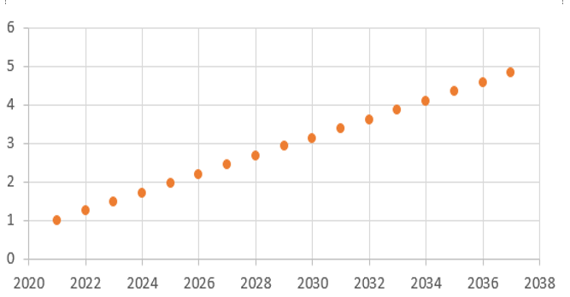
We obtained a graph of the dependence of temperature indicators and the generalized heat transfer indicator
As the temperature increases, the heat transfer coefficient increases according to the graph by the value of the coefficient ∆Tꞌ.
In 2050, the coefficient ∆Tꞌ will be 5.48, ceteris paribus
∆Тꞌ

Slide 13
Thank you!
KYIV
L'VIV
ODESSA

