Slide 1
619285-EPP-1-2020-1-FI-EPPKA2-CBHE-JP Multilevel Local, Nation- and Regionwide Education and Training in Climate Services, Climate Change Adaptation and Mitigation
CLIMATE SERVICES FOR BUILDINGS DEVELOPMENT ON MARINE COASTS
Dmytro Diadin, Viktoriya Shepel, Maksym Martyniuk, Tetiana Kryvomaz
6 May 2024. ClimED 4th Training

Slide 2
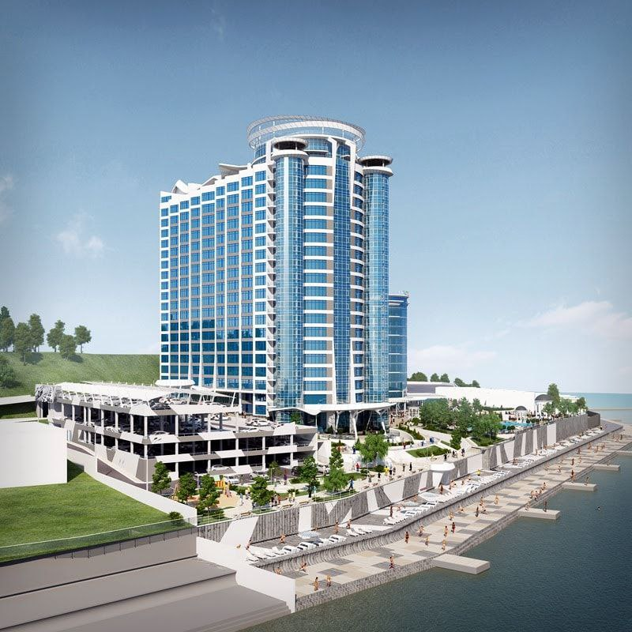
Name | Affiliation
Dmytro Diadin | Beketov National University of Urban Economy, Kharkiv
Viktoriya Shepel | National University Odessa Maritime Academy, Odessa
Maksym Martyniuk | Odessa State Environmental University / Institute of Marine Biology of the NAS of Ukraine, Odessa
Tetiana Kryvomaz | Kyiv National University of Building and Architecture

Slide 3
Climate services for buildings development on marine coasts
Region of study: Odessa region, Ukraine
Why?
To combine our skills and promote knowledge exchange
A lot of people wants to live near the sea => Chaotic building
If it can't be avoided, we need choose the lesser evil
Marine coast and the sea are vulnerable and unique ecosystems
Necessity of mitigating of anthropogenic impact to climate change
Variability of sectors in coastal areas
Vulnerability to climate change and anthropogenic pressure (as indicated in Strategy 2030)

Slide 4
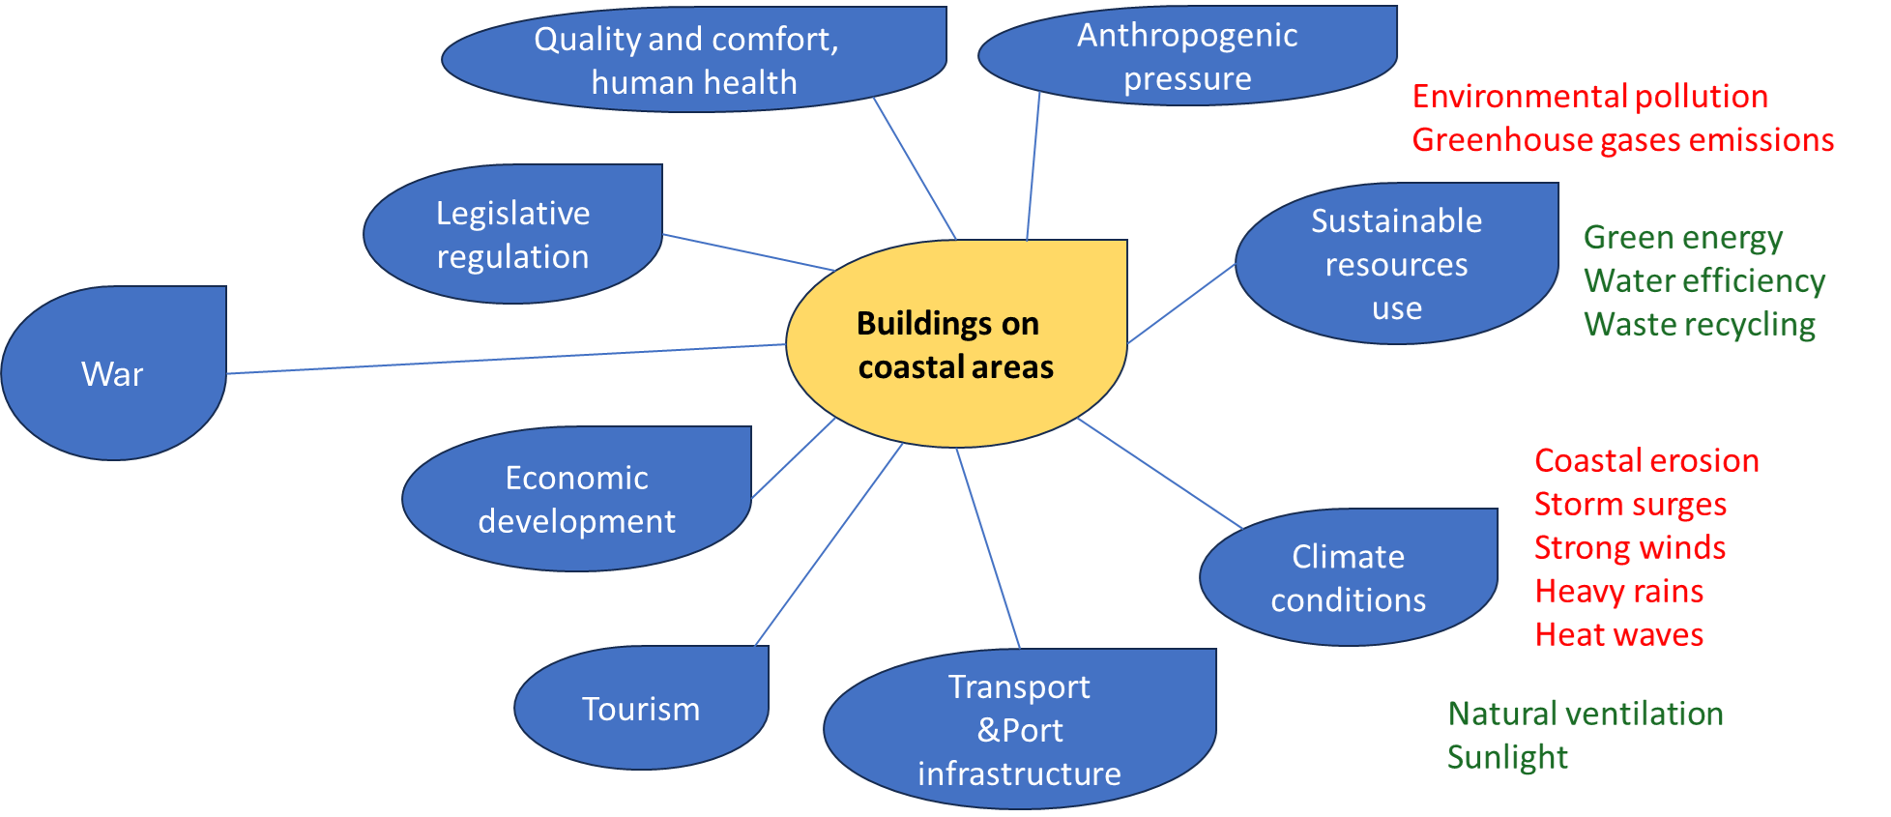
Development of co-creation methodology for climate-dependent
building sectors

Slide 5
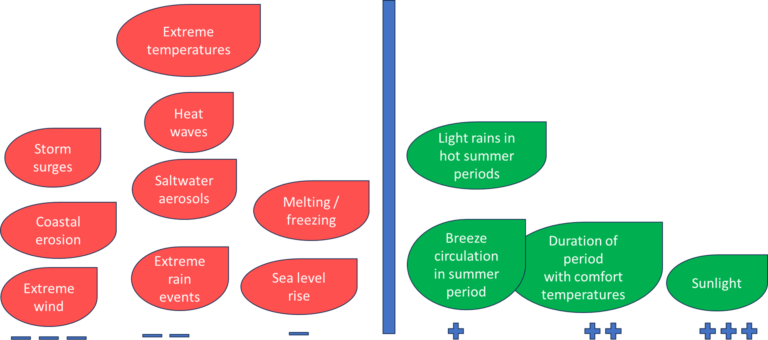
Impacts of meteo-climatic conditions

Slide 6
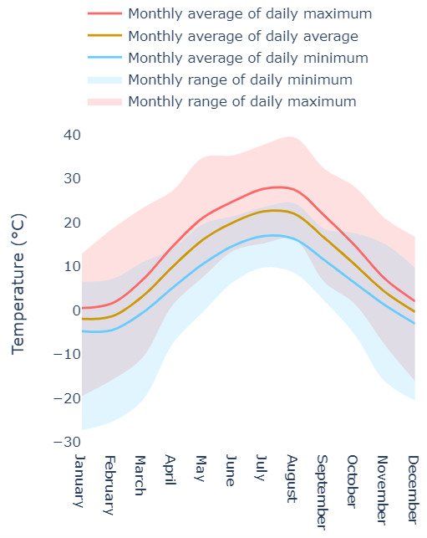
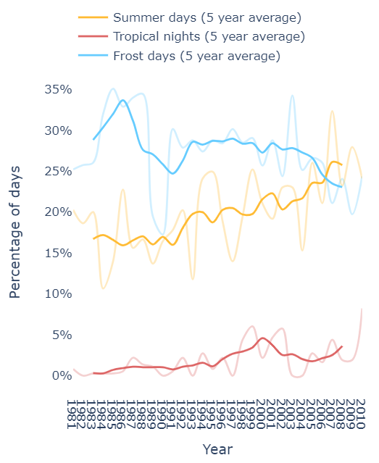
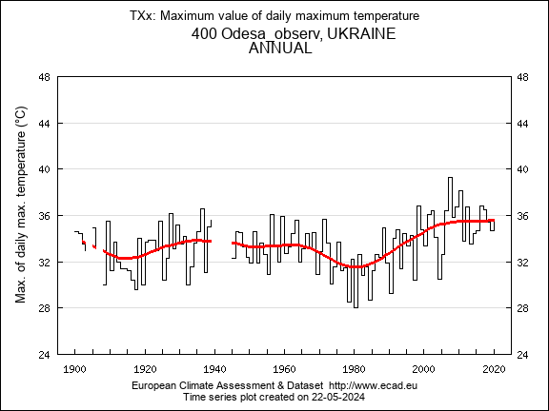
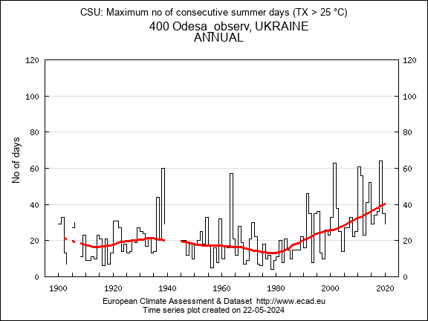
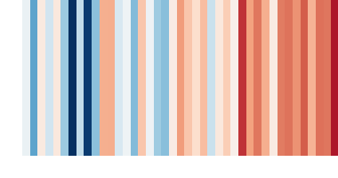
Indicator proposal
Description of the indicator:
extreme temperatures and heat waves - heat stress for construction and road materials, impacts on public health
Data needed to compute the indicator:
daily maximum temperature, n of consecutive days with temperature > 25°C, tropical nights
Location of the data to compute the indicator:
ECA&D, Copernicus CDS
Possible end users of the indicator:
construction companies, tourism and travel agencies, hotel and restaurant services
https://cds.climate.copernicus.eu/apps/c3s/app-era5-explorer
https://www.ecad.eu/indicesextremes/index.php
Notes:
Warming stripes provide an at-a-glance view of yearly temperature trends in Odessa for the period 1979-2020. The colour of each stripe represents the temperature anomaly for a given year, or how much warmer (red) or colder (blue) that year was relative to the long-term reference period of 1981-2010.

Slide 7
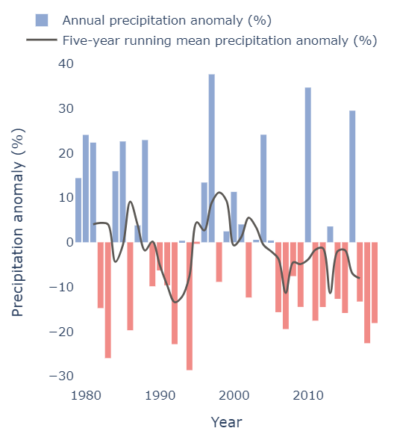
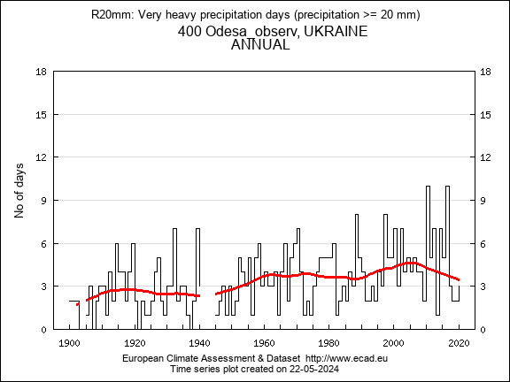
Indicator proposal
Description of the indicator:
heavy rains - damage of road infrastructure, flooding, surface water pollution
Data needed to compute the indicator:
heavy precipitation days (>= 20 mm), precipitation anomaly
Location of the data to compute the indicator:
ECA&D, Copernicus CDS
Possible end users of the indicator:
construction companies, transportation, tourism and recreation services
https://cds.climate.copernicus.eu/apps/c3s/app-era5-explorer
https://www.ecad.eu/indicesextremes/index.php
Notes:
The anomaly plot shows the precipitation anomaly for each year in the 1979-2020 period, or how much more (blue) or less (red) precipitation fell each year as a percentage relative to the long-term reference period of 1981-2010.

Slide 8
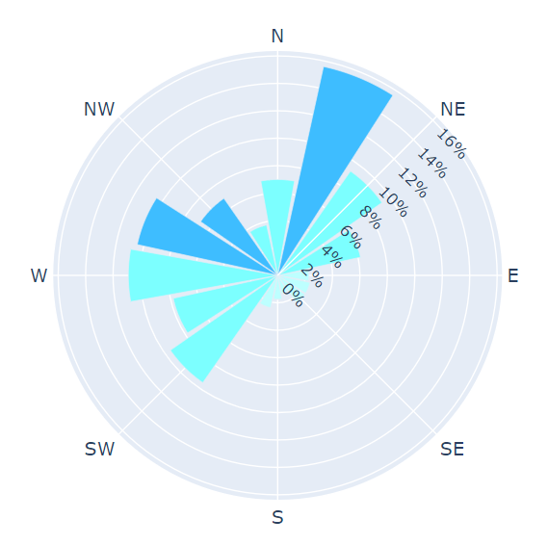
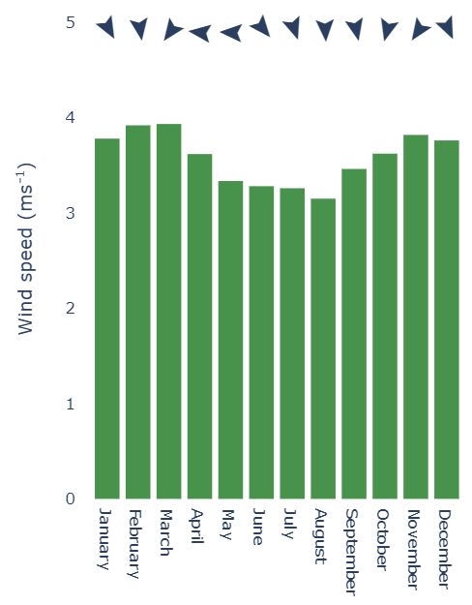
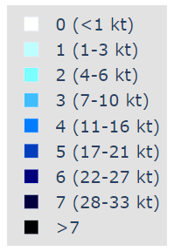
Indicator proposal
Description of the indicator:
wind conditions - affecting stability of high constructions, risks of damage and disruptions
Data needed to compute the indicator:
wind directions and speed, wind gusts
Location of the data to compute the indicator:
ECA&D, Copernicus CDS
Possible end users of the indicator:
construction companies, tourism agencies

Slide 10
Climate Data Homogenization
Variables:
➢Daily precipitation
➢Daily maximum temperature
Weather stations:
➢ Odesa
➢ Kherson
➢ Mykolaiv
Data source:
➢European Climate Assessment & Dataset (ECA&D) daily data

Slide 11
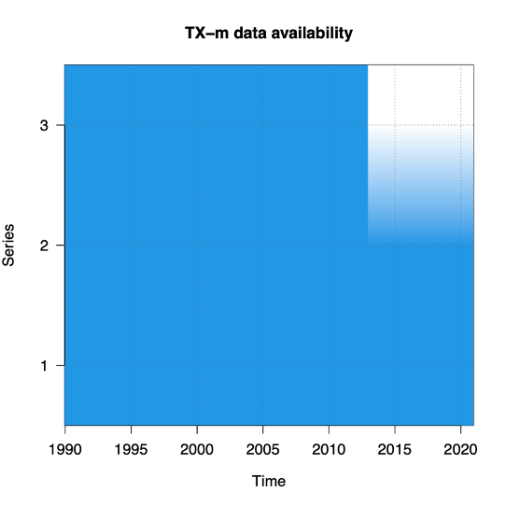
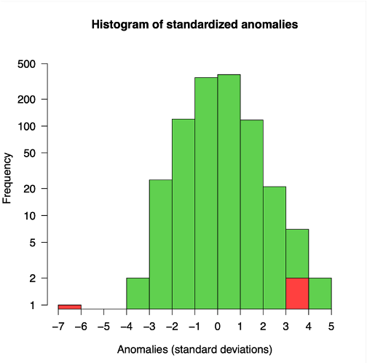
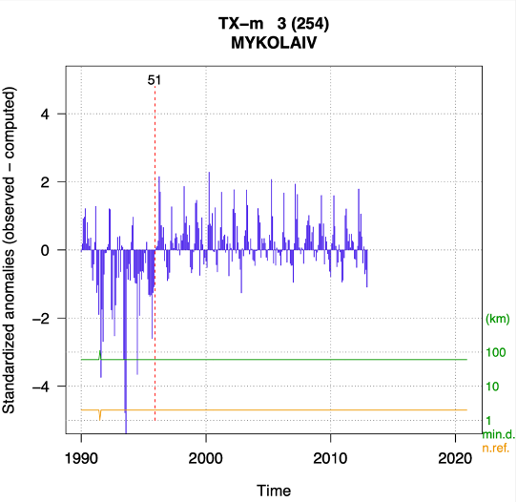
Homogenization graphic output of maximum temperature 1990−2020
Data availability along the study period
Histogram of spatial anomalies
Example of detection of a shift in the mean

Slide 12
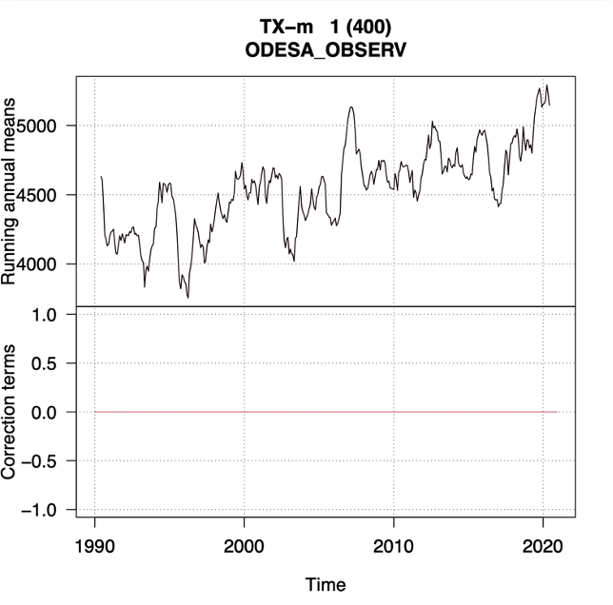
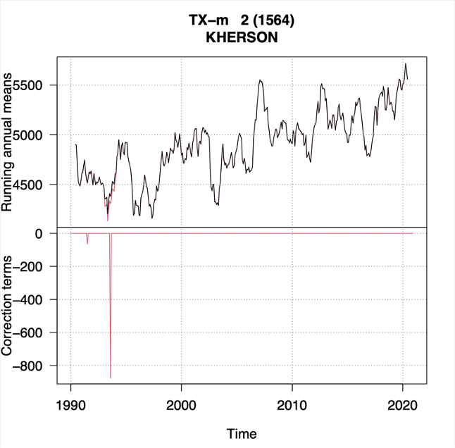
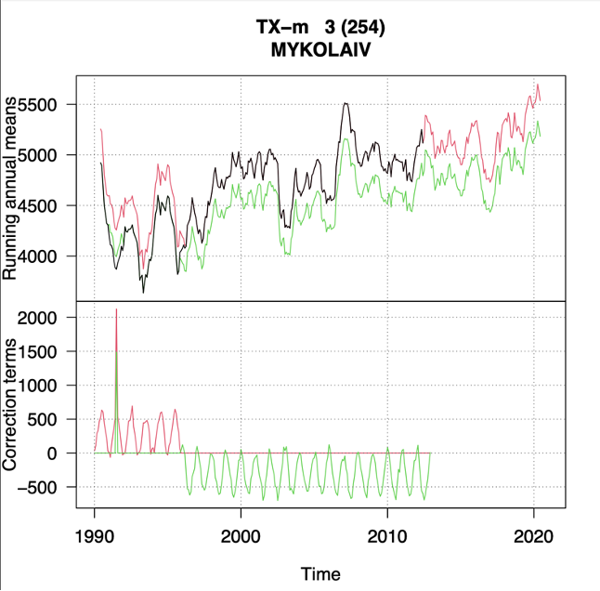
Adjusted series and applied corrections for daily maximum temperature data 1990-2020

Slide 13
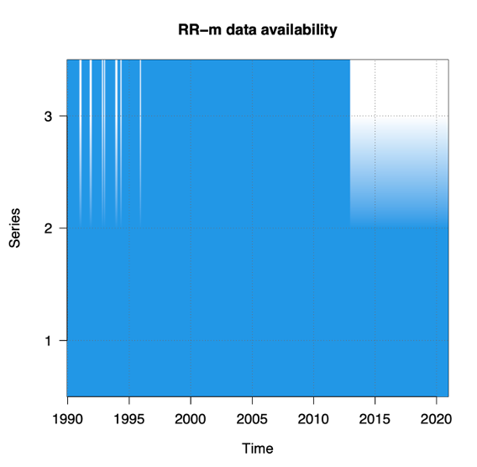
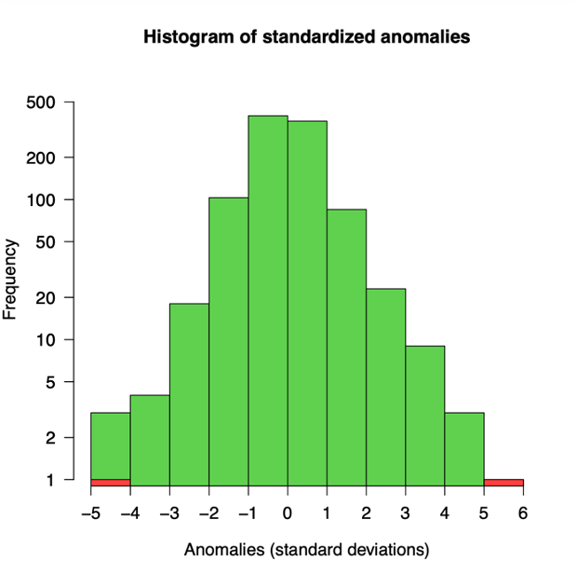
Homogenization graphic output of precipitations 1990−2020
Changes in the mean where not detected In series of anomalies
Data availability along the study period
Histogram of spatial anomalies

Slide 14
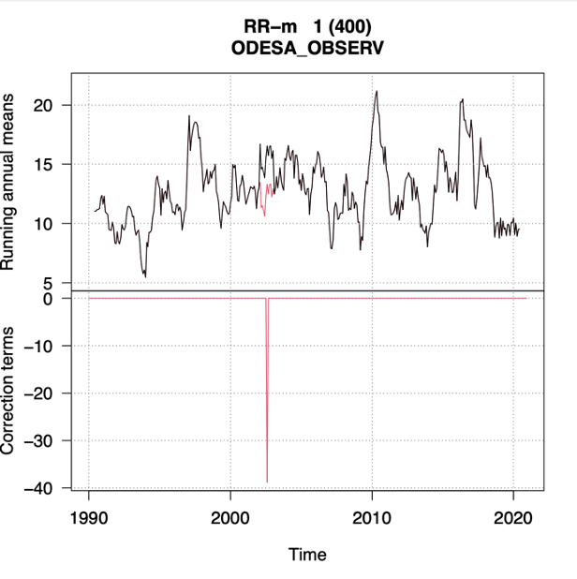
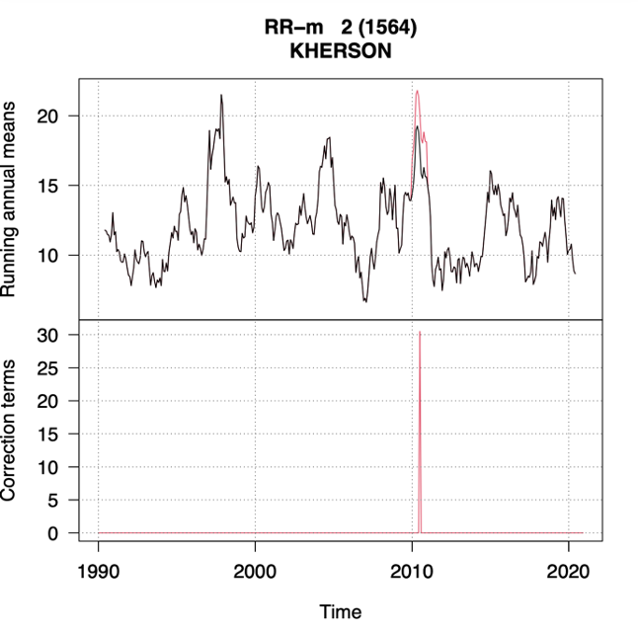
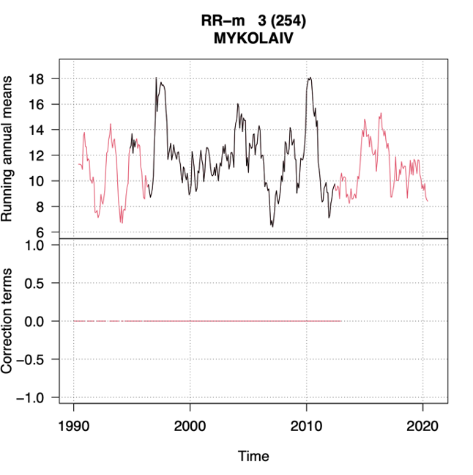
Adjusted series and applied corrections for daily precipitations data 1990-2020

Slide 15
Communication proposal: create Association "Friends of the Coast"
Our mission
❖Providing adaptation to climate change impacts
❖Safety and quality of the built environment for the human health and wellbeing
Our goals
➢Climate service contributes to local and global sustainable development
➢Advantages of receiving climate recommendations
➢Minimizing the anthropogenic activity impact to climate change and the environment

Slide 16
Communication proposal: Association "Friends of the Coast"
Interests of our stakeholders
❖Scientists: climate service, research, networking, influence platform
❖Developers: sustainable architectural planning and selection of building materials
❖Local communities: reduction of anthropogenic load, distribution of tourist flows, new opportunities for development
❖Habitants: quality, comfort and safety of coastal buildings
❖Business: expansion of touristic services
❖Tourists: wide range of opportunities in different weather conditions
❖Authorities: planning of the territory with preservation of the environment

Slide 17
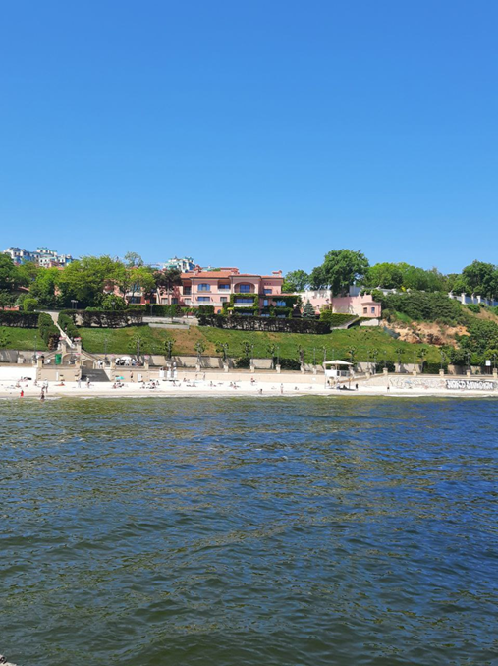
Communication proposal: climate services of Association "Friends of the Coast"
Consultations and training
➢Integration of the building into the natural coastal landscape
➢Selection of building materials for the coastal zone
➢Adaptation of construction structures to coastal conditions
➢Using sunlight for natural lighting and energy supply
➢Natural ventilation of coastal buildings
➢Protection of the building from flooding and storm threats
➢Fire safety in the coastal zone
➢What to do in extreme weather conditions
Climate change and the built environment

Slide 18
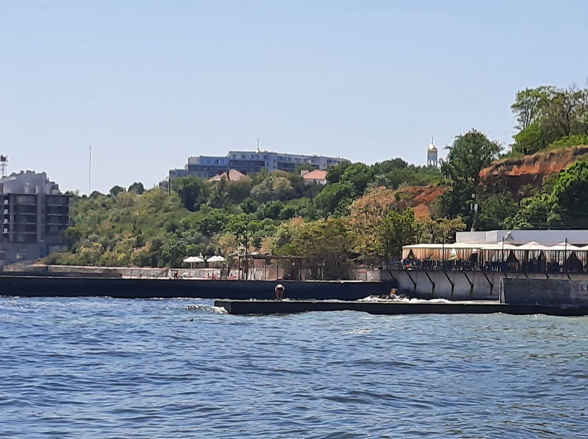
Communication proposal: events of Association "Friends of the Coast"
Climate information events
➢Campaign “Save the coast together”
➢Field climatic trainings
➢Seasonal excursions
➢Climate forum
➢Art festival BCCS (Building, Climate, Coast & Sea)
➢All about climate change for children
➢Competition "The best climate sustainable house"

Slide 19
Communication proposal: outdoor activities of Association "Friends of the Coast"
On-site facilities
➢Museum of climate change
➢Exhibition “Climate sustainable house on the coast"
➢Artistic climate installations and photo zones
➢Climate walk educational activities
➢Thematic Footpaths
➢Weather stations

Slide 20
Communication proposal: online activities Association "Friends of the Coast"
Networks
➢Weather forecast from Katya flounder
➢YouTube channel "All about the climate, coast and sea"
➢Interactive maps of the coast at your request
➢Online game "Climate Change Safeguards"
➢Short video for YouTube Shorts, TikTok
➢News on Telegram, YouTube, Facebook, Instagram

Slide 21
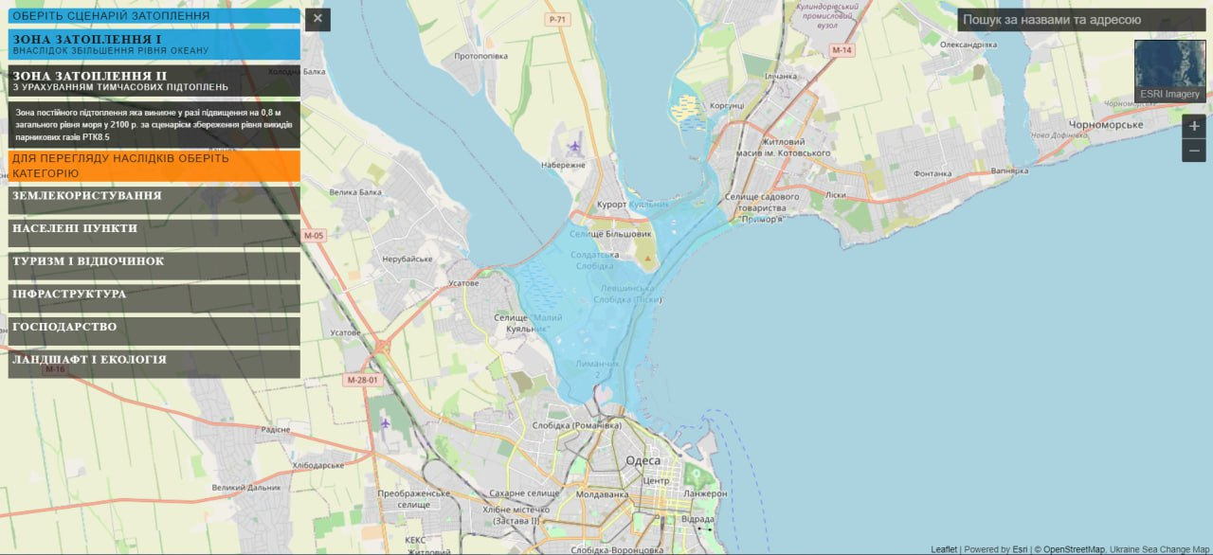
Example of interactive maps

Slide 22
Future needs
People, nature and buildings in Ukraine need to be restored after the war devastation
Construction and development on coastal areas need advices on
calculation methods of direct and indirect carbon emissions
practical cases on climate change mitigation and adaptation
Climate scientists will have a lot of work because all companies will have to provide ESG reporting in the coming years

Slide 23
Conclusions
The course convincingly demonstrated the importance of climate information in all areas of human activity (even the unexpected!)
The gaps between climatologists scientists and potential users of climate information are significant
It is clearly demonstrated how to overcome this gaps
Prospects for productive cooperation have opened up
Inspiration for new projects has been received

Slide 24
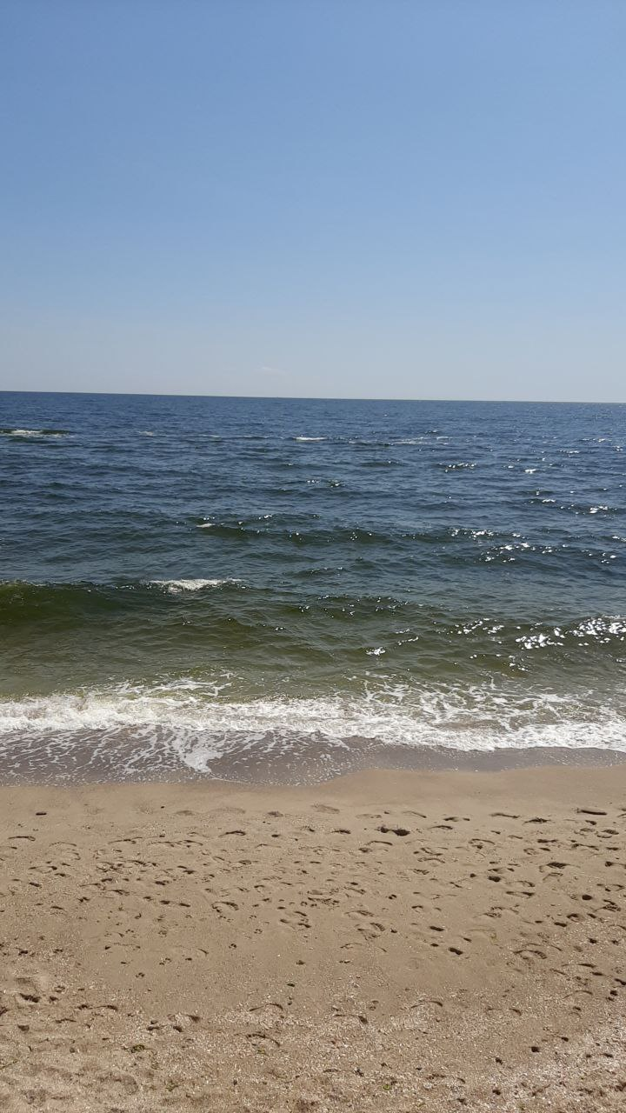
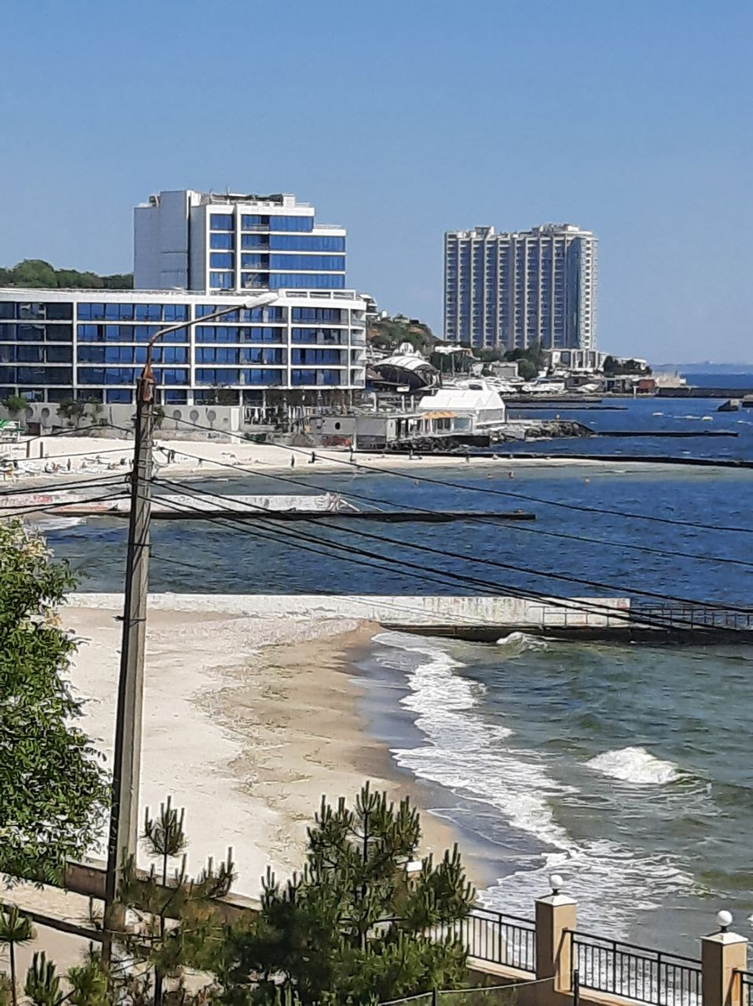
Thank you for attention!
Дякуємо за увагу!
¡Gracias por su atención!

