Slide 1
619285-EPP-1-2020-1-FI-EPPKA2-CBHE-JP
Multilevel Local, Nation- and Regionwide Education and Training in Climate Services, Climate Change Adaptation and Mitigation
“Urban Forestry Vulnerability, Challenges and Adaptation Potential under Climate Change in the Region of Southern Bessarabia, Ukraine”
Olena Drozd, Yuriy Vergeles, Oleksii Hustenko, Nadiia Prykhod’ko (Working Group A8)
6-24 May 2024. ClimED 4th Training

Slide 2
Presentation of the group
Name | Affiliation | Professional Area | Role in the Project
Olena Drozd | (Beketov NUUEK) | Environmental Science | Conceptualisation, data management, modelling, co-ordination
Oleksii Hustenko | (OSENU) | Earth Science | Data acquisition & management
Nadiia Prykhod’ko | (OSENU) | Earth Science | Data processing & visualisation
Yuriy Vergeles | (Beketov NUUEK) | Ecology | Conceptualisation, interpretation of results, visualisation, co-ordination, communication

Slide 3
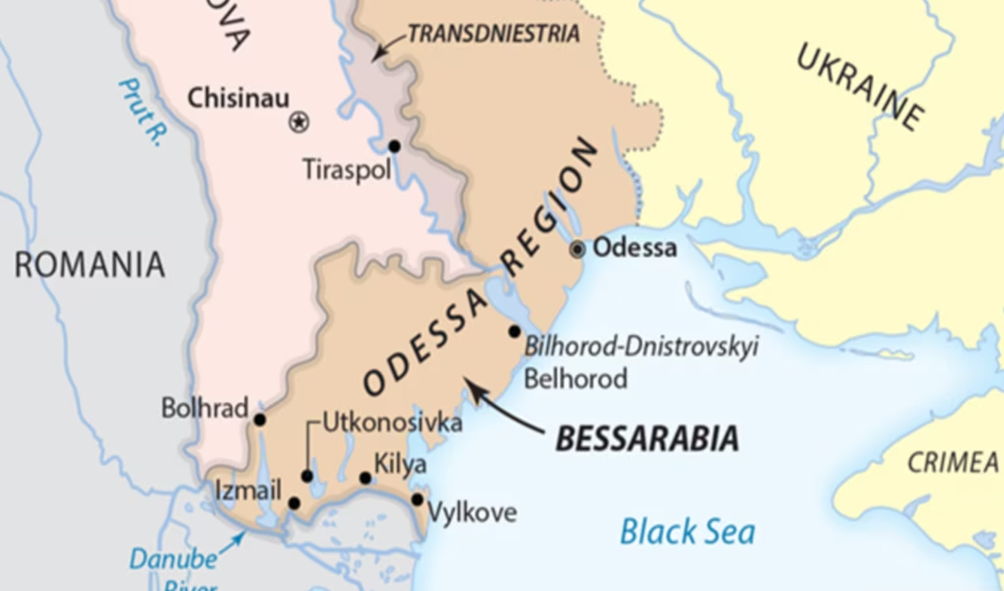
Topic of the working group
Topic: Urban Economy / Urban Forestry
Region of study: Southern Bessarabia, Ukraine
Region: | Southern Bessarabia
Tot. population: | 565,5 thousand (as by 2020)
No. cities/towns: | 8
Urban population: | 285,4 thousand (as by 2020)
Economic profile: | Agriculture, food production, wine-making, machinery, freight and maritime transportation, tourism & hospitality, resort services
meteostations
https://esu.com.ua/article-75193

Slide 4
Topic of the working group
Ecosystem Services of Urban Forest:
Primary Production & Carbon Sequestration
Biogeochemical Cycling
Habitats for Urban Flora & Wildlife
Cooling Urban Heat Island (UHI)
Erosion & Flood Control
Groundwater Aquifer Recharge
Pollution & Noise Reduction
Amenities & Recreation
Real Estate Value
Nature Aestetics & Exploration
Ecosystem Disservices of Urban Forest:
Invasive Allien Species Spread
Pest & Disease Outbreaks
Ignition/Fire Risk
Allergenity
Damages to Buildings, Constructions, Road & Engineering Infrastructure

Slide 5
GENERAL
FRAMEWORK
ADAPTATION POTENTIAL
IAS Control
Groundwater Depletion
Equity to Green Area Access
VULNERABI-LITIES TO CLIMATE CHANGE
URBAN FORESTRY/
URBAN GREENING
CHALLENGES
Droughts
Pests & Diseases
Maintenance Costs
Changes in Tree Species & Age Structure
Cooling Potential
Carbon Sequestration Potential
Enhancement of Public Health Benefits
ECOSYSTEM SERVICES

Slide 6
STAKEHOLDERS
CITY COUNCILS
MUNICIPAL AUTHORITIES
ECOSYSTEM SERVICES OF URBAN FOREST
CITY PLANNERS
URBAN FORESTRY ENTERPRISES
TARGET GROUP: URBAN RESIDENTS & VISITORS
URBAN FORESTRY EXPERTS
URBAN FORESTRY BUSINESSES: TREE NURCERIES
ECOSYSTEM DISSERVICES OF URBAN FOREST
PUBLIC HEALTH PROFESSIONALS
Positive attitude/impact
Negative attitude/impact
Neutral attitude
ENVIRONMENTAL ACTIVIST GROUPS
URBAN ENGINEERING INFRASTRUCTURE ENTERPRISES

Slide 7
METEO-CLIMATIC FACTORS THAT IMPACT URBAN FOREST’S ESs
Prolonged vegetation period
Prolonged drought
Extreme wind
Prolonged frost-free period
+/- in total annual precipitation
Evenly distributed monthly precipitation
Flush flood
Spring Freeze

Slide 8
INDICATORS IDENTIFICATION/RANGING
seasonal
1-5 years
6-10 years
11-30 years
Prolonged vegetation period
Prolonged vegetation period
Evenly distributed monthly precipitation
Conditions that benefit
Prolonged frost-free period
Prolonged frost-free period
Extreme wind
Extreme wind
Flush flood
Conditions taht harm
Prolonged drought
Prolonged drought
Prolonged drought
Spring Freeze

Slide 9
Meteo-climatic variables selected
Annual average minimum daily temperature: TN, deg C
Annual average maximum daily temperature: TX, deg C
Annual average mean daily temperature: TG, deg C
Annual number of days with TX > +35°C: TX35, days/year
Annual number of consecutive dry days: CDD, days/year
Annual average total daily precipitation: PR, mm/day
Annual number of wet days: RR1, days/year
Annual number of days with very heavy precipitation (PR>=20 mm): R20mm, days/year
Highest 1-day precipitation amount: RX1day, mm
Annual mean of surface wind velocity: WIND, m/s

Slide 10
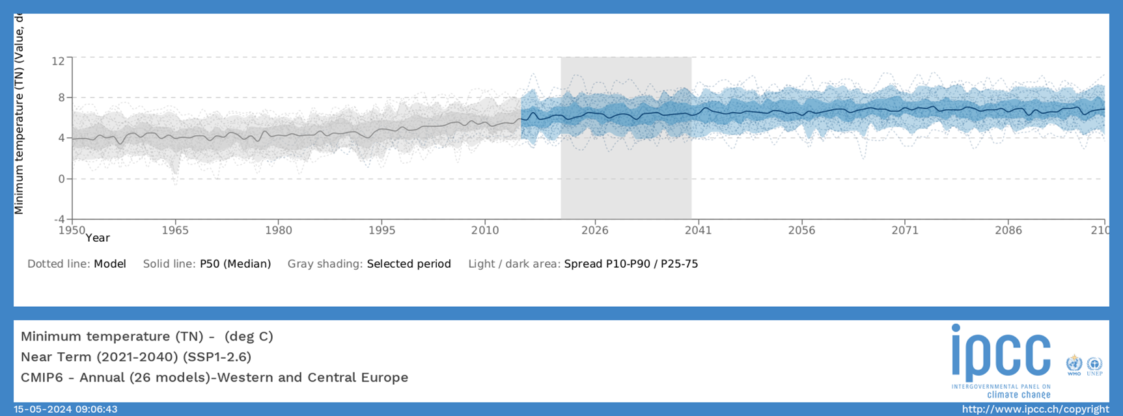
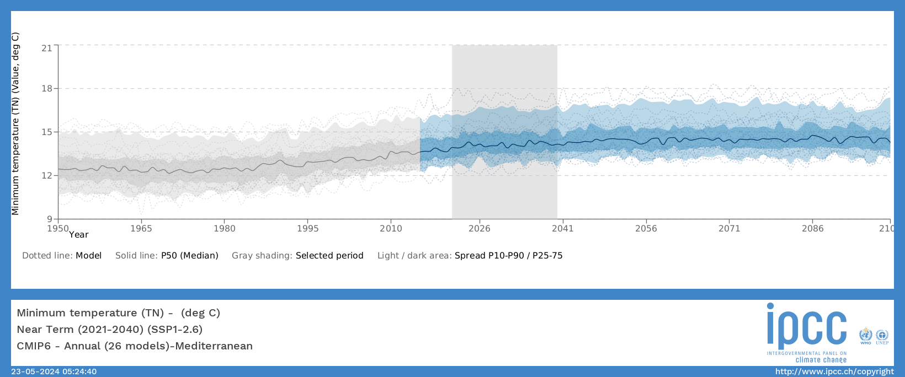
Modelling & Forecasting / Wider Geographic Scope : TN
Western and Central Europe
Mediterra-nean

Slide 11
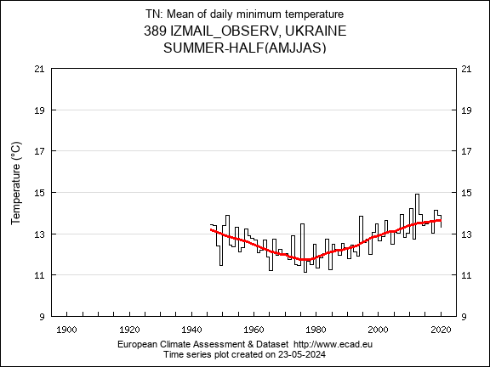
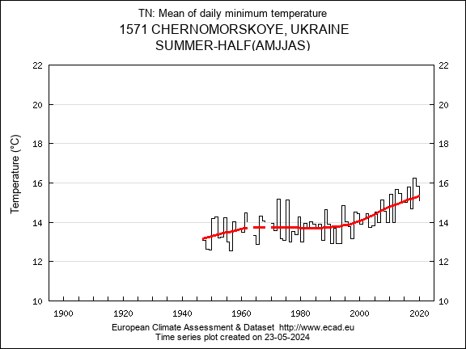
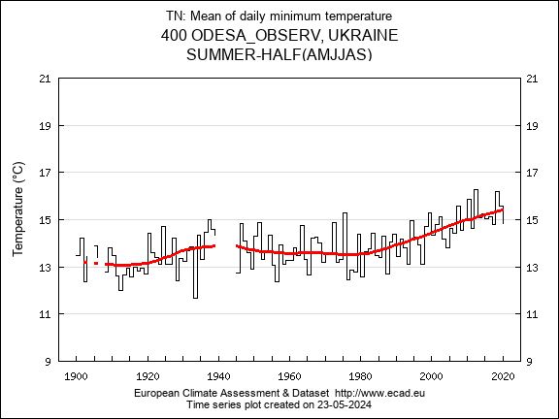
Modelling & Forecasting / Narrower Geographic Scope : TN
W E

Slide 12
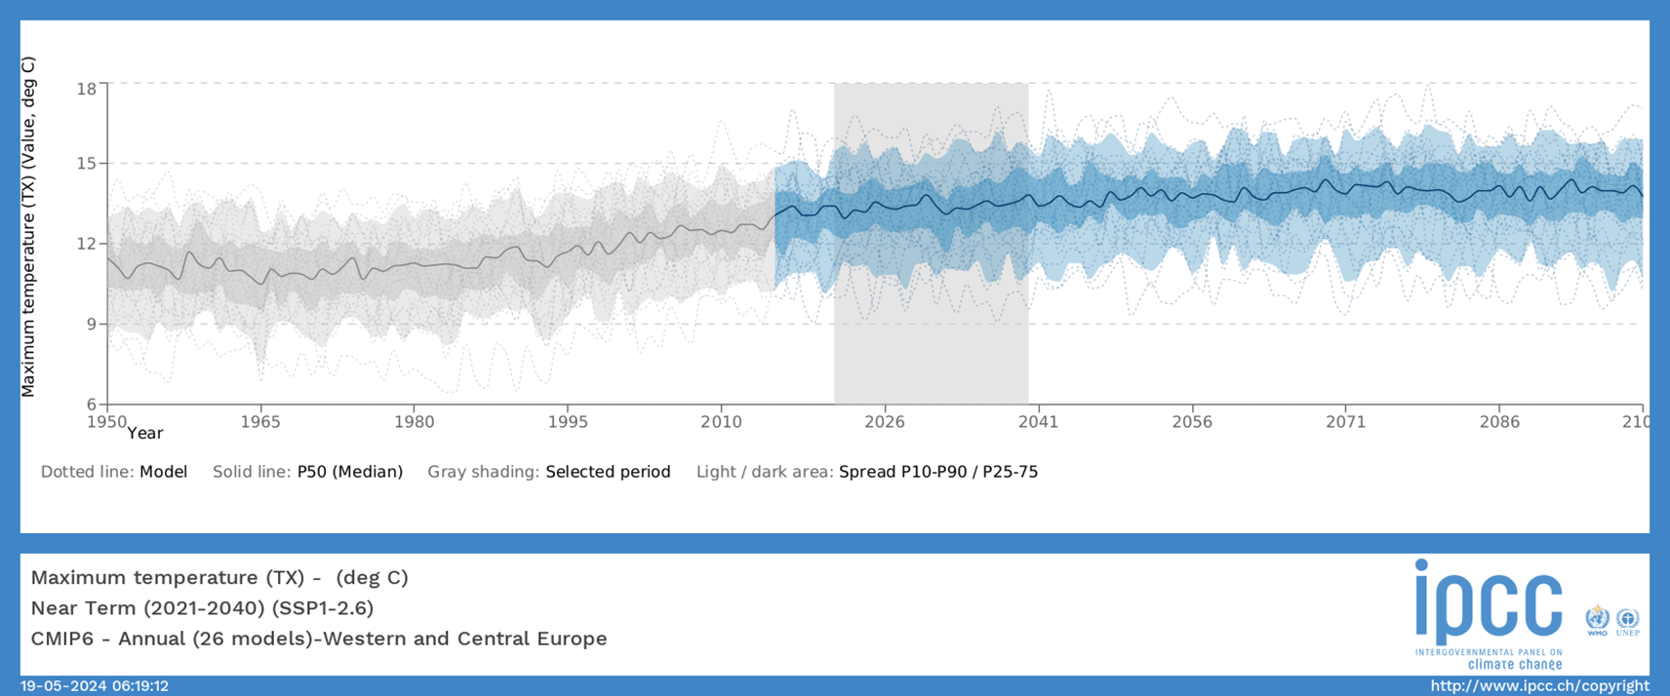
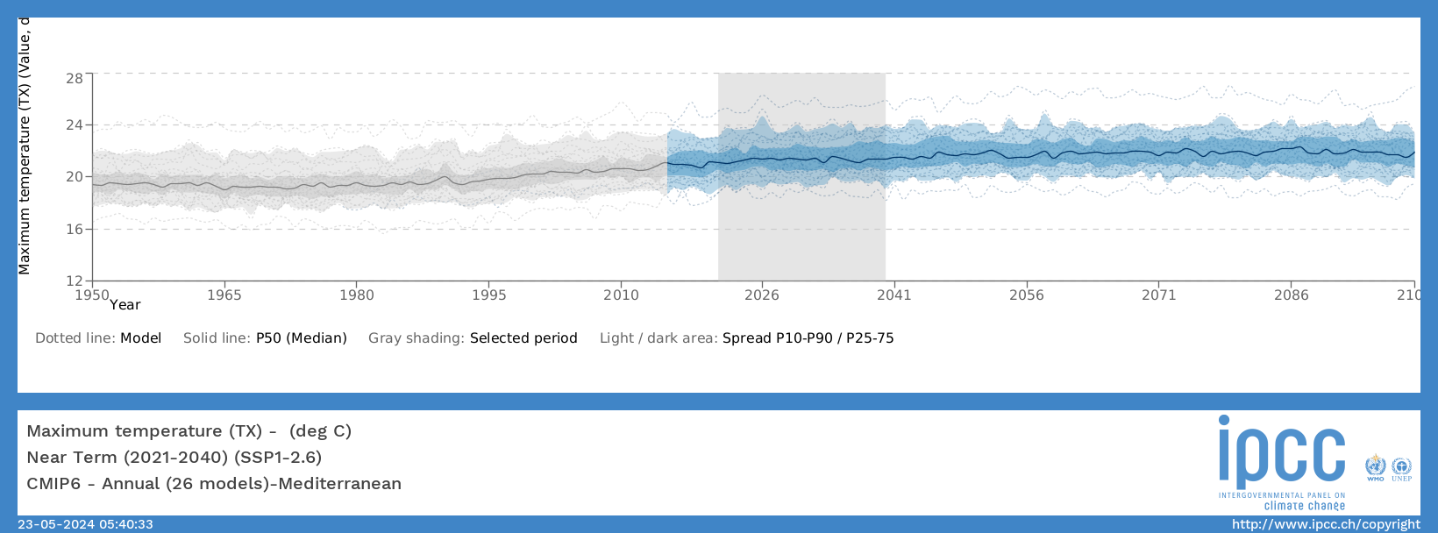
Modelling & Forecasting / Wider Geographic Scope : TX
Western and Central Europe
Mediterra-nean

Slide 13
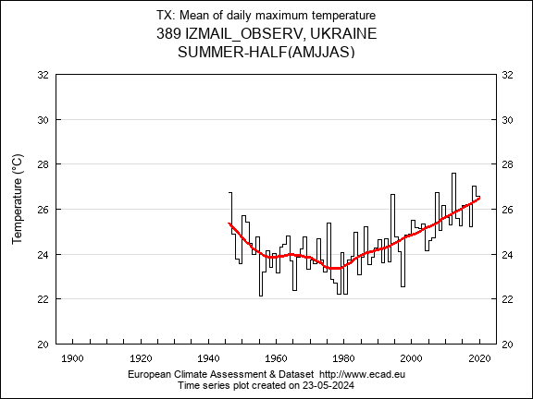
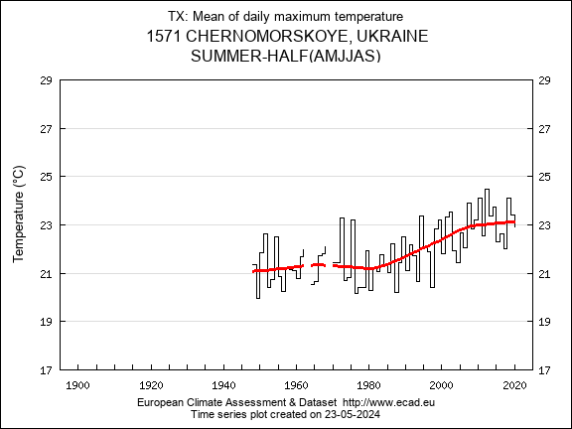
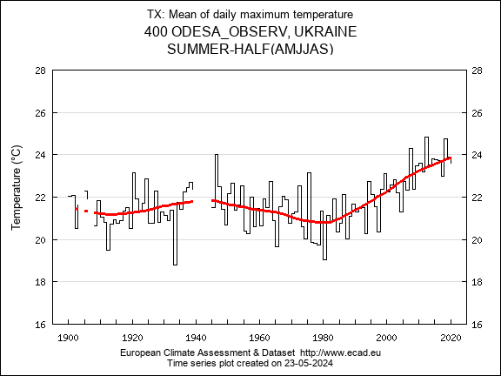
Modelling & Forecasting / Narrower Geographic Scope : TX
W E

Slide 14
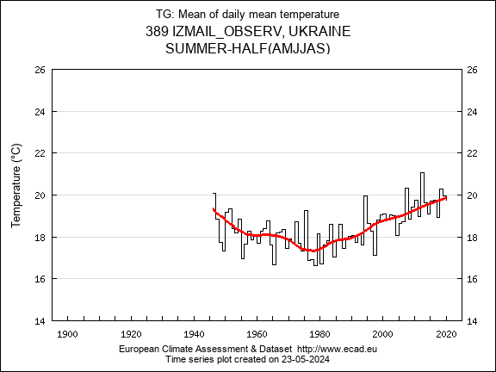
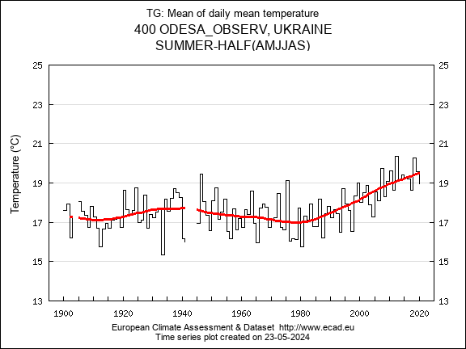
Modelling & Forecasting / Narrower Geographic Scope : TG
W E

Slide 15
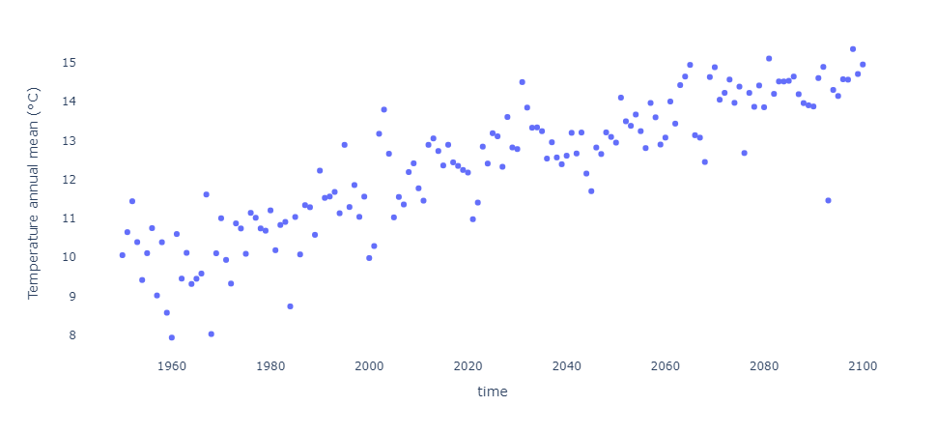
Modelling & Forecasting / Narrower Geographic Scope : TG, RCP4.5

Slide 16
Modelling & Forecasting / Wider Geographic Scope : TX35
Western and Central Europe
Mediterra-nean

Slide 17
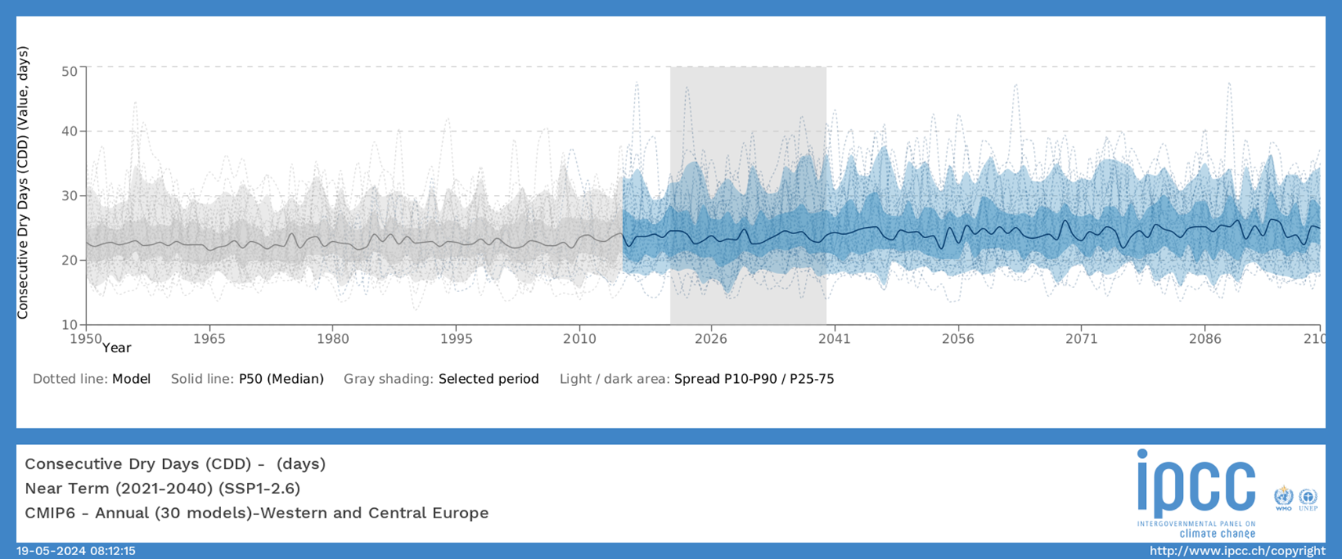
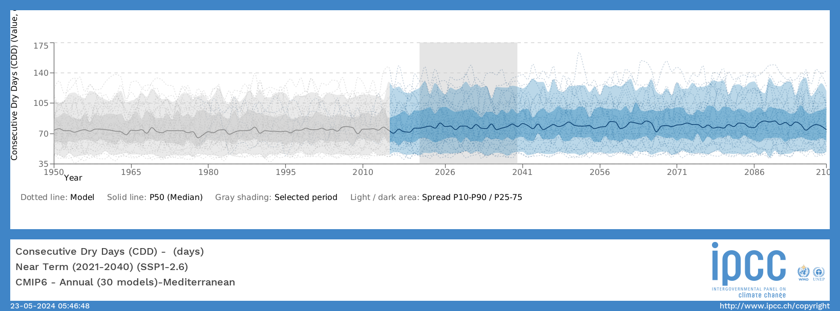
Modelling & Forecasting / Wider Geographic Scope : CDD
Western and Central Europe
Mediterra-nean

Slide 18
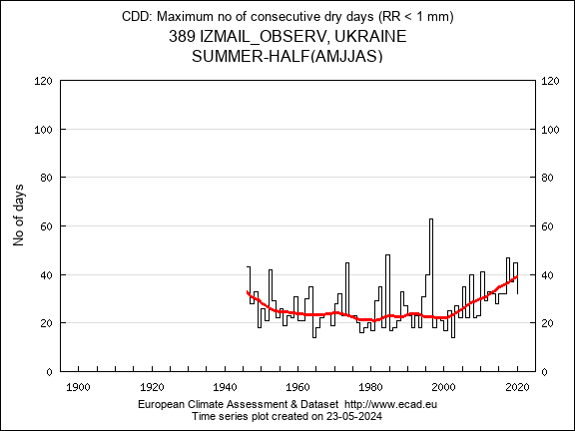
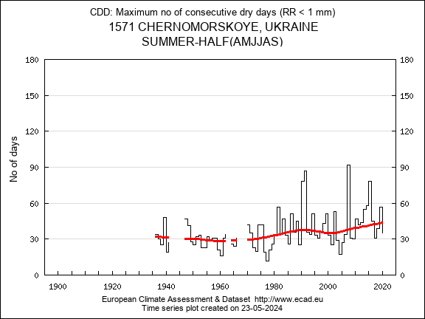
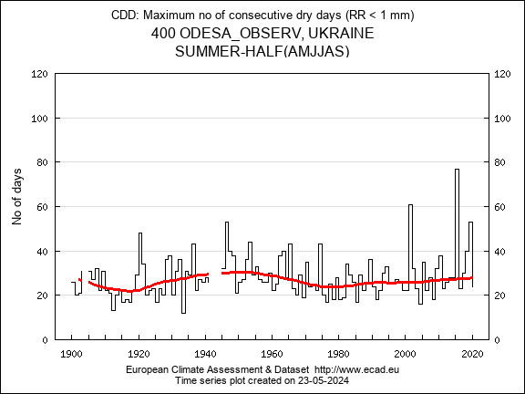
Modelling & Forecasting / Narrower Geographic Scope : CDD
W E

Slide 19
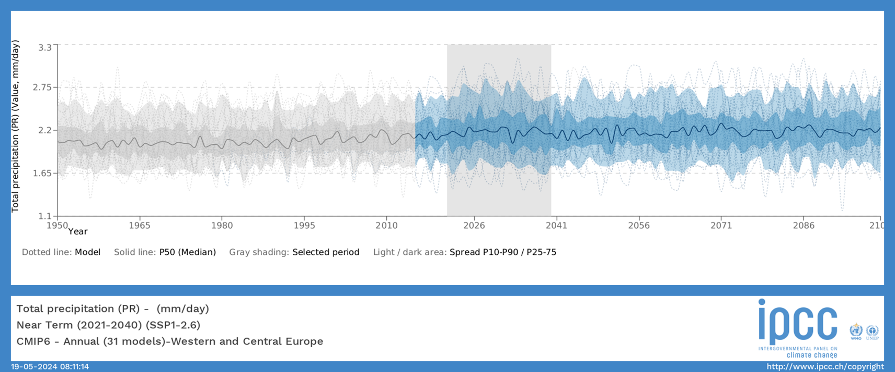
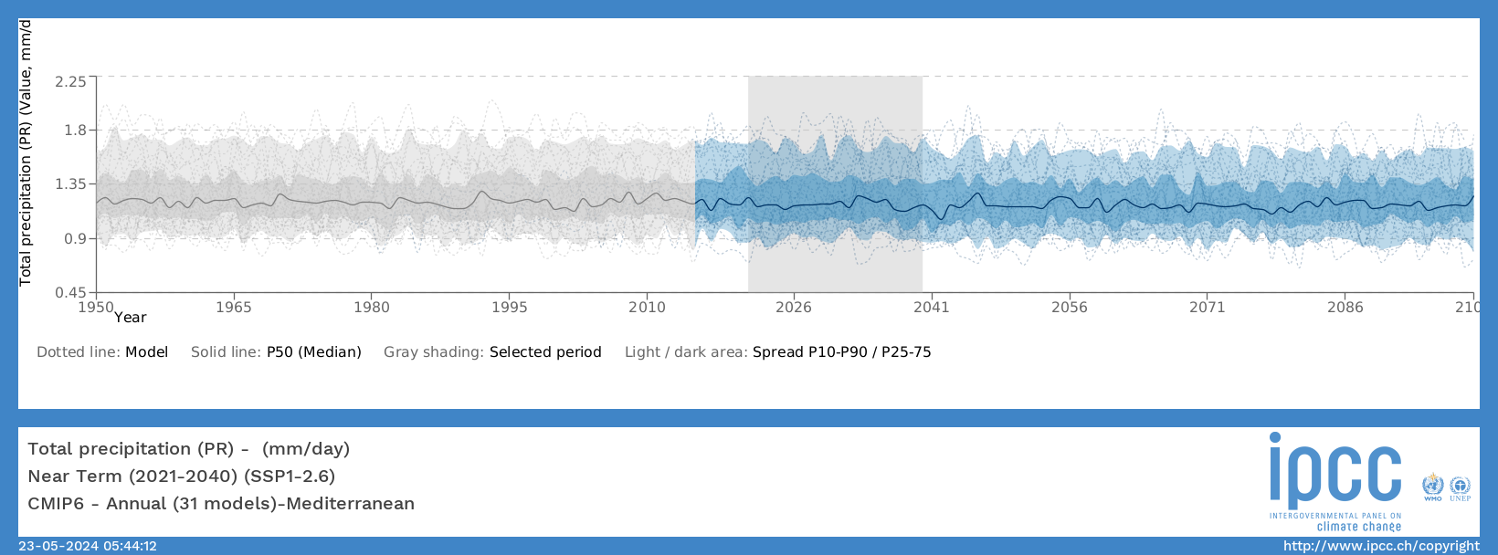
Modelling & Forecasting / Wider Geographic Scope : PR
Western and Central Europe
Mediterra-nean

Slide 20
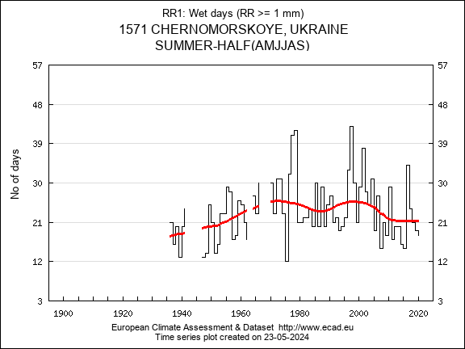
Modelling & Forecasting / Narrower Geographic Scope : RR1
W E

Slide 21
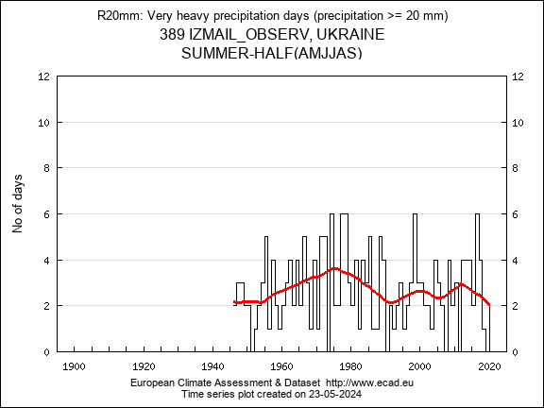
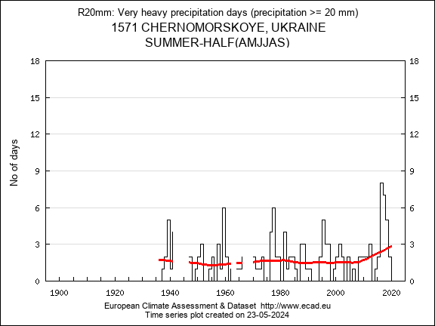
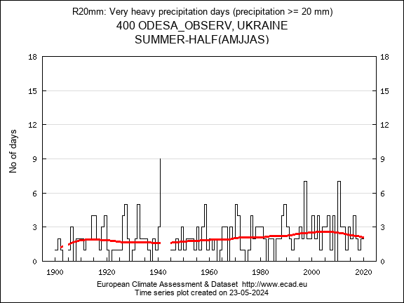
Modelling & Forecasting / Narrower Geographic Scope : R20mm
W E

Slide 22
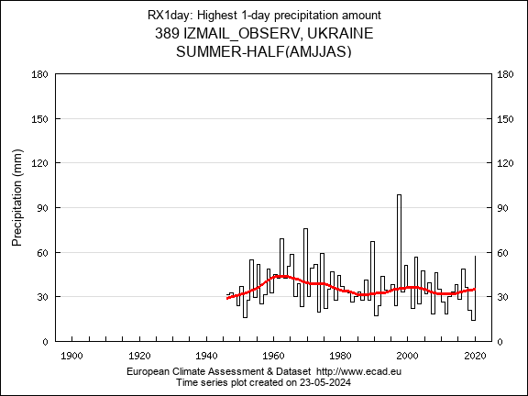
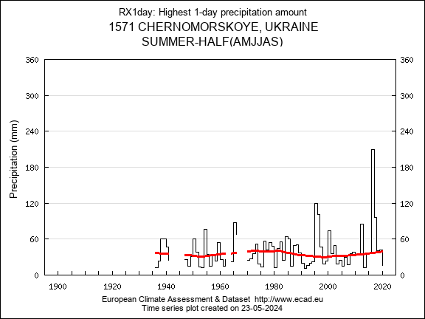
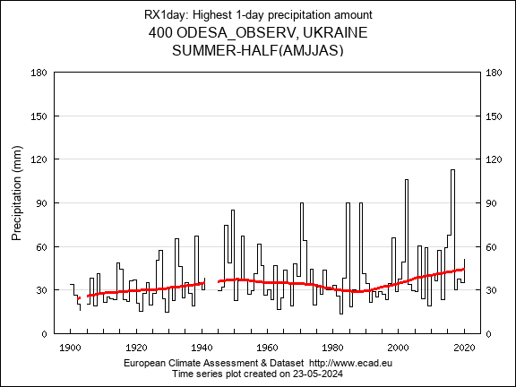
Modelling & Forecasting / Narrower Geographic Scope : RX1day
W E

Slide 23
Indicator proposal
Description of the indicator: 6-month standardized precipitation index
Data needed to compute the indicator: PR
Location of the data to compute the indicator: http://www.ecad.eu
Possible end users of the indicator:
URBAN FORESTRY EXPERTS
CITY PLANNERS
URBAN FORESTRY BUSINESSES: TREE NURCERIES
URBAN FORESTRY ENTERPRISES

Slide 24
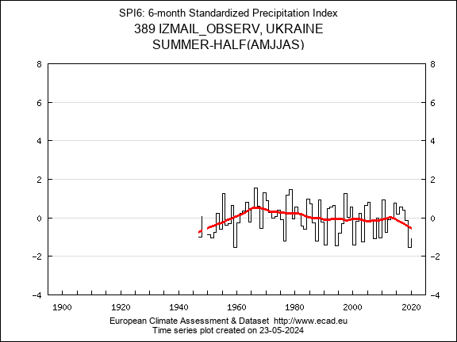
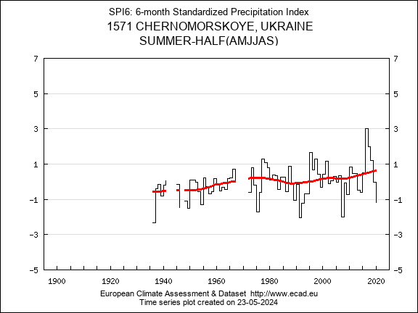
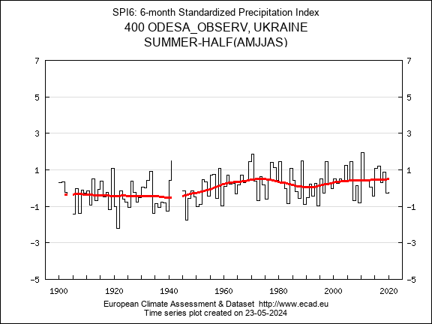
Modelling & Forecasting / Narrower Geographic Scope : SPI6
W E

Slide 25
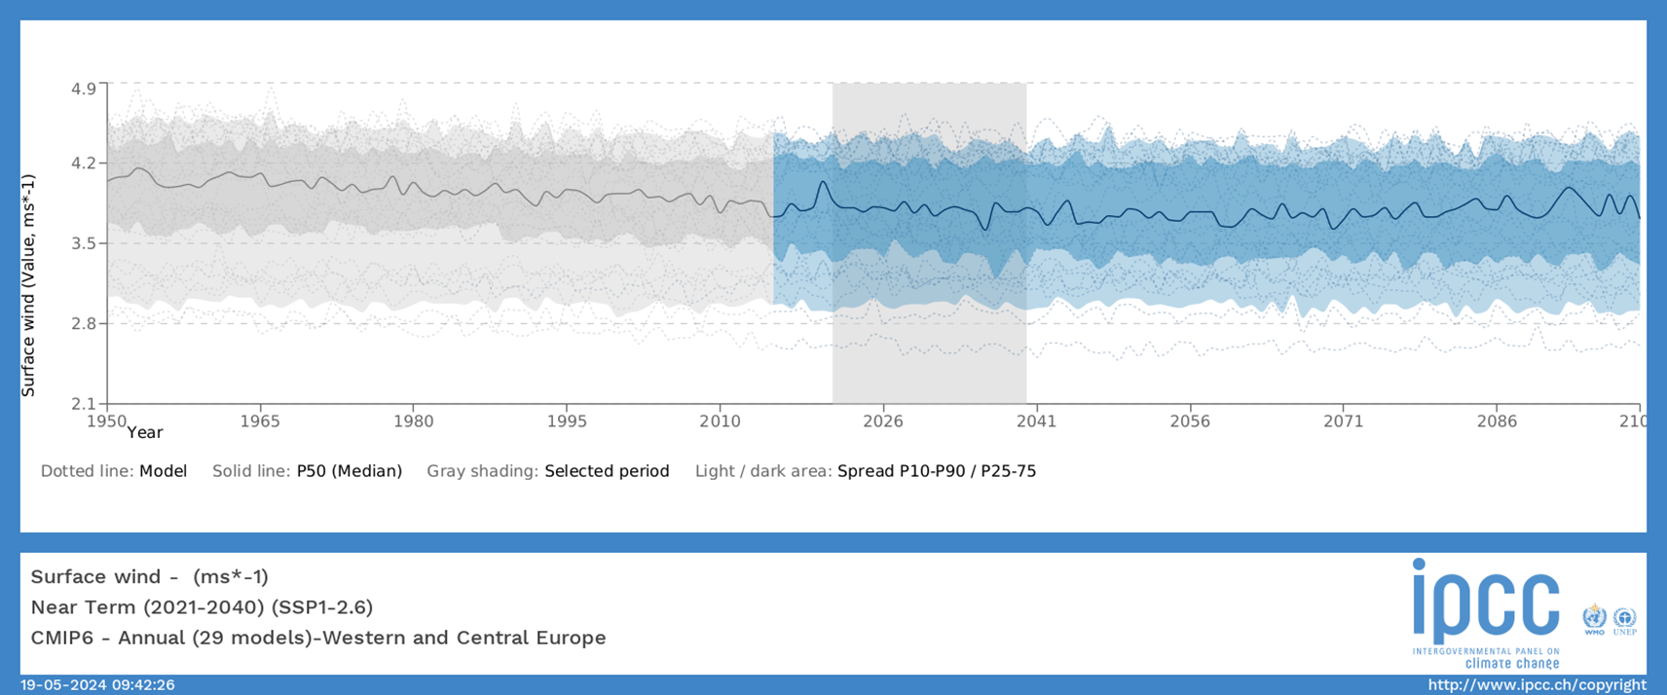
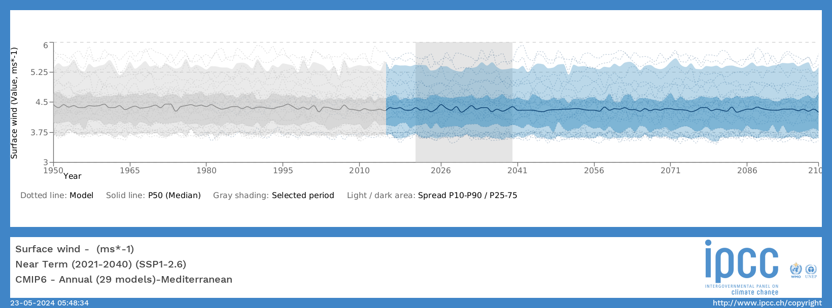
Modelling & Forecasting / Wider Geographic Scope : Wind
Western and Central Europe
Mediterra-nean

Slide 26
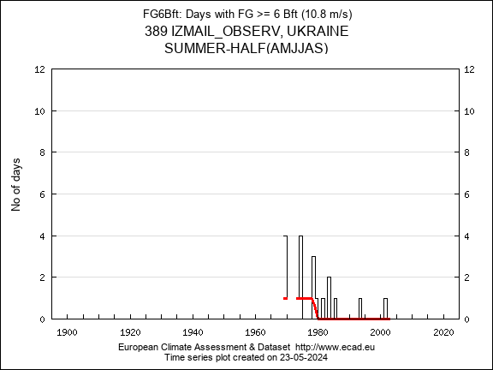
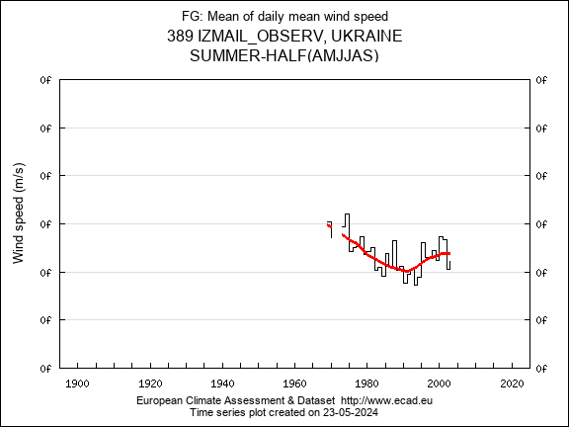
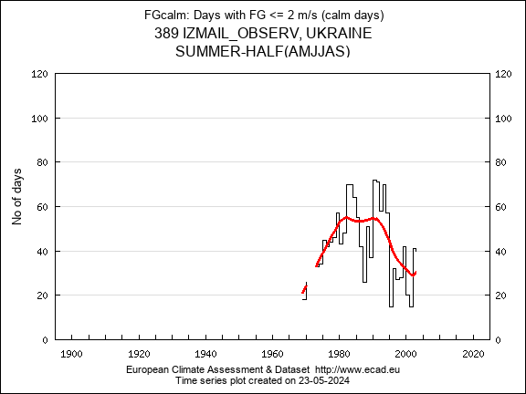
Modelling & Forecasting / Narrower Geographic Scope : Wind characteristics

Slide 27
Climate Change Summary
Variable / Index | Current Trend (1990-2020) | Projection 20 years
Annual average minimum daily temperature
Annual average maximum daily temperature
Annual average mean daily temperature
Annual number of extremely hot days
Annual number of consecutive dry days
Annual average total daily precipitation
Annual number of wet days |  | ?
Annual number of days with very heavy precipitation (>=20 mm) |  | ?
Highest 1-day precipitation amount
Annual mean of surface wind velocity

Slide 28
Indicator proposal
Description of the indicator: composite probabilistic index of meteo-climatological harshness
Data needed to compute the indicator: CDD, TX35, RR1, R20mm
Location of the data to compute the indicator: IPCC, ECAD
Possible end users of the indicator:
CITY PLANNERS
URBAN ENGINEERING INFRASTRUCTURE ENTERPRISES
MUNICIPAL AUTHORITIES
PUBLIC HEALTH PROFESSIONALS
URBAN FORESTRY EXPERTS

Slide 29
Indicator proposal
Present the name of the indicator: MCHI – Meteo-Climatological Harshness Index
Present the variables that build the indicator: CDD, TX35, R20mm,
Identify the weight of the variables:
MCHI = 1000*{[prob(CDD)+prob(TX35)]*[prob(R20mm)]},
where prob(CDD)=CDD/365,25; prob(TX35)=TX35/365,25; prob(R20mm)=R20mm/365,25
Identify the categories of the variables: probabilities of independent extreme events, probabilities of linked extreme or {normal & extreme} events

Slide 30
Indicator proposal: Computer simulation

Slide 31
Communication proposal
CITY COUNCILS
Website
MUNICIPAL AUTHORITIES
URBAN FORESTRY EXPERTS
App
URBAN FORESTRY BUSINESSES & PROFESSIONALS
Newsletter
CITY PLANNERS
simple language, maps, diagrams
URBAN ENGINEERS
simple language, emojis, maps, diagrams
PUBLIC HEALTH PROFESSIONALS
ENVIRONMENTAL ACTIVIST GROUPS
LAY PERSONS
complex language, maps, diagrams

Slide 32
Future needs
To raise awareness and popularize possible ways to mitigate and adapt to climate change, not just talk about the problem
for the sector’s employees and decision-makers: trainings and workshops that raise awareness of climate change issues
both for professionals and lay persons: simple and accessible tools/indicators, algorithms for prompt decision-making
examples of successful practices that are relatively simple by the approach and effective by the decisions made and actions taken to mitigate and adapt to climate change

Slide 33
Conclusions
The lessons from this course:
multiple approaches and versatile methodology of identifying sectoral problems related to climate change, specifying stakeholders’ needs, proposing and testing climate change /vulnerability indicators
wider international context
data acquisition from multiple sources
multiple channels and formats for communicating climate products/services to different end- users
State if you need more training materials related with the work done during the training:
manuals/primers on data homogenisation and quality control

