Slide 1
619285-EPP-1-2020-1-FI-EPPKA2-CBHE-JP Multilevel Local, Nation- and Regionwide Education and Training in Climate Services, Climate Change Adaptation and Mitigation
Urban greenery under the impact of climate change, on the example of the city of Odesa, Ukraine
Viktoriia Kuryshyna, Inna Rybalka, Halina Katerusha, Natalia Danilova
24 May 2024. ClimED 4th Training

Slide 2
Presentation of the group А9
Name | Affiliation
Viktoriia Kuryshyna | Odesa State Environmental University (Odesa, Ukraine) Senior Lecturer, Department of Meteorology and Climatology
Inna Rybalka | O.M. Beketov National University of Urban Economy in Kharkiv (Kharkiv, Ukraine) Associate Professor, Department of Urban Ecology and Engineering
Halyna Katerusha | Odesa State Environmental University (Odesa, Ukraine) Associate Professor, Department of Meteorology and Climatology
Nataliia Danilova | Odesa State Environmental University (Odesa, Ukraine) Associate Professor, Department of Agrometeorology and Agro-ecology

Slide 3
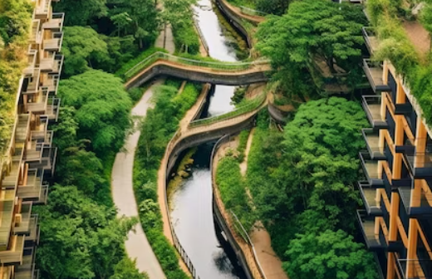
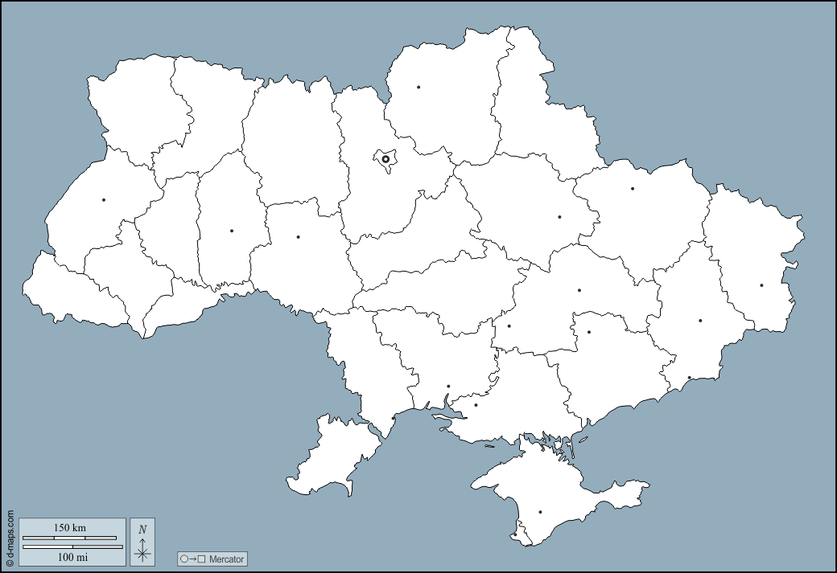
Topic of the working group
Sector of the Economy – Urban Economy
Subsector – Urban greenery/Urban forestry
Study areas – Steppe zone of Ukraine (Odesa)
Odesa

Slide 4
Step 1
Housing
Public zones: city garden, square, street plantings, green zones at administrative and public institutions
Special green places: sanitary protection zones of industrial enterprises, protective zones against adverse natural phenomena, water protection, fire protection, reclamation purposes, zones along railways and highways
Urban greenery
Power supply
Service locations
Water supply
Urban
economy
Excavation: planning, leveling areas, digging and filling holes, compacting soil
Restricted zones: green places at kindergartens, schools, educational institutions, hospitals and industrial enterprises
Urban construction
Ecosystem Servises
Transport
Growing trees, shrubs and flower plants: preparation and processing of planting and seed materials, their planting and sowing, watering, treatment with pesticides, digging up plantings and cutting flower plants
City Property Management
Reduce the temperature
Retention of storm water
Metropolitan information systems
Air and water cleaning
Reducing wind speed
Noise reduction
Supporting biodiversity

Slide 5
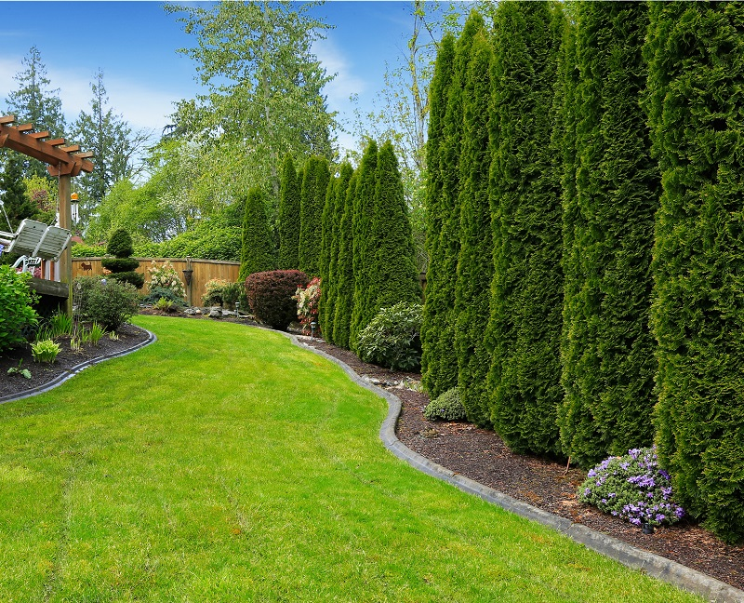
Indicator proposal
Description of the indicator:
TPW indicator
amount of precipitation
wind speed
variations between maximum and minimum temperatures, divided into average temperature for several (5-7) days?☺
Data needed to compute the indicator:
temperature
precipitation
wind speed

Slide 6
Step 2. Green public zones
Frosts during the growing season
Annual mean temperature increase
High cloudiness
Direct solar radiation
Weak and moderate precipitation
Weak wind
Gusts of wind, squalls, hurricanes
Long sunshine
duration
High relative humidity
Heat waves
Heavy
precipitation
Drought

Slide 7
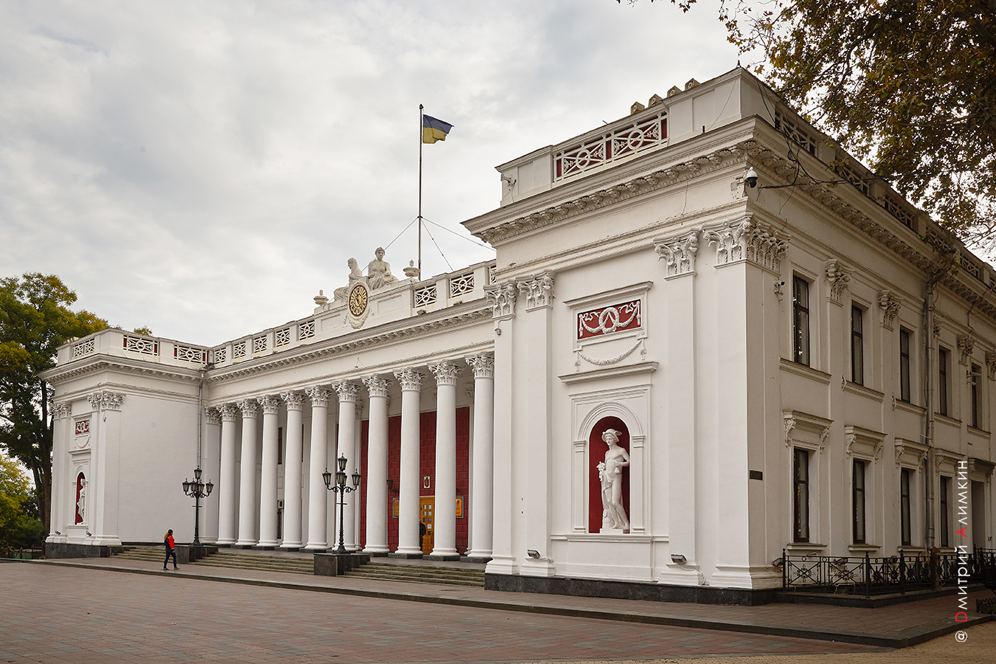
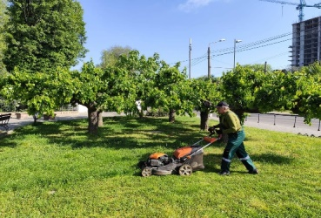
Step 3. Adaptation measures
Conditions that harm
Condition that benefits
short term measures
long term measures
short term measures
long term measures
monitoring,
damage control
state protection
Administration
damage
assessment
budget planning
monitoring
Public and Private sectors,
Professional & Citizen Groups
general
maintenance
damage control
(restoration)
development
of a company
growth strategy
damage control
protection actions
volunteering
in damage control
creating a wide
volunteer
movement
improvement
of the local area
Target groups
local area support
Notes:
Після аналізу кліматичних даних? Або хоча б переліку індикаторів?

Slide 8
Stakeholders
Possible end users of the indicator:
City managers
C.E.O. in the field of urban greenery
Environmental protection officers
C.E.O. of the private gardening enterprises
Landscape designers
Experts from research institutions and educational institutions
Eco-activists
Citizens
Tourists
Administration
Public sector
Private sector
Professional & Citizen Groups
Target groups
Notes:
Після аналізу кліматичних даних? Або хоча б переліку індикаторів?

Slide 9
Stakeholders | Short term | Medium term | Long term
• City managers
• C.E.O. in the field of urban greenery
• Environmental protection officers
• C.E.O. of the private gardening enterprises
• Landscape designers
• Experts from research institutions and educational institutions
• Eco-activists
• Citizens
• Tourists
Gusts of wind, squalls, hurricanes
Heavy
precipitation
Annual mean temperature increase
Frosts during the growing season
High cloudiness
Heat waves
Weak wind
Drought
Direct solar radiation
Long sunshine
duration
Weak and moderate precipitation
High relative humidity
Weak and moderate precipitation

Slide 10
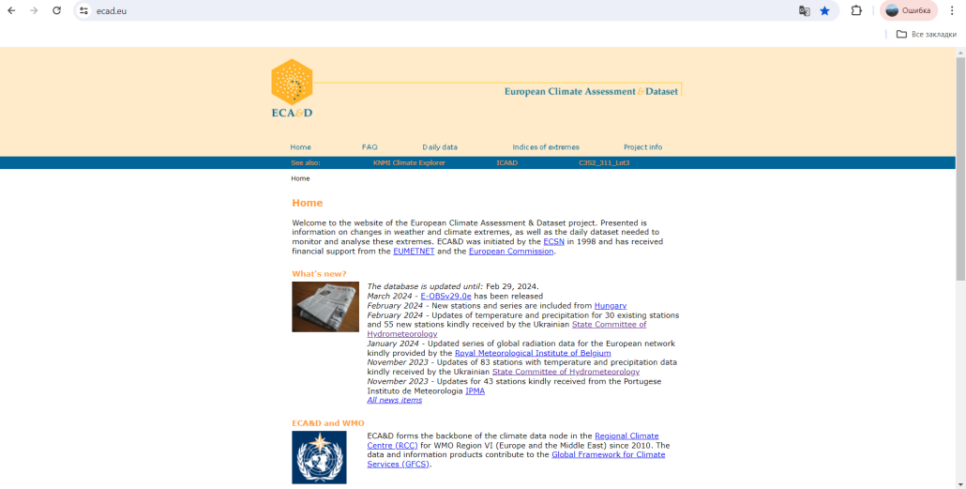
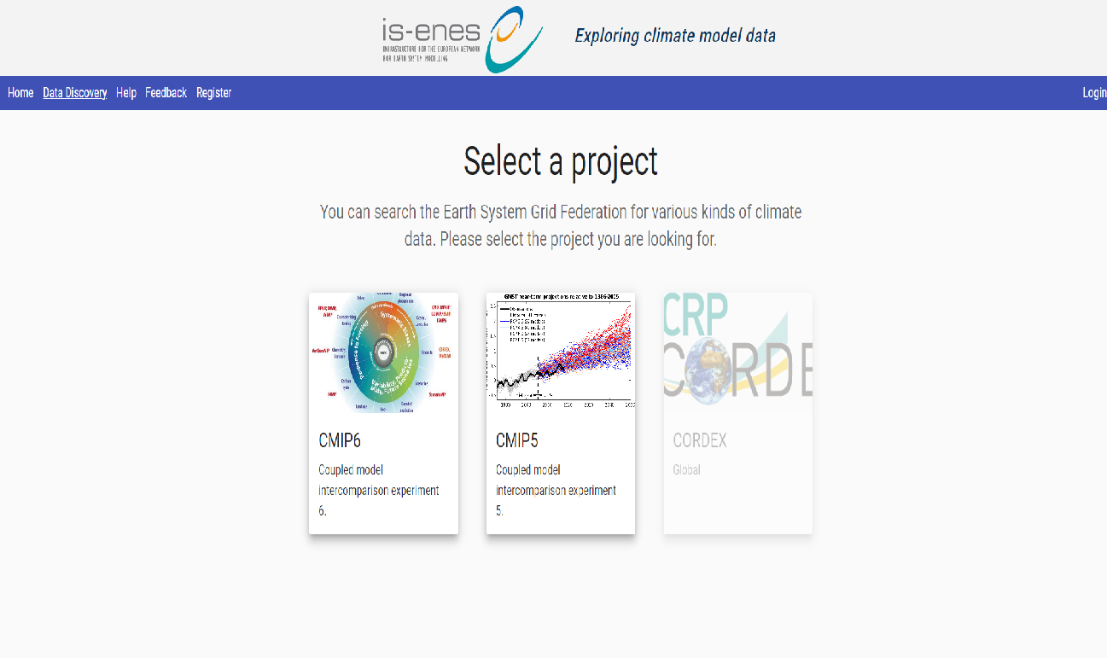
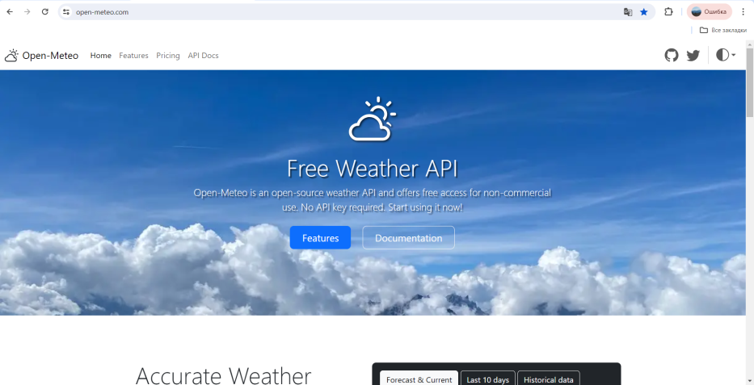
Indicator TPW
Description of the indicator: indicator TPW characterizing the possibility of landscape improvement in cities
Data needed to compute the indicator: temperature, precipitation, wind speed
Location of the data to compute the indicator:
https://www.ecad.eu/
https://www.climate4impact.eu/c4i-frontend/project
https://open-meteo.com/

Slide 11
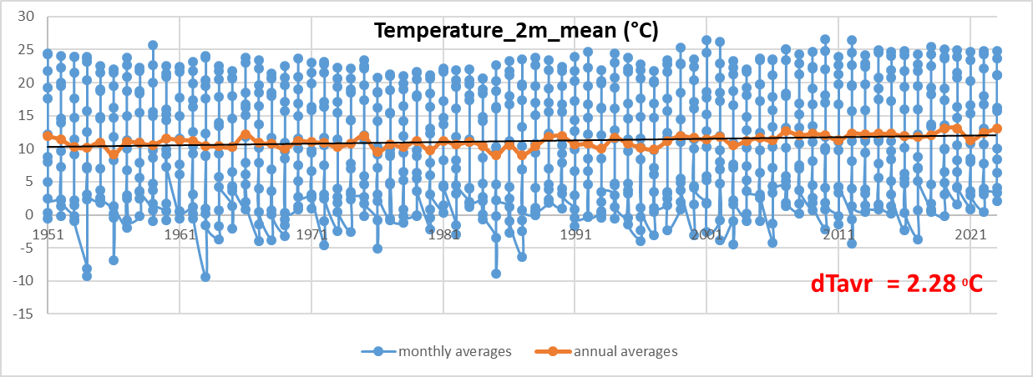
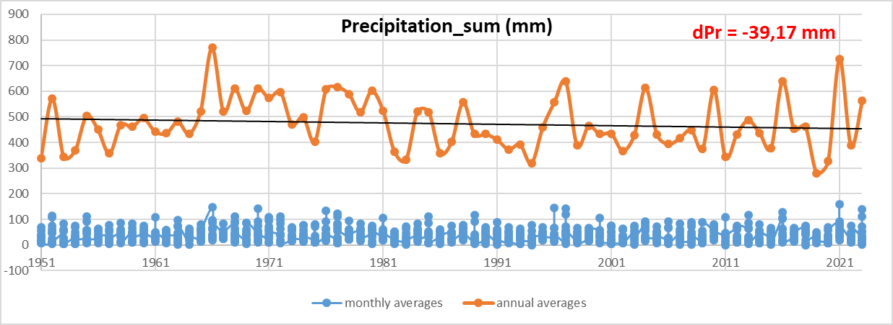
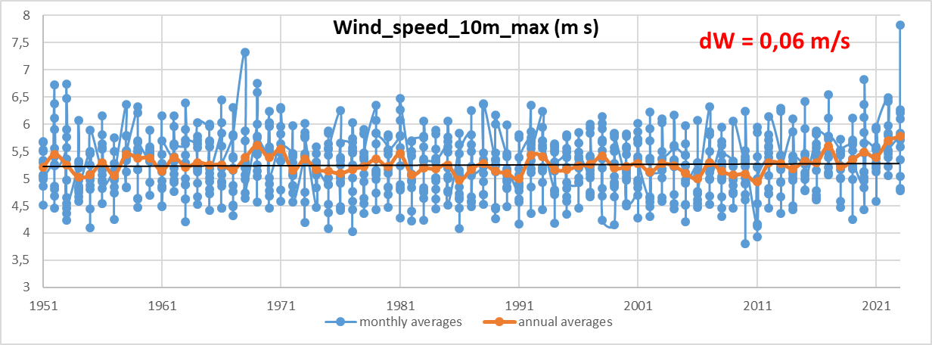
Indicator TPW

Slide 12
Number of the variable | Name of the variable | Range | Value | Indicator (in case it is needed) | Source of the data | 1961-1990 | 1991-2020
Х1 | Temperature, ºC | <-10 | -1 | Daily Mean temperature | https://www.ecad.eu/ https://open-meteo.com/ | 76 | 49
 |  | -10 - +10 | 0 |  |  | 5050 | 4904
 |  | 10 - 20 | 1 |  |  | 3759 | 3317
 |  | 20 - 30 | 0 |  |  | 2072 | 2674
 |  | >30 | -1 |  |  | 0 | 14
Х2 | Precipitation, mm | <1 | -1 | Daily precipitation |  | 8171 | 8596
 |  | 1-10 | 2 |  |  | 2450 | 2041
 |  | 11-20 | 1 |  |  | 225 | 203
 |  | 21 - 30 | 0 |  |  | 33 | 36
 |  | >30 | -2 |  |  | 20 | 27
Х3 | Wind speed, m/s | >15 | -3 | Daily gust wind speed |  | 0 | 0
 |  | 11-15 | -2 |  |  | 98 | 90
 |  | 6-10 | -1 |  |  | 5550 | 5528
 |  | 0-5 | 0 |  |  | 5309 | 5340

Slide 13
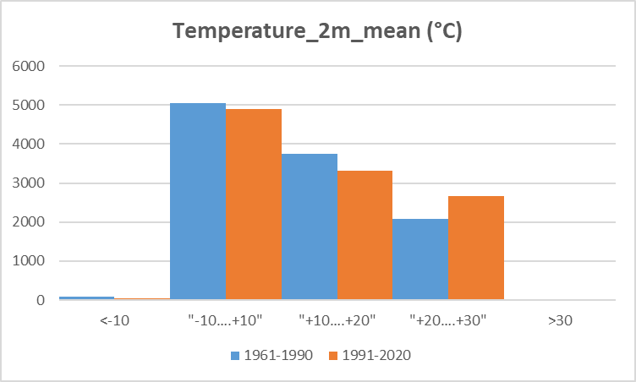
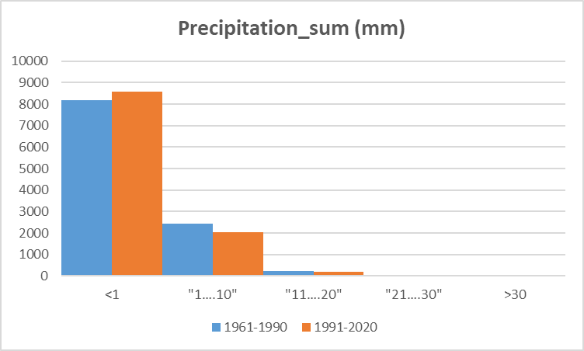
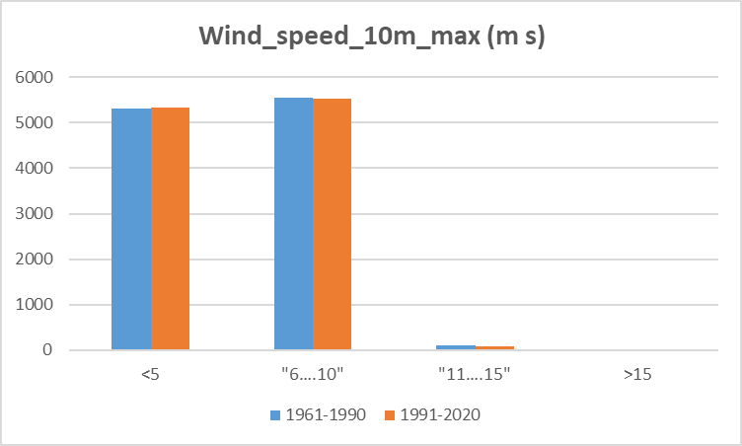

Slide 14
The construction of the TPW indicator
Name of variables | Formula | Definition | Range
Temperature | TPW = Temperature + Precipitation + Wind speed | optimal | >1
Precipitation |  | threshold | - 1 … 1
Wind speed |  | extreme | < -1

Slide 15
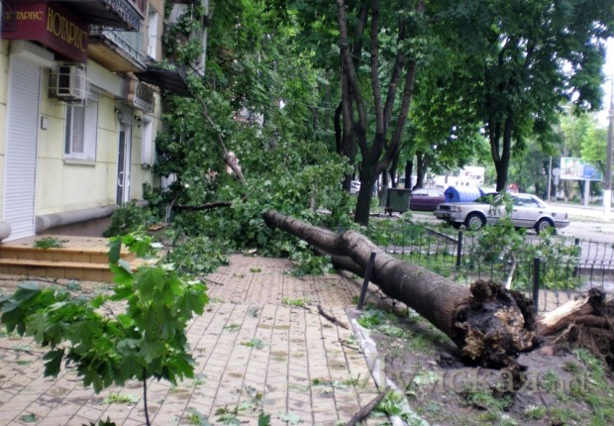
Hurricane in Odessa
on May 31, 2013
on July 1, 2013
T=21,4 ⁰C - 0 Pr=4,5 mm - 2
W=23,9 m/s - -3
Indicator TPW=-1
T=20,2 ⁰C - 0 Pr=66 mm - -2
W=32 m/s - -3
Indicator TPW=-5

Slide 16
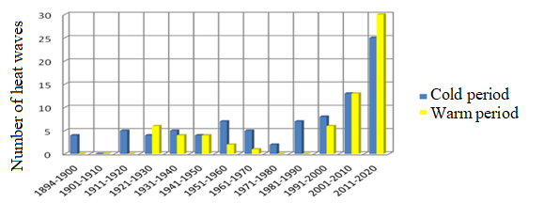
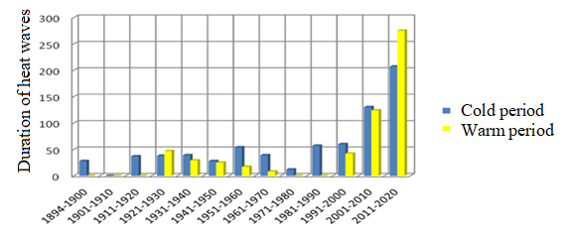
Heat waves
A heat wave is a phenomenon when the daily maximum temperature (in a period of 6 or more consecutive days) exceeds the average maximum daily temperature for the same calendar day in the period 1961-1990 by at least 5 °С
The maximum duration of the heat wave in the cold period was 26 days (1.01-26.01.2007), in the warm period it was 20 days (26.04-15.05.2012). The average duration of a heat wave is 8.2 days in the cold period, 8.6 days in the warm period, and the average for the year is 8.4 days.
Until 2010, the number and duration of heat waves during the cold period prevailed over the corresponding indicators during the warm period. After 2010, the ratio changed and there was maximum growth.
Dynamics of the number and duration of heat waves
by decades for warm (5-10) and cold (11-4) periods

Slide 17
Communication proposal
The main users of the CS: landscaping companies, urban residents, construction and engineering companies, maintenance companies, administrations (local governments, policy- and decision makers) and others
Identify the channel for communication the CS: website, app, newsletter (Telegram, Viber, Facebook etc.)
Identify the format to communicate the CS: simple language, emojis, maps

Slide 18
Future needs
Identify if there is a need to create new working networks: project/product managers, IT-developers, marketing specialists, financial specialists, climate service specialists, financial resources
Identify if there is a need to create a new project to develop the CS started during this week: YES
Write other issues of interest: bridging the gaps between climatologists and end-users of climate service

Slide 19
Conclusions
Identify the more interesting lessons from this week course: all lectures
State if you need more training materials related with the work done during this week

Slide 20
THANK YOU!

