Slide 1
619285-EPP-1-2020-1-FI-EPPKA2-CBHE-JP Multilevel Local, Nation- and Regionwide Education and Training in Climate Services, Climate Change Adaptation and Mitigation
Climate services during extreme weather conditions and natural disasters
Group D11
6 May 2024. ClimED 4th Training

Slide 2
Presentation of the group
Name | Affiliation |  | Department / Position
Oleh Shablii | OSENU | A11 | Head of the Department | oleg.shabliy@gmail.com
 |  |  | Department of Foreign Relations
Kseniia Prybolovets | ONMU | A11 | Department of Dermatovenerology | kseniaprib@ukr.net
 |  |  | Doctor-Intern of the 1st year
Hanna Kriukova | ONMU | A11 | Department of Obstetrics and Gynecologist | khv16.02@gmail.com
 |  |  | Doctor-Intern of the 2st year
Mykhailo Pervak | ONMU | A11 | Department of simulation medical technologies | lashelgo@gmail.com
 |  |  | PhD in Pathophysiology, Associate Professor
Leonid Kholopov | ONMU | A11 | Department of Internal Medicine No. 2 | kholopov@ukr.net
 |  |  | PhD in Pathophysiology, Associate Professor

Slide 3
Climate services during extreme weather conditions and natural disasters
Topic: Climate services during extreme weather conditions and natural disasters.
Region of study: Ukraine
Climate services are crucial for managing extreme weather and natural disasters due to these key reasons:
1. Preparedness: Enable advanced preparation for severe weather, reducing potential harm.
2. Efficient Response: Timely data ensures quicker, more effective emergency responses.
3. Economic Protection: By minimizing disaster impacts, they help safeguard economic stability.
4. Public Safety: They provide crucial warnings to the public, enhancing safety and health.
5. Resilience: Services support the development of strategies to adapt and endure future climate challenges.

Slide 5
Indicator proposal
Description of the indicator: Extreme Weather Resilience Index (EWRI)
Data needed to compute the indicator:
Historical weather data (temperature, precipitation, wind speed)
Infrastructure data (type, distribution, and resilience of built environment)
Emergency response times and effectiveness
Population density and demographics

Slide 6
Indicator proposal
Тhe name of the indicator: Extreme Weather Resilience Index (EWRI)
Тhe variables that build the indicator:
Weather Severity Score (WSS): Based on historical extremity and frequency of weather events in Ukraine.
Infrastructure Resilience Score (IRS): Based on robustness and readiness of local infrastructure.
Response Efficiency Score (RES): Based on speed and effectiveness of emergency responses.
Community Vulnerability Score (CVS): Based on demographic factors and social vulnerability.
Identify the weight of the variables: WSS: 30% IRS: 30% RES: 20% CVS:20%
Identify the categories of the variables: Environmental, Societal, Economic factors

Slide 7
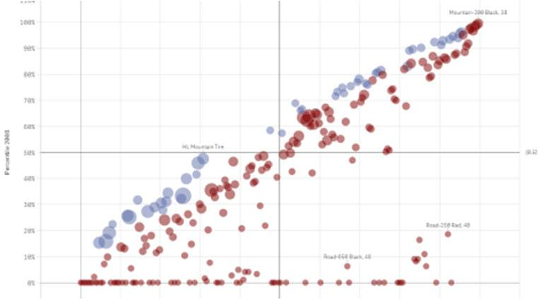
Indicator proposal
Weather Severity Score (WSS): Based on historical extremity and frequency of weather events in Ukraine. 1) Define extreme weather events: events that exceed the 90th percentile of historical data
2) Collect and homogenize data: convert temperatures and precipitation amounts into z-scores
3) Weighting Factors: sum up to 100% and reflect importance of each event type.
4) Calculate Annual Scores: the normalized intensity*frequency of events. Take sum all scores for all event types.
5) Aggregate to a Final WSS: averaging the annual Weather Severity Scores over all years considered.
The final Weather Severity Score (WSS) is then:
Let's assume N types of events and T years of data. Let Ii,t​ and Fi,t​ be the normalized intensity and frequency of event type i in year t, respectively, and Wi​ the weight for event type i. The formula for the annual Weather Severity Score St​ for year t is:

Slide 8
Indicator proposal
Formula for EWRI: Let WSS,IRS,RES,WSS,IRS,RES, and CVSCVS represent the scores for each component, respectively. Let wWSS,wIRS,wRES,wWSS​,wIRS​,wRES​, and wCVSwCVS​ be the weights assigned to each component. The formula for the EWRI is then a weighted sum of these scores:
EWRI=(wWSS​×WSS)+(wIRS​×IRS)+(wRES​×RES)+(wCVS​×CVS)
wWSS​,wIRS​,wRES​,wCVS​ are the weights (as fractions of 1) assigned to each component.
The weights should satisfy wWSS+wIRS+wRES+wCVS=1wWSS​+wIRS​+wRES​+wCVS​=1.

Slide 10
Indicator proposal
Location of the data to compute the indicator:
Meteorological data from the Ukrainian Hydrometeorological Center
European Climate Assessment and Dataset
Infrastructure data from Ukraine's Ministry of Infrastructure
Demographic and emergency response data from the State Emergency
Ukrainian Statistical Service
Possible end users of the indicator:
Ukrainian government emergency management agencies
Local governments and municipal councils
Non-governmental organizations involved in disaster relief
Insurance companies
General public

Slide 11
Communication proposal
The main users of the CS: Local government officials
Disaster management teams
Non-profit organizations in climate resilience
Residents in high-risk areas
The channel for communication the CS:
Website: Real-time dashboard updates
Mobile app: Push notifications during critical conditions
SMS: Immediate updates and precautions
Newsletter: Weekly resilience tips and updates
The format to communicate the CS: Simple language that is easy to understand
Use of emojis for quick understanding of weather severity
Interactive maps to visualize risk areas and safe zones

Slide 12
Communication proposal
The value proposition for CS: The Extreme Weather Resilience Index (EWRI) provides crucial, real-time insights into weather-related risks, helping to prepare effectively, respond swiftly, and build long-term resilience against extreme weather conditions.
Present the mock-up of your website/app/newsletter: identify the main attributes that should include
Real-time interactive maps showing risk levels
Weather forecast integration with personalized alerts based on user location
Tips for preparation and response during various weather events
Customizable alert settings based on user preferences and locations
Links to emergency services and resources

Slide 13
Future needs
Creation of New Working Networks:
Need for Interdisciplinary Teams: Establish a network including meteorologists, urban planners, emergency response teams, and IT specialists to enhance the integration of data and response strategies specific to Ukraine.
International Collaboration: Form partnerships with similar networks in other regions of Europe to share best practices and data, enhancing the predictive accuracy and effectiveness of the Extreme Weather Resilience Index (EWRI).

Slide 14
Future needs
Development of New Projects: Project for Advanced Data Integration: Initiate a project focused on the development of advanced algorithms and machine learning models to improve the predictive capabilities of the EWRI, utilizing more diverse data sources.
Community Engagement Initiative: A new project aimed at increasing community involvement in the development and refinement of the EWRI to ensure it meets the practical needs of end users.
Other issues of interest
Research on Climate Change Impacts: Further study on how climate change is altering weather patterns in Ukraine, which may require adjustments in the EWRI calculation.
Funding and Resource Allocation: Identifying potential sources of funding for the continuous improvement and expansion of the climate service.
Regulatory and Policy Framework: Examining the need for developing or adjusting policies to support the effective use of EWRI in disaster preparedness and urban planning.

Slide 15
Conclusions
The more interesting lessons from this week course:
Lecture. Climate data homogenization. Concepts and examples. Enric Aguilar Lecture. Sensitivity of heat wave metrics calculation to input climate data (case of Ukraine), Oleg Skrynyk (online)
Lecture. Potential uses of climate services in tourism: surf, beach and snow tourism. Dra. Anna Boqué, URV

