Slide 1
619285-EPP-1-2020-1-FI-EPPKA2-CBHE-JP Multilevel Local, Nation- and Regionwide Education and Training in Climate Services, Climate Change Adaptation and Mitigation
"Climate services for cardiology"
D12 group
10 May 2024. ClimED 4th Training

Slide 2
Presentation of the group
Name | Affiliation | Department | Position
Alina Semerhei- Chumachenko | OSENU | Meteorology and Climatology | PhD in Geography, Associate Professor
Tetiana Shablii | ONMU | Department of Obstetrics and Gynecology | PhD in Medicine, Associated Professor
Svitlana Kotiuzhynska | ONMU | Vice-rector for research and educational work | Doctor of Medical Sciences, Professor
Tetyana Yermolenko | ONMU | Department of Obstetrics and Gynaecology | Doctor of Medical Sciences, Professor
Viktoriia Buheruk | ONMU | Department of General Practice | PhD in Medicine, Associated Professor

Slide 3
Topic of the working group
Topic: Climate services for cardiology
Medicine. Cardiology
Region of study: Odessa city, Ukraine

Slide 4
1. The rationale for the selection of the place and the field
Cardiology is a medical specialty that deals with the study, diagnosis, treatment and prevention of diseases of the heart and blood vessels.
Cardiologists examine patients with heart conditions, such as hypertension (high blood pressure), coronary artery disease (coronary artery disease), heart failure, arrhythmias (irregular heart rhythms), congenital and acquired heart defects, inflammatory heart disease and other conditions. associated with the heart and blood vessels.
Several weather can have a very negative impact on the condition of cardiac patients:
High air temperature can increase stress on the cardiovascular system, especially in people with heart failure or hypertension. They can also lead to dehydration and increased blood viscosity, which increases the risk of blood clots and heart attacks.
High humidity can make the atmosphere more difficult to breathe, especially for people with respiratory and cardiovascular diseases.
Extreme hot air can lead to heat stroke, dehydration and circulatory problems, and heart attack.
Burst​s air temperature and atmospheric pressure can cause stress and anxiety, and worsen the condition of the cardiovascular system. For some people, this can cause high blood pressure and worsening heart symptoms.
Odessa was chosen for the project because the A12 group lives in Odesa and most of its members are employees of university clinics, and the new competencies will help treat cardiac patients more effectively.

Slide 5
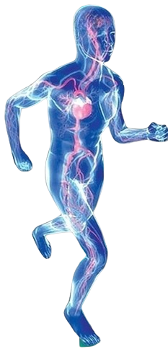
The main mechanisms of the pathogenesis of cardiovascular diseases at extreme temperatures:
temperature-sympathetic reactivity
the renin-angiotensin system, which is activated by cold
dehydration
electrolyte imbalance caused by extreme temperature
systemic inflammatory reactions caused by heat stroke.
The interaction of these mechanisms may vary depending on individual factors, environmental conditions, and overall health.
Ischemic Heart Disease in Odessa
1995-2017
The number of coronary heart diseases in Odessa relative to other regions of Ukraine
http://medstat.gov.ua/ukr/news.html?id=242

Slide 6
2. Description of the climate data used
Databases
European Climate Data Assessment (ECAD) and E-OBS:
https://www.ecad.eu/dailydata/
https://www.ecad.eu/download/millennium/millennium.php#heat
Copernicus Climate Change Service https://cds.climate.copernicus.eu/toolbox
KNMI Climate Explorer https://www.climdex.org/access/

Slide 7
https://www.ecad.eu/utils/showindices.php?8eomovar1c6c2o97n9vn8fi3hv

Slide 8
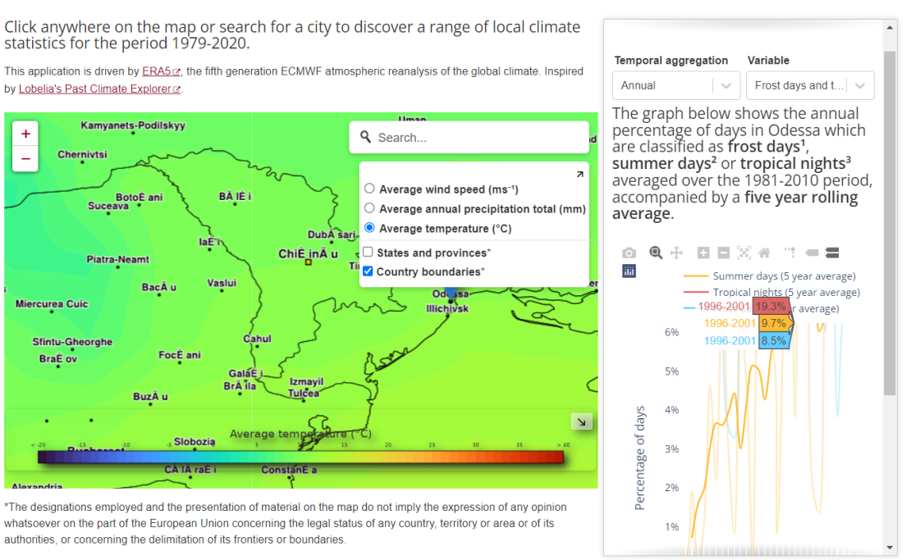
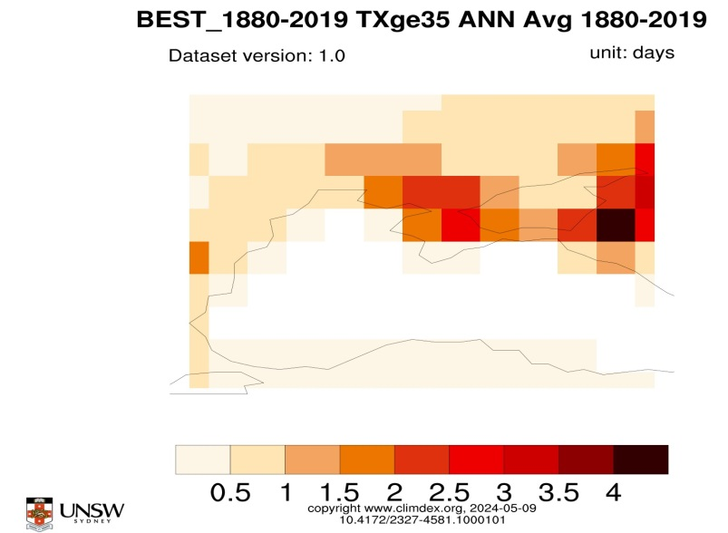
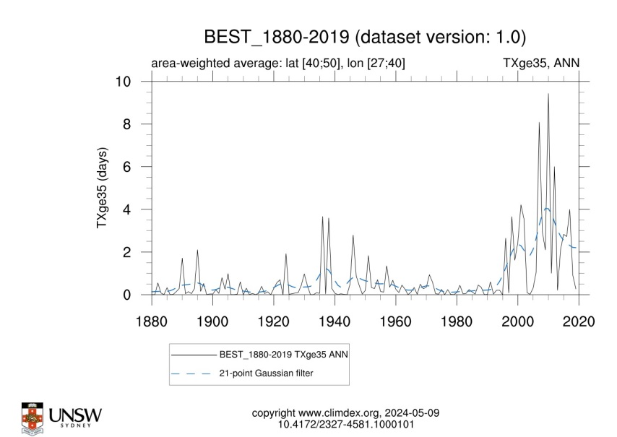
https://www.climdex.org/access/
https://cds.climate.copernicus.eu/cdsapp#!/software/app-era5-explorer?tab=app

Slide 9
3. Analysis of basic climate indices
METEO-CLIMATIC CONDITIONS THAT HARM THE ACTIVITY | DETAIL/ COMMENT | 1-3 DAYS | 10-15 DAYS | SEASONAL FORECAST | 30 YEARS PROJECTION
EXTREME HEAT | > 35 ˚C | Air conditioning, adequate fluid intakey, restriction of physical activi, dose adjustments or changes in treatment | air conditioning, adequate fluid intakey, restriction of physical activi, dose adjustments or changes in treatment | air conditioning, stable operation of electrical networks, sanitary education work, | air conditioning, stable operation of electrical networks, sanitary education work,
EXTREME COLD (FOR CARDIO) | < 0 ˚C | intakey, restriction of physical activity, dose adjustments or changes in treatment, space heating | intakey, restriction of physical activity, dose adjustments or changes in treatment, space heating | space heating, stable operation of electrical networks, sanitary education work | space heating, stable operation of electrical networks, sanitary education work
TROPICAL NIGHTS | nights with a minimum temperature of 20°C | Air conditioning, adequate fluid intakey, restriction of physical activi, dose adjustments or changes in treatment | air conditioning, adequate fluid intakey, restriction of physical activi, dose adjustments or changes in treatment | air conditioning, stable operation of electrical networks, sanitary education work, | air conditioning, stable operation of electrical networks, sanitary education work,
HIGH HUMIDITY | >.75 % | Air conditioning, adequate fluid intakey, restriction of physical activi, dose adjustments or changes in treatment | air conditioning, adequate fluid intakey, restriction of physical activi, dose adjustments or changes in treatment | air conditioning, stable operation of electrical networks, sanitary education work, | air conditioning, stable operation of electrical networks, sanitary education work,
HEAT BURST | > 12 ˚С per day | adequate fluid intakey, restriction of physical activity, dose adjustments or changes in treatment | air conditioning, adequate fluid intakey, restriction of physical activity, dose adjustments or changes in treatment | air conditioning, stable operation of electrical networks, sanitary education work, | air conditioning, stable operation of electrical networks, sanitary education work,
PRESSURE BURST | > 8 hPa per day | adequate fluid intakey, restriction of physical activity, dose adjustments or changes in treatment | adequate fluid intakey, restriction of physical activity, dose adjustments or changes in treatment | stable operation of electrical networks, sanitary education work, healthy lifestyle, daily regime | stable operation of electrical networks, sanitary education work, healthy lifestyle, daily regime
STRONG WIND | > 15 m/s | restriction of physical activity, dose adjustments or changes in treatment | restriction of physical activity, dose adjustments or changes in treatment | stable operation of electrical networks, sanitary education work, healthy lifestyle, daily regime | stable operation of electrical networks, sanitary education work, healthy lifestyle, daily regime
THUNDERSTORM |  | restriction of physical activity, dose adjustments or changes in treatment | restriction of physical activity, dose adjustments or changes in treatment | stable operation of electrical networks, sanitary education work, healthy lifestyle, daily regime | stable operation of electrical networks, sanitary education work, healthy lifestyle, daily regime
METEO-CLIMATIC CONDITIONS THAT BENEFIT THE ACTIVITY | DETAIL/COMMENT
COMFORTABLE AIR TEMPERATURE | 15-24 ˚C
OPTIMUM RELATIVE HUMIDITY | 40-60 %
COMFORTABLE DEW POINT | 10-16 ˚C
COMFORTABLE TEMPERATURE VARIABILITY FROM DAY TO DAY | 0-4 ˚С
COMFORTABLE VARIABILITY OF ATMOSPHERIC PRESSURE FROM DAY TO DAY | 1-4 hPa per day
LIGHT PRECIPITATION | < 10 mm per day
LIGHT WIND | 1-4 m/s

Slide 10
4. Co-creation workshop development

Slide 12
5. Indicator for climate dependent sector

Slide 13
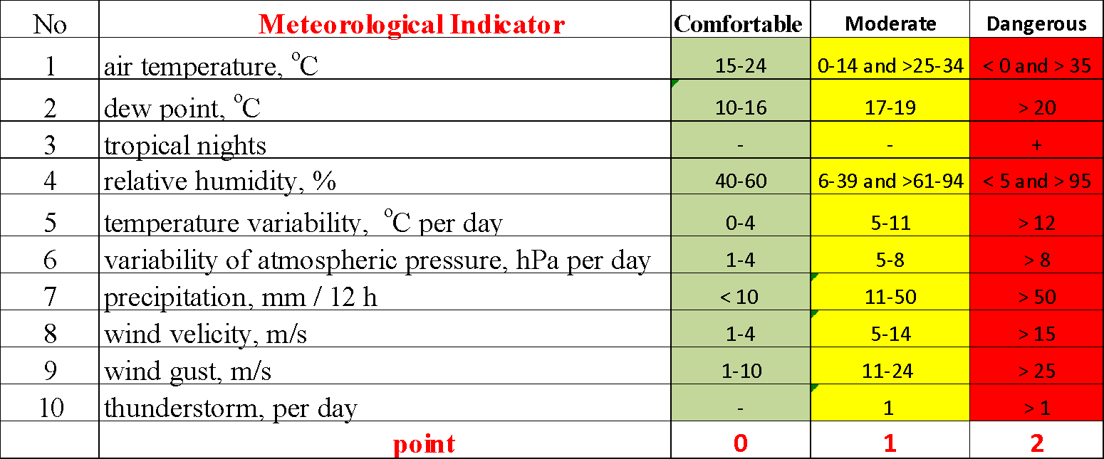
6. Indicator proposal
Variables that build the indicator
name of the indicator – ICAR (Index Cardio):
the weight of the variables: 10 %
formula ICAR = X1+X2+...+Xn
Identify the categories of the variables: Environmental
Quantitative – X1, X2, X4, X5, X6, X7, X8, X9
Qualitative – X3, X10
Minimum | Maximum | Optimal Range | Moderate Range | Dangerous Range | Very Dangerous Range
0 | 20 | 0-5 | 6-10 | 10-15 | 16-20
Source of data:
https://open-meteo.com/
https://www.meteoblue.com/en/weather/
https://www.ecmwf.int/
https://cds.climate.copernicus.eu/

Slide 14
7. Communication strategy
Creating a communication strategy for climate services within cardiology involves addressing how climate and environmental factors affect cardiovascular health and how this information is communicated to healthcare providers and patients
Digital tools and applications
Use in telemedicine programs
Hotlines and online platforms where patients can seek specialist advice
Introduction this index into health monitoring systems
Educational master classes for medical students
Seminars for cardiologists and therapists
Interactive platforms for public education

Slide 15
8. Conclusions and general valorization of the course
All lectures and practical classes were very useful and interesting!!! Many thanks!!!
The most interesting lessons from this course
Climate information and testing tools for climate information management for Climate Dependent sectors (Dr. Jon Olano, Dra. Anna Boqué, Dr. Anton Shkaruba)
Lecture I. Climate Datasets, an overview. Dr. Enric Aguilar, URV
Lectura IV. Climate Change Indices. Past experiences and new developments. Dr. Enric Aguilar, URV
Lecture VIII. Sensitivity of heat wave metrics calculation to input climate data (based on a case of Ukraine). Dr. Oleg Skrynyk (online), URV
Lecture X. Deriving climate products. Dr. Sergio Vicente, CSIC-IPE
Lecture XI. From global drought assessment to drought climate services. Dr. Sergio Vicente, CSIC-IPE
Lecture XI. Drought in Ukraine. Dra. Inna Semenova, CSIC-IPE
Lecture XVI. Potential uses of climate services in tourism: surf, beach and snow tourism. Dra. Anna Boqué, URV

Slide 16
Thank you!!!!

